Slide 1

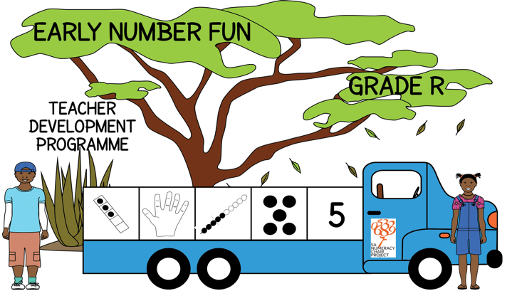


Early Number Fun
Grade R programme
Session 9
16th May 2017
Mellony Graven, Debbie Stott
Carolyn Stevenson-Milln; Roxanne Long; Samu Chikiwa

Slide 2
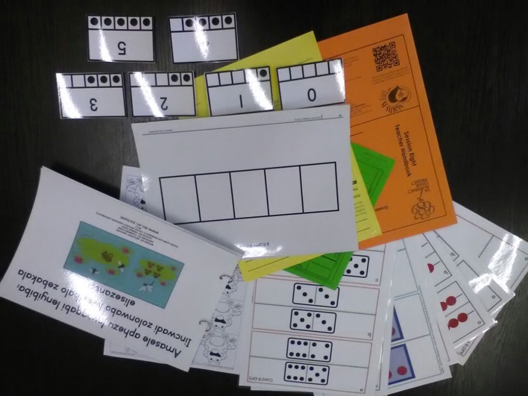
Group feedback on: resources from session 8
In groups of 3-4 and with teachers from other schools discuss the questions on the handout
Select a scribe to jot down main ideas and points of discussion

Slide 3
Cognitive control
Spot the Difference activities page 6
Skills:
  to develop executive functions of working memory and shifting attention
  to develop descriptive language of comparison
Instructions:
  learners to compare two pictures on one card
  look for what is the SAME and what is DIFFERENT between them

Slide 4
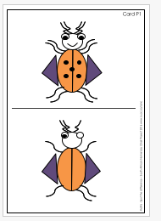
2nd set of 10
Spot the difference cards
  Encourage learners to explain the differences they notice to develop their language of comparison using words about:
    colour, shape, quantity, cardinal positions and so on.

Slide 5
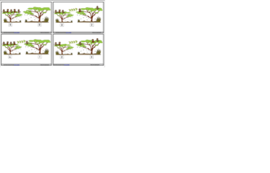
Supplementary 5 Monkeys in the Tree activities
Sequencing cards (page 12)
Skills
  Ordering and sequencing in a logical way
  Working with the ordinal sequence
  Reinforcing mathematical concepts from the story
  Encourages language development
  Encourages learners to express their thinking

Slide 6
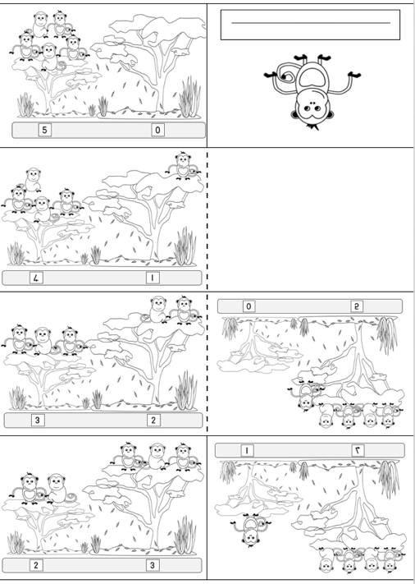
Supplementary 5 Monkeys in the Tree activities
Mini-folded books (page 13)
Skills:
  Listening
  Fine motor skills (in the folding and colouring process)

Slide 7
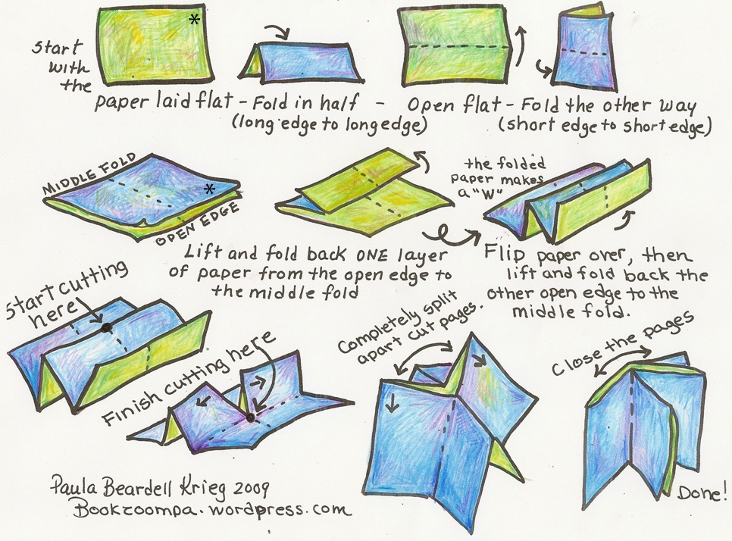

Slide 8
Learner progression
CONTEXT-BOUND– BUT extending to OBJECT-BOUND counting

Slide 9
Number story activities:
Key numeracy skills (pages 7 to 9)
Context bound counting and calculating
(1-10)
Object bound counting and calculating
(1-10)
Numeral recognition
(numerals 1-10)
Compare quantities and develop language of more/ less/ many/ none / same / equal
Develop comparative language for size – big and small; more and less
Recognition of words like ‘more’ ‘less’ ‘big’ ‘small’ ‘same’ ‘equal’
Develop a patterned sense of bonds to 10
(i.e. 10-0; 9-1; 8-2; 7-3; 6-4; 5-5; 4-6; 3-7; 2-8; 1-9; 0-10)

Slide 10
Number stories – key literacy skills
Love of stories and love of reading
Listening and prediction skills
Comprehension skills
Develop comparative language for size:
  big and small; more and less; same and equal
Common word recognition:
  ‘more’ ‘less’ ‘big’ ‘small’ ‘same’ ‘equal’
Imagination and own story telling
Logic, structuring and organisation of ideas

Slide 11


isiXhosa
Afrikaans
English

Slide 12
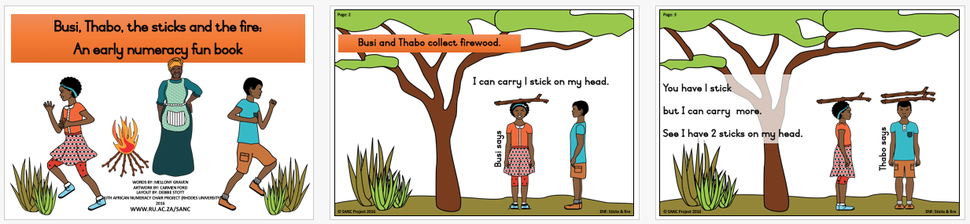
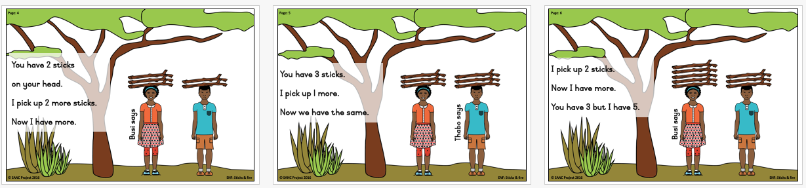
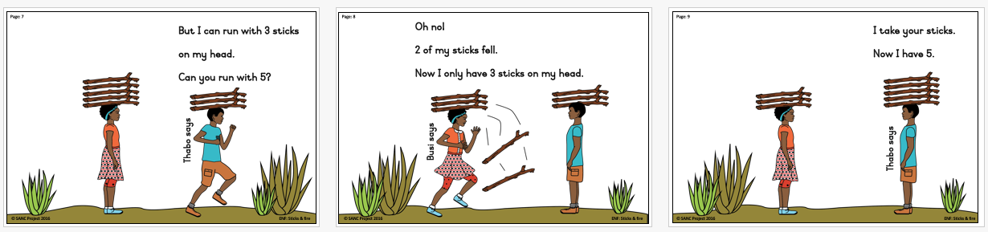
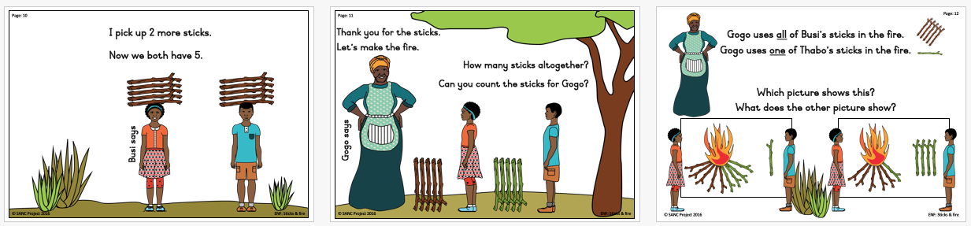

Slide 13
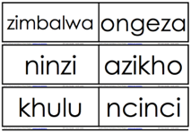
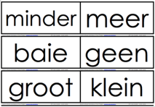
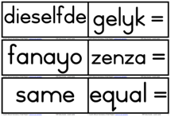
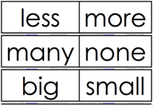

Slide 14
5 and 10-frames for developing a sense of 5 and 10
Understanding that numbers are composed of tens and ones is an important foundational concept, setting the stage for work with larger numbers.
A strong sense of "ten" is a prerequisite for place-value understanding and mental calculations.
allows learners to “see” numbers
useful for developing number sense within the context of ten
help to form mental images of the numbers represented

Slide 15
Working with the 5 and 10-frame
Grade R and 1 explore numbers with a 5-frame 1st
Then move onto 10-frame
Introduce the 10-frame with the following rule, a standard way to fill the frame:
  Always fill the top row first, starting on the left, the same way you read.
  When the top row is full, counters can be placed on the bottom row, also from the left.

Slide 16
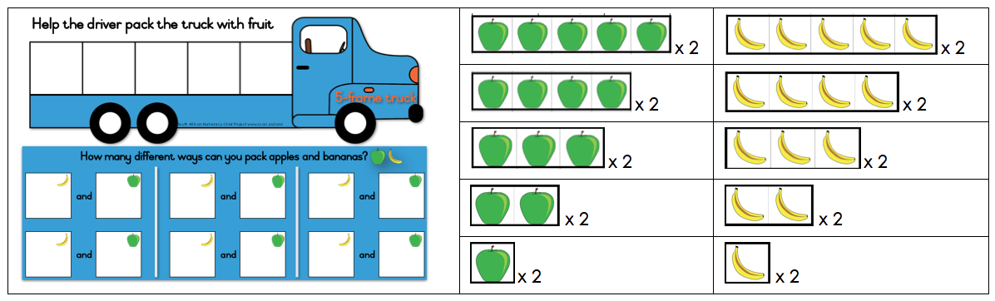
Activities with the 5-frame truck
How many different ways can the driver pack the fruit in the 5-frame truck?
Aim: to give the learners a context in which to learn about using the 5-frame and to work with the combinations that make 5
A set consists of:
  Truck board
  Set of apple strips
  Set of banana strips

Slide 17
Using the 5-frame truck and fruit
Using the strips of fruit, learners place different combinations of fruit onto the 5-frame truck
Each time they make a combination, they draw or write down the combination in the white boxes
Initially, allow the learners to work out the combinations in any order.
Look at their combinations and ask learners questions about these.
After they have completed the activity, you might ask if there is a way to make sure they get all the ways of making 5.
The intention is for learners to come to order the combinations in a structured way over time:
i.e. 5-0; 4-1; 3-2; 2-3; 1-4; 0-5
If the learners have had experience with either the Monkeys in the trees or Umbrellas and Children stories, you might draw their attention to the order used in the stories.

Slide 18
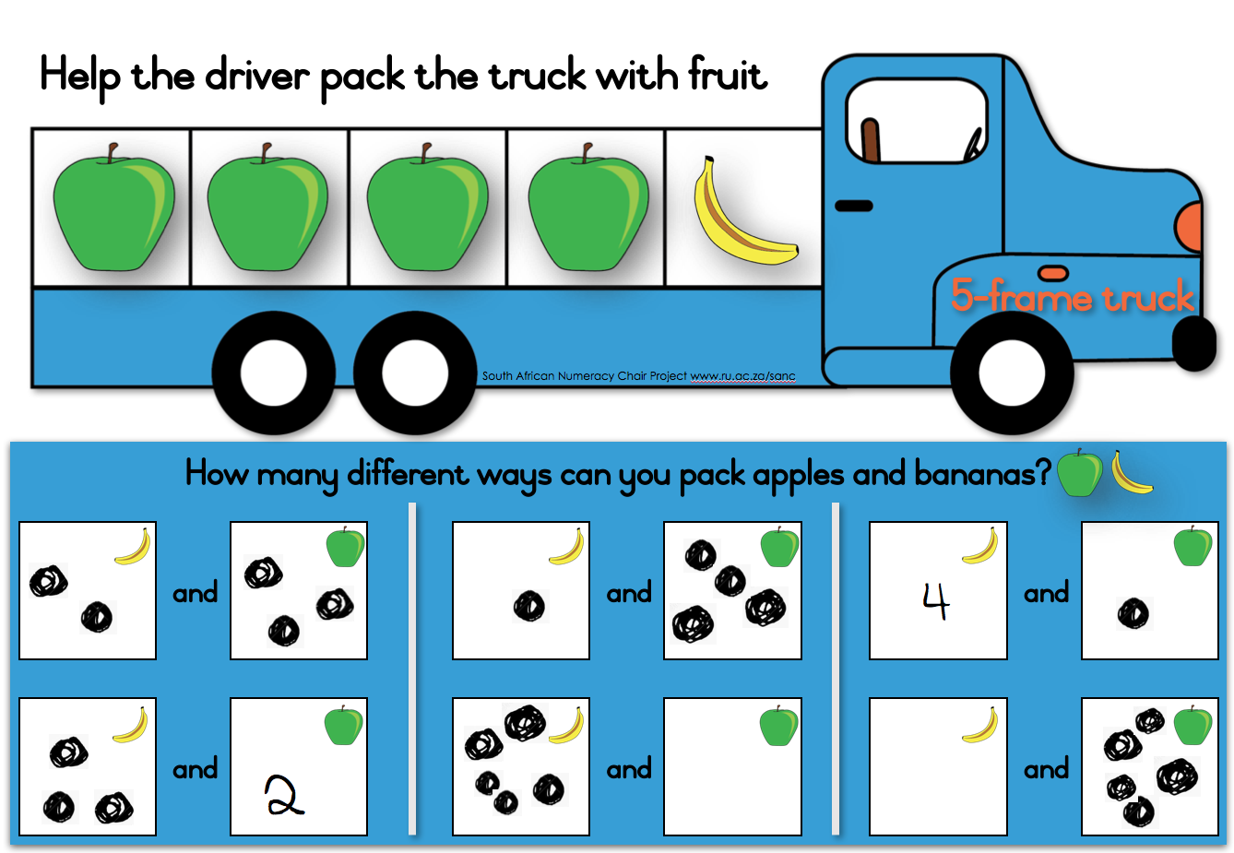
For example:
Learners might draw dots, write numbers or draw the actual fruit (or any combination of these) in the white boxes

Slide 19
Using the 10-frame truck and fruit
The focus of this activity is similar to that of the 5-frame truck
With the 10-frame, it is an ideal time to introduce the ‘rule’ about filling the frame:
  Fill the top row first, starting on the left, the same way you read.
  When the top row is full, counters can be placed on the bottom row, also from the left
Point out to the learners what the top row is, where top left is.
Get the learners to point to and use gestures to show these.
Learners can count the number of squares in the 10-frame, starting at the top left and moving down.
When the learners are familiar with the 10-frame structure, they can use the strips of fruit as they did with the 5-frame to place different combinations of fruit onto the 10-frame.
the intention is for them to come to order the combinations in a structured way over time:
10-0; 9-1; 8-2; 7-3; 6-4; 5-5; 4-6; 3-7; 2-8; 1-9; 0-10

Slide 20
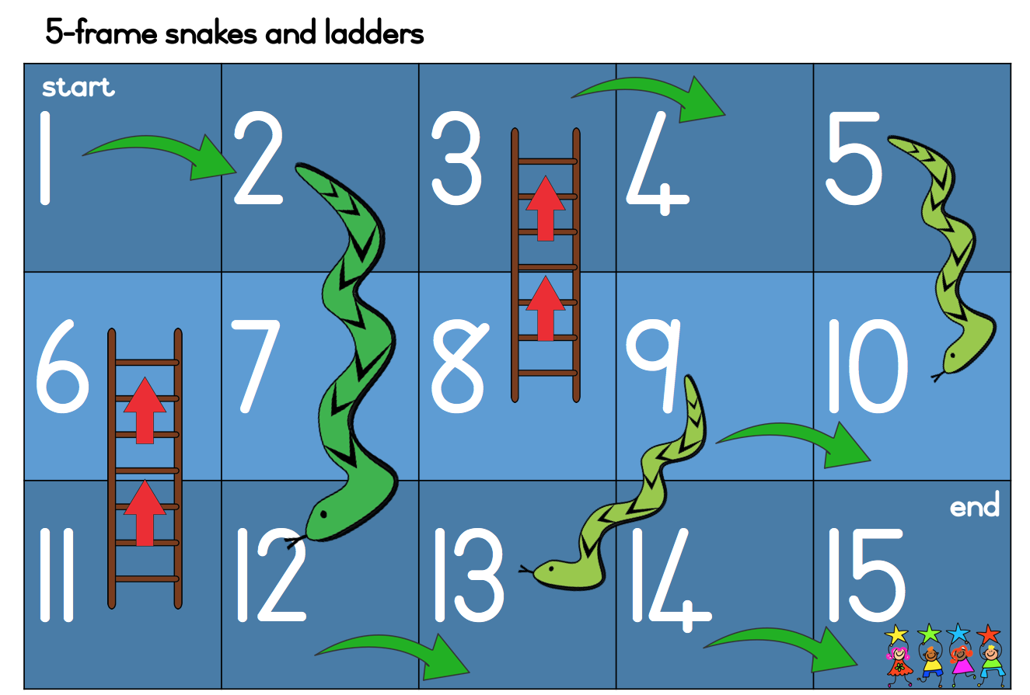


5-frame Snakes and Ladders game
You need:
Counter (stone/bottle top) for each child
One dice per pair

Slide 21
Next session
Next session – Tuesday 13th June
Travel well

