Slide 1
NICLE SESSION 6
OCTOBER 2013

Slide 2
Connecting to South African curriculum and documents
Conceptual
2-digit multiplication

Slide 3
HOW DO YOU DO?
2 digit multiplication

Slide 4
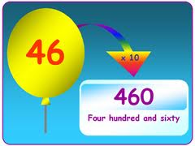
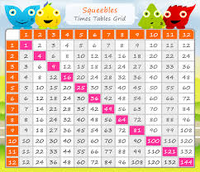
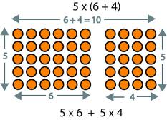
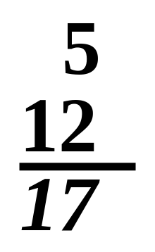
TO DO:
Multiplication of 2 digit numbers …
…
Must know times tables
…
Must know how to
Multiply by 10
Multiply by 100
…
Must know how to add
in place value columns
Need to make connections to conceptual and visual representations such as arrays and area models (DISTRIBUTIVE PROPERTY)

Slide 5
Representations: arrays
How many dots in this grid?
How many different ways can you see the dots?
The GRID can also be called an ‘ARRAY’
4 x 2
3, 6, 9, 12
4, 8, 12
3 x 4
How many dots in this array?
36?

Slide 6
Lets play …
ARRAY BINGO

Slide 7
How many dots in this array / grid?
216?
Easier to represent it conceptually using the AREA MODEL by breaking each number into its PLACE VALUE COMPONENTS
10 8
10
2

Slide 8
Grid multiplication method
216?
10 8
10
2
10 x 10 = 100 | 8 x 10 = 80
10 x 2 = 20 | 8 x 2 = 16
100 + 80 = 180
20 + 16 = 36
180 + 36 = 216

