Slide 1




Celebrating Human Powers and
Using Them to Think Mathematically
Promoting Mathematical Thinking
John Mason
Grahamstown
June 2013
The Open University
Maths Dept
University of Oxford
Dept of Education

Slide 2
Conjectures
Everything said here today is a conjecture … to be tested in your experience
Arithmetic is the study of
  Actions on numbers
  Properties of those actions …
    and hence properties of numbers
Calculations are a by-product
The best way to sensitise yourself to learners
  is to experience parallel phenomena yourself
So, what you get from this session is what you notice happening inside you!

Slide 3
Outline
Lesson without opportunity to use powers, especially generalising …
  … is not a mathematics lesson!
Importance of working together ON MATHEMATICS in order to remain sensitive to learner’s lived experience.
Tasks in which to experience some of your natural powers being used mathematically

Slide 4

Repeating Patterns
5.0 yrs
5.1 yrs
model
4.1 yrs
5.4 yrs
Marina Papic (2007)

Slide 5
Say What You See (SWYS)
Where did you start?:
Specific squares
‘at the beginning’?
Analyse ‘pattern’?
‘Bottom up’
(details)
‘Top down’?
(overview)
Different propensities:
Become aware so as to
Develop flexibility

Slide 6
Copying with Exchange
Make a copy but exchange:
Yellow for Blue;
Pink for Green;
Green for Red
First Action:
How did you do that?
First square that your attention discerned?
Analyse ‘pattern’ first?
Discerning colours?
Recognising positions (relationships)?
Once repeating pattern established …

Slide 7


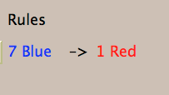

Exchange
1 Large –> 5 Small
3 Large –> 1 Small
Notes:
Compare with ‘money’
Flexibility (size isn’t everything)

Slide 8
Bag Arithmetic
Imagine a bag of cubes
I put three cubes in
I take out 4 cubes
How many cubes are in the bag now relative to the number I started with?

Slide 9
Number-Line Walks
-12
-11
-10
-9
-8
-7
-6
-5
-4
-3
-2
-1
0
1
2
3
4
5
6
7
8
9
10
11
12
Imagine you are standing somewhere on a number line facing in the positive direction (make a note of where you start!)
There are three actions:
  Go forward a specified number of steps
  Go backwards a specified number of steps
  Turn through 180 degrees

Slide 10
Circle Turning
People stand in a circle no-one facing into or out of the circle.
There is one action
  If you are facing someone, you turn through 180°
On each clap, everyone performs the appropriate action.
What happens?
Change the actions to
  If you are facing someone you turn left through 90°
  If you are facing into or our of the circle you turn left 90°

Slide 11
Counting Out
In a selection ‘game’ you start at the left and count forwards and backwards until you get to a specified number (say 37).
Which object will you end on?
A
B
C
D
E
1
2
3
4
5
9
8
7
6
10
…
If that object is elimated, you start again from the ‘next’. Which object is the last one left?
Notes:
How do you know?
Generalise!

Slide 12
Set Ratios
In how many different ways can you place 17 objects so that there are equal numbers of objects in each of two sets?
What about requiring that there be twice as many in the left set as in the right set?
What is the largest number of objects that CANNOT be placed in the two sets in any way so that the ratio is 5 : 2?
What can be varied?

Slide 13
How Many Rectangles do you need to make this shape?
FIRST:
Say What You See (SWYS)
You need to discern what it is you are to count!
Notes:
Tangrams could help develop flexibility, but this is the’ undoing’ of a tangram ‘doing’
To count it is necessary to discern; when children count incorrectly, perhaps they are not discerning stably?

Slide 14
Finding the perimeter
How much information is required?
Is knowing the lengths of the four longest sides sufficient?
Generalise!

Slide 15
Working with Patterns
…
A repeating pattern has appeared at least twice
…
Extend both sequences
What colour will the 100th square be in each?
What square will have the 37th green square in each?
At what squares will the first of a pair of greens in the second sequence align with a green in the first sequence?
What colour should the missing square be?
…

Slide 16
Pattern Continuation
Notes:
Clapping
Pattern wheels
What happens if/when the horizontals match the verticals?.

Slide 17
Fraction Actions
Raise your hand when you can see (on this slide) …
  Something that is 3/5 of something else
  Something that is 2/5 of something else
  Something that is 2/3 of something else
  Something that is 3/2 of something else
  Something that is 5/3 of something else
  What other fraction actions can you see?
Draw a picture for which you can directly see
  3/7 of, 4/3 of and 7/8 of

Slide 18
SWYS

Slide 19
Describe to Someone How to See something that is …
1/3 of something else
1/5 of something else
1/7 of something else
1/15 of something else
1/21 of something else
1/35 of something else

Slide 20
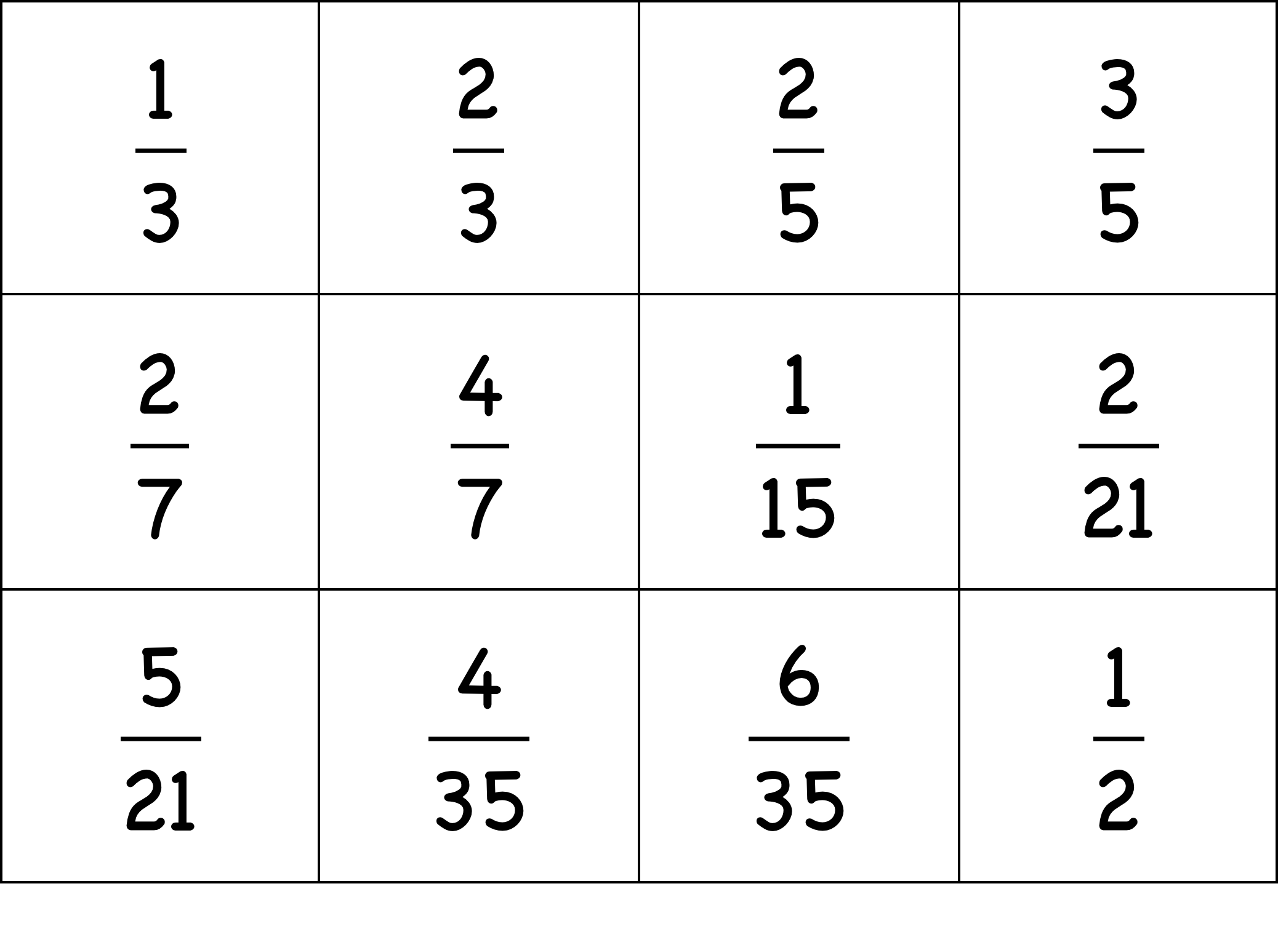
Sorts of Sorts
Sort them into two classes
Make up another one for each of your classes
Notes:
Sorting and Matching tasks reveal a good deal about what learners are attending to.
Construction tasks are even more revealing

Slide 21
Sorts of Sorts
Make up a set of 6 fractions which you think other people will not put correctly in number-line order
Put your fraction cards in numberline order
Notes:
Sorting and Matching tasks reveal a good deal about what learners are attending to.
Construction tasks are even more revealing

Slide 22
Sorts of Relationships
How many different multiplicative relations can you find?
How many different additive relations can you find?
What other mathematical content could you use in this type of task?
How many different subtractive relations can you find?
How many different divisive relations can you find?
Notes:
Sorting and Matching tasks reveal a good deal about what learners are attending to.
Construction tasks are even more revealing

Slide 23

Number Necklaces
www.datapointed.net/visualizations/math/factorization/animated-diagrams/

Slide 24
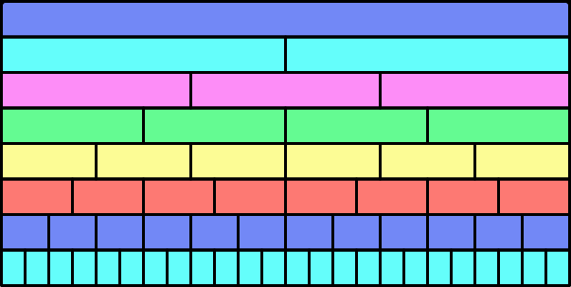
Wall Tiles

Slide 25
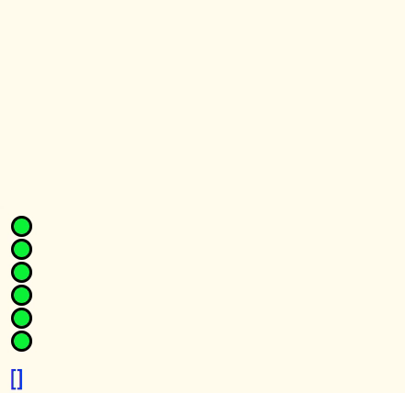
Pebble Arithmetic

Slide 26
What’s The Difference?
–
=
First, add one to each
What then
would be
the difference?
What then
would be
the difference?
First,
add one to the larger and subtract one from the smaller
What could
be varied?
Notes:
• 153 – 87 = ? Orally; visibly;
•That is arithmetic; Now let’s do some mathematics!
Two volunteers: think of a three digit number and a two digit number.
• We’re going to subtract the smaller from the larger but before we do, lets add one to both.
What’s the difference now?

Slide 27
Understanding Division
234234 is divisible by 13 and 7 and 11;
  What is the remainder on dividing 23423426 by 13?
  By 7? By 11?
Make up your own!

Slide 28
Doing & Undoing
What operation undoes ‘adding 3’?
What operation undoes ‘subtracting 4’?
What operation undoes ‘subtracting from 7’?
Notes:
Dave Hewitt’s THOAN sequences

Slide 29
More Doing & Undoing
What undoes ‘multiplying by 3’?
What undoes ‘dividing by 4’?
What undoes ‘multiplying by 3/4’?
  Two different expressions!
  Dividing by 3/4
  or Multiplying by 4 and dividing by 3
What operation undoes dividing into 12?

Slide 30
Composite Doing & Undoing
I am thinking of a number …
What’s my number?
I add 8 and the answer is 13.
What’s my number?
I add 8 and then multiply by 2;
the answer is 26.
I add 8; multiply by 2; subtract 5;
the answer is 21.
What’s my number?
I add 8; multiply by 2; subtract 5; divide by 3;
the answer is 7.
What’s my number?
HOW do you turn +8, x2, -5, ÷3 answer into a solution?
7
Generalise!

Slide 31
Outer & Inner Tasks
Outer Task
  What author imagines
  What teacher intends
  What students construe
  What students actually do
Inner Task
  What powers might be used?
  What themes might be encountered?
  What connections might be made?
  What reasoning might be called upon?
  What personal dispositions might be challenged?

Slide 32
Powers & Themes
Powers
Themes
Imagining & Expressing
Specialising & Generalising
Conjecturing & Convincing
Stressing & Ignoring
Organising & Characterising
Doing & Undoing
Invariance in the midst of change
Freedom & Constraint
Extending & Restricting
Are students being encouraged
to use their own powers?
or
are their powers being usurped by textbook, worksheets and … ?

Slide 33
Teaching students to think mathematically …
involves developing a disposition to
  think mathematically, to use powers mathematically, to be mathematical
  to attend to situations mathematically
How often do you think mathematically
  with and in front of students?
What are they attending to? (and how?)
What are you attending to when interacting with students? (and how?)

Slide 34
Attention
Holding Wholes (gazing)
Discerning Details
Recognising Relationships
Perceiving Properties
Reasoning on the basis of properties

Slide 35
Reflection
It is not the task that is rich
  but the way the task is used
Teachers can guide and direct learner attention
What are teachers attending to?
  powers
  themes
  Heuristics
  The nature of their own attention

Slide 36
To Follow Up
http://mcs.open.ac.uk/jhm3
j.h.mason@open.ac.uk
Thinking Mathematically (new edition 2010)
Developing Thinking in Algebra (Sage)
Designing & Using Mathematical Tasks (Tarquin)
Questions and Prompts: primary (ATM)

