Slide 1
South African Numeracy Chair Project Maths Club Development Programme
Workshop Two

Slide 2
Key ideas in addition and subtraction
Part-part
Whole
relationships
Adding in any order
COUNT ON
Grouping with
FRIENDLY numbers
Relating to 5 and 10
Equals sign
“Equivalence”

Slide 3
Big Idea 1: Part-part whole relationships
Addition and subtraction fit together using a whole-part-part structure
Whole
Part A | Part B
Part A + Part B = Whole Part B + Part A = Whole | Whole – Part A = Part B Whole – Part B = Part A
80
70 | 10
70 + 10 = 80 10 + 70 = 80 80 - 70 = 10 80 – 10 = 70 | 80 = 70 + 10 80 = 10 + 70 10 = 80 – 70 70 = 80 – 10
Learners should be able to write down all the equivalent number sentences for any addition or subtraction fact.
Based on the idea that the ‘answer’ does not always follow the = sign e.g. 80 = 70 + 10

Slide 4
Big Idea 2: Counting strategies
Count all
E.g. 5 + 3, some children may count from one
“one, two, three, four, five – six, seven, eight!”
Known as Count All.
Advanced counting-by-one strategies
Generally advance from counting all to count on strategies
Count up from
Count up to
Count down from
Count down to

Slide 5
Advanced counting-by-one strategies
Count-up-from: addition Example: 6 plus 3 “Six, ... seven, eight, nine, ... nine!” With this scenario, the number to count on is known in advance. | Count -up-to: addition Example: 6 plus what equals 9 or 6 + ☐ = 9 “Six, ... seven, eight, nine, ... three!” The essential feature is that the student counts on from “six”. This strategy involves keeping track of counts but the student does not know in advance the number of counts.
Count -down-from: subtraction Example: 9 take away 3 “Nine, ... eight, seven, six, ... six!” This strategy involves keeping track of backward and the student knows in advance the number of counts. | Count-down-to: subtraction Example: 9 take away what equals 6 or 9 - ☐ = 6 “Nine, ... eight, seven, six, ... three!” This strategy involves keeping track of backward counts. The student knows in advance where he or she is counting to.

Slide 6
How does this fit with the progression spectrum?

Slide 7
Big Idea 3: Friendly numbers
When adding three or more numbers it is helpful to look for pairs or groups of numbers that are easy to add using known facts. These can be called friendly numbers
A friendly number is normally 10, a decade or century number For example, with 5 + 8 + 2, it is easier to rearrange the numbers to add 8 + 2 first to make a ‘friendly’ 10 than to begin with 5 + 8

Slide 8
Big Idea 4: Equivalence
Understanding the importance of the equals sign meaning ‘equivalent to’ (i.e. that 6 + 4 = 10, 10 = 6 + 4 and 5 + 5 = 6 + 4 are all valid uses of the equals sign) is crucial for later work in algebra.
Empty box problems can support the development of this key idea. Correct use of the equals sign should be reinforced at all times. Altering where the equals sign is placed develops fluency and flexibility.

Slide 9
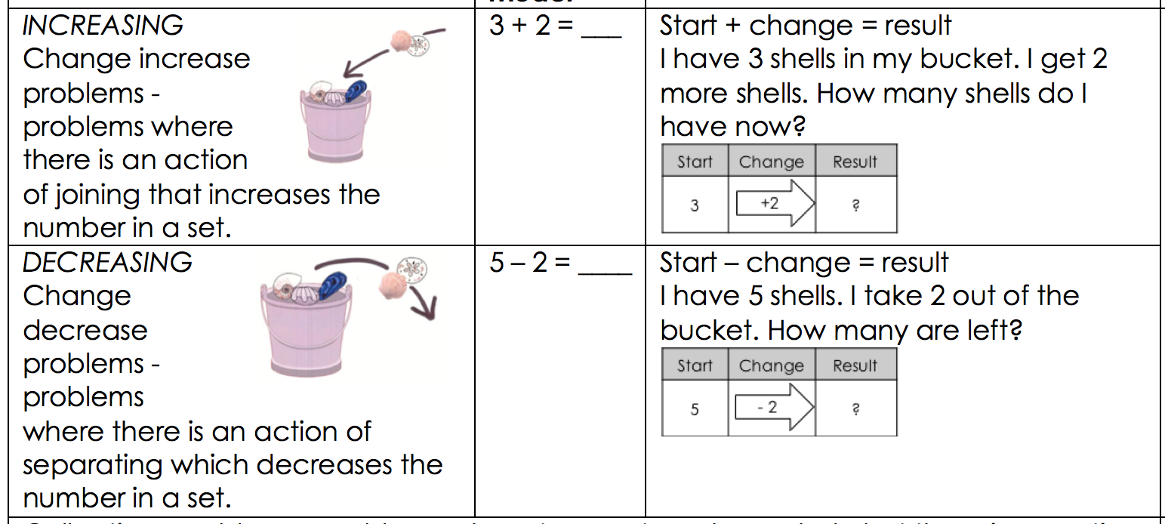
Types of addition and subtraction problems: INCREASING & DECREASING LIKE A MOVIE (DYNAMIC)

Slide 10
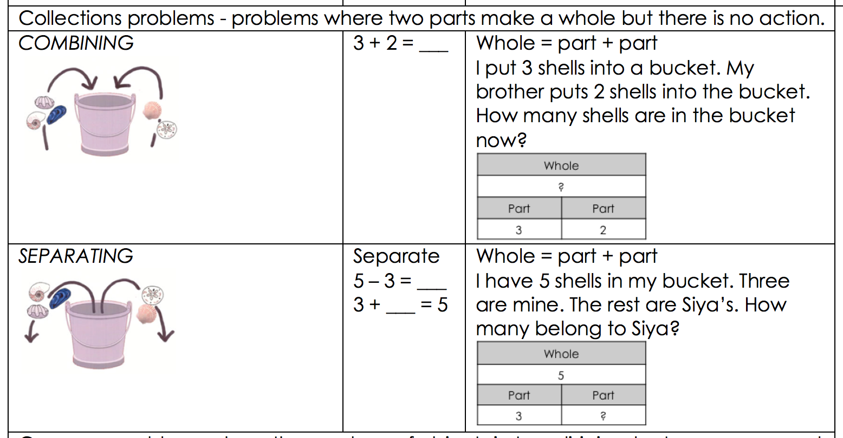
Types of addition and subtraction problems: COMBINING & SEPARATING SNAPSHOT IN TIME (STATIC)

Slide 11
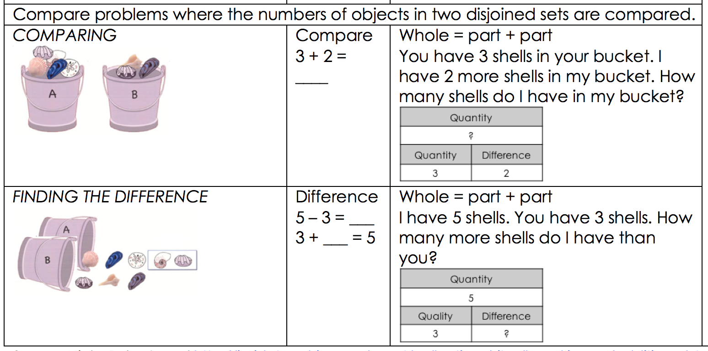
Types of addition and subtraction problems: COMPARING & FINDING THE DIFFERENCE SNAPSHOT IN TIME (STATIC)

Slide 12
Practical information for setting up clubs

Slide 13
Object of learning for sessions 4 to 9
Emphasis on the part-part-whole relationships is inherent in all activities in linking addition and subtraction.
Emphasise that addition of two or more numbers can be done in any order is important to support children’s fluency. When adding two numbers it can be more efficient to put the larger number first to encourage ‘counting on’.
Emphasis that when adding three or more numbers it is helpful to look for pairs of numbers that are easy to add. For example, given 5 + 8 + 2 it is easier to add 8 + 2 first than to begin with 5 + 8.
All card and dice games are intended to promote learners’ fluency in using number facts

Slide 14
SESSION 4 TO 9 FOCUS
The activities detailed in this booklet help to focus on these big ideas and are intended to help you as the club leader to encourage learners to progress from counting all to more efficient strategies for addition and subtraction.
The session overviews for:
Grade 1
Grades 2 & 3
IP grades
if you encounter a learner who needs to be extended or remediated in your clubs, you have access to other activities that can be useful
At the start of each session, check the PURPOSE OF THE SESSION / OBJECT OF LEARNING and APPROACH TO RUNNING THE SESSION boxes at the top of each planning sheet to set your focus for each session.

Slide 15
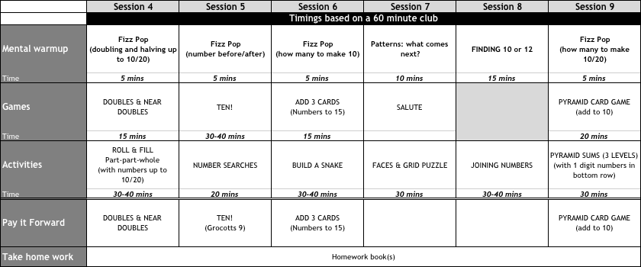
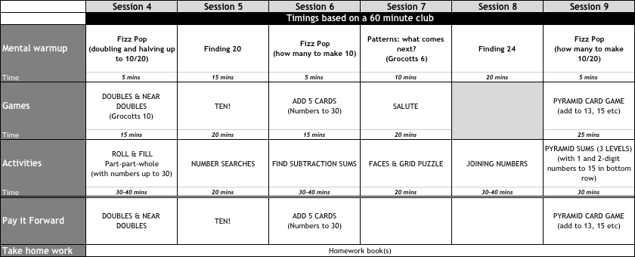
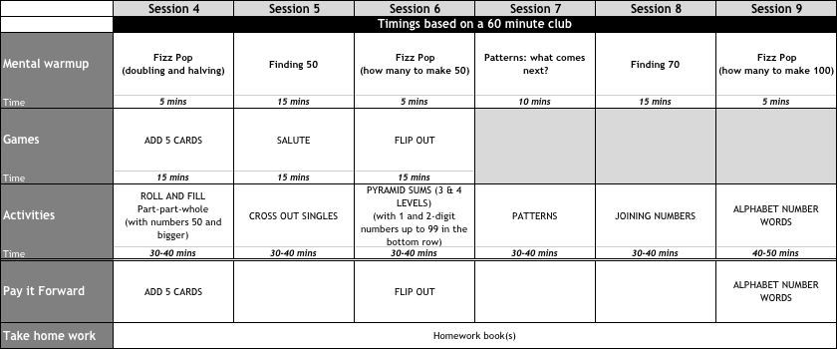

Slide 16
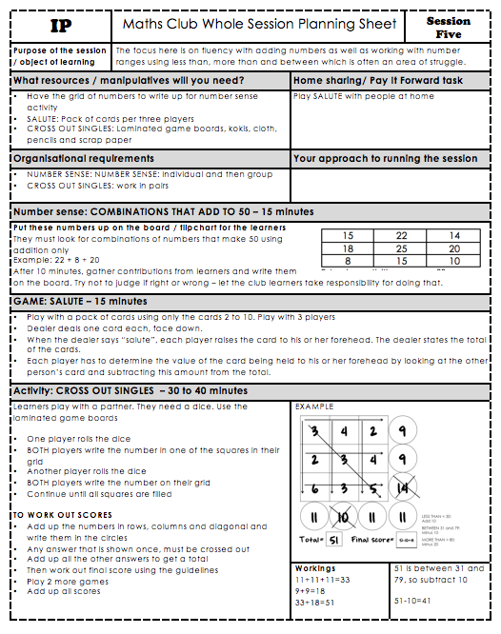
Preparation for the session
Mental maths / number sense
Card and dice games
Activities

Slide 17
Using the activities in club sessions
Some have been laminated for re-use
To save paper, you have been given photocopied sets for your clubs:
12 if the activity is for individual work
6 if the activity is for pair work
At the beginning of a club session, put a copy into plastic sleeves
Learners use dry-wipe markers to work on the sleeve
At the end of the session:
Clean the sleeves
Remove the activities and put back in your file

Slide 18
Remainder of this session
Getting a feel for
Activities
Games

Slide 19
www.ru.ac.za/sanc
Website

