Slide 1
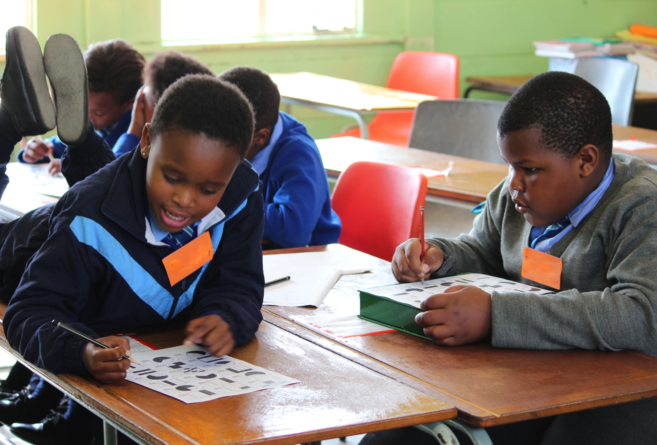


… enabling spaces for both recovery and extension of mathematical proficiency in young learners
After school maths clubs …
PGCE FP/IP Research Conference 28th October 2014
Debbie Stott

Slide 2
After school maths clubs rationale
After school programs are a critical first step in the process of changing not just how we educate our children, but how we come together, in partnership - school and community - to ensure their success (White, 2005, p. 8)
The positive effects of participating in OST programmes as follows:
  young people benefit when they spend time engaged in structured pursuits that offer opportunities for positive interactions with adults and peers, encourage them to contribute and take initiative, and contain challenging and engaging tasks that help them develop and apply new skills and personal talents (Durlak & Weissberg, 2007 p. 5)

Slide 3
why maths clubs could be beneficial
Graven (2011b) gives four reasons:
Remediation work that consolidates mathematical foundations is an urgent requirement for many learners in South African schools and clubs could provide a place for this type of remediation to take place.
Clubs could also create opportunities to challenge and extend those learners who are coping at their grade level and perhaps to strengthen their mathematical dispositions and confidence.
Clubs could also provide an opportunity to strengthen groups of learners in class, who could serve as catalysts for furthering mathematical proficiency of others in their classes.
Clubs could provide extended learning opportunities for learners to work on mathematics in OST.

Slide 4
Outcomes associated with participation in after school programmes
Academic:
  better attitudes toward school
  better performance in school (as measured by achievement test scores and grades)
  improved homework completion
  better engagement in learning
Social and emotional benefits:
  improved self-confidence
  self-esteem
  improved social and communication skills and/or relationships with others (peers, parents, teachers)
  improved feeling and attitude towards self and school
  development of initiative (Little, Wimer, & Weiss, 2007)

Slide 5

Developing Mathematical Proficiency in our clubs
Productive disposition – connect with identities and ways of being

Slide 6
Maths clubs in our SANC project
  Began with a pilot club in 2011
  Since then our team has run 14 clubs at schools and local development centres
  Support another 7 clubs run by the teachers we work with in our development project
  I run two clubs a year:
    Two different schools
    8 to 10 learners in each
    once a week during term time
    About 1 hour

Slide 7
Contrasting clubs and classrooms
Formal maths classroom / environment
Participation expected (in-school-time)
Less learner choice over the activities
Curriculum and assessment standards as a prescriptive framework influencing activities
Largely acquisition based and often driven by teaching for/to assessments
Teacher led and much whole class teacher learner interaction
Assessment tends to be summative and results in ranked performance
Prescriptive, teacher controlled classroom rules within general school rules
Informal club / maths environment
Voluntary participation (out-of-school time)
More learner choice over the activities
Curriculum as contextual guide for activities
Participation based, where participants are active and engaged
Many interactions are learner led with few whole class-mentor interactions and many one-to-one interactions between mentors and learners.
Assessment is formative and integrated and is used to guide individual learning experiences for the participants
Negotiated sociomathematical norms which may differ from in-school time rules

Slide 8
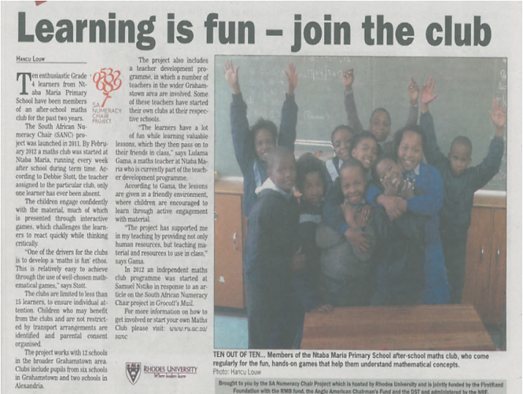
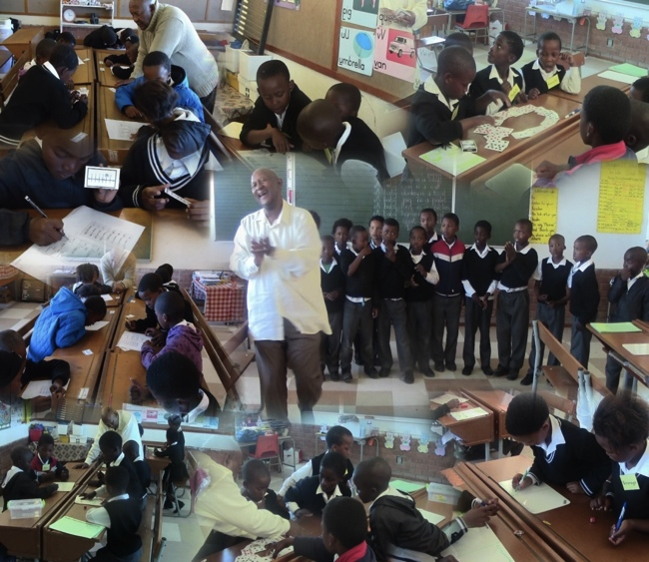
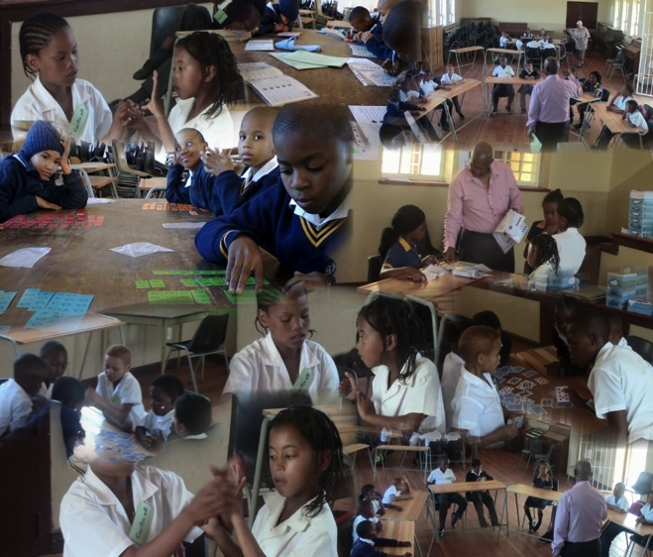
Developmental foci for learners
Strengthening foundations
Extending and challenging
Focusing on efficiency and progression
Sense making, connection, conceptual understanding
Notes:
Gr 4s don’t know basic number bonds to 10
* 2+98
If can connect 2+98 as the same as 98+2 (because order in addition doesn’t matter while in subtraction it does) then we can simply count on 98, 99, 100. Or we could use our understanding of place value to add the 2 to 8 and then to 90. These foci were all research informed and based on a through piloting process.

Slide 9
Developmental opportunities for teachers too
Clubs as mini explorative spaces (or 'labs’)
To try out:
  new activities and games
  assessments before using them in the classroom
clubs provide a safe space for educators to:
    Build their own confidence
    Try new pedagogical approaches

Slide 10
Clubs essential learning spaces for facilitators and researchers
trial methods/ ideas/ resources for NICLE
Aha moments
Encounter key challenges (linguistic; conceptual, contextual)
Research spaces and opportunity to give something back – ethical commitment with regards to research access

Slide 11
Focus on recovery of foundations is essential!
Without foundational understanding learners ‘play school’ (no opportunity to learn)
ANAs & other – show that many of our learners still count all, count on
25 + 36; 52 + 369; 236 x 24
majority of learners can’t participate – there is no OTL without recovery – curriculum is beyond the ZPD for majority

Slide 12
Club research points to strong recovery
PhD - 2012 case study clubs (mixed ability)
  strong learner progression across Wright et al levels from Feb – Nov 2012
Masters research studies –similar shifts
Highlights/ anecdotes 2013 clubs
  club learners moving towards ‘top performers’ in class
  attitude towards doing math hw & working with numbers transformed (Parents)
  willingness to talk/ share & engagement in class is greater – helpers (Teachers)

