Slide 1
Linguistic obstacles to second language learners’ access to mathematical talk for individualised sense-making
Sally-Ann Robertson & Mellony Graven
South African Numeracy Chair Project
Education Department, Rhodes University
s.a.robertson@ru.ac.za/ m.graven@ru.ac.za
MERGA 40 2017 40 years on: We are still learning
Faculty of Education, Monash University (Clayton Campus, Melbourne, Australia), 2-6 July 2017

Slide 2
Background
Mathematical sense-making
Language (L1/L2)
Literacy
South African learners’ low levels of mathematical sense-making
A language policy that promotes additive bilingualism; but socio-economic aspirations that promote English at the expense of learners’ mother tongues .

Slide 3
Concern
Learners’ playground joie de vivre in L1 is shut down upon entry into the L2-dominated mathematics classroom environment.
Use of L2 constitutes a barrier to the use of language as a tool for mathematical sense-making.

Slide 4
Context
Two Grade 4 mathematics classrooms in ‘township’ schools:
Ms M’s LoLT: Straight for English from Grade 1
Ms P’s LoLT: First year of transition to English (MT - Grades 1-3)
Q: How do Ms M & Ms P use talk in supporting their learners’ mathematical sense-making?

Slide 5
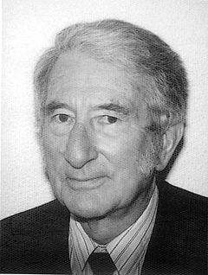
Go for Code-switching?
Go for the Language of power?
“As we learn more about the power of language, and its penetration into everything we do and think, so we also come to realize that intervening in the processes of language is an extraordinarily complex affair … “
Go for Bi-/Multi- Lingualism?
Should we perhaps try Translanguaging?
 | (Halliday, 2007, p. 12)
Could we go for
first prize cognitively – Mother Tongue?

Slide 6
“Children have to learn to use language for a range of purposes and in a range of cultural and situational contexts” (Gibbons, 2003, p. 250).
MODE CONTINUUM
More spoken-like | More written-like
Interactive, face to face | Non-interactive, ‘mono-logic’
Context dependent (linguistic + physical cues) | Context independent
Dynamic & responsive | Static
Spontaneous | ‘Polished’
Everyday, common-sense lexis | More formal and abstract lexis
Lexically sparse (mainly ‘high frequency’ words) | Relatively lexically dense
[Adapted from Eggins (2004) and Gibbons (2006)]

Slide 7
Cummins’ BICs/ CALP distinction
TWO kinds of classroom talk:
Basic Interpersonal Communication Skills (BICS), and
Cognitive Academic Language Proficiency (CALP).
Both are necessary in the classroom
BICS is the more important for initial sense-making
CALP then becomes the key to deepening engagement in mathematical discourse.

Slide 8
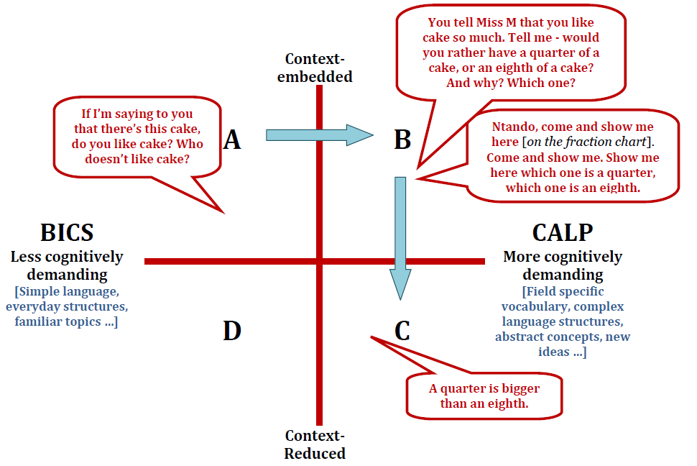

Slide 9
Teachers’ comments (1)
Ms M: Language is very important, because maths isn’t only about numbers: ‘add this’, ‘subtract this’. There’s lots of language involved. There’s English language first of all: that is a challenge to these learners. And also the maths language itself. So if one doesn’t have English as a language and also the maths language, then … there’s no learning and teaching that is taking place.
Ms M’s emphasis appeared to be on inculcating the ‘legitimate text’. She did not significantly disrupt her school’s ‘straight for English’ policy. Her pushing her learners to make statements of ‘mathematical fact’ in L2(even though many may not yet have conceptually grasped the fact/s) appeared to pay-off in terms of national assessments.

Slide 10
Teachers’ comments (2)
Ms P: They are supposed to be taught in English, … so I’m supposed to speak English, but I can’t do otherwise. So – most of the time, I speak Xhosa – the one that they understand.
Ms P allowed extensive use of L1 in order to facilitate her learners’ mathematical sense-making. This L1 emphasis appeared , however, to compromise her learners as regards national assessments, although ...

Slide 11
ANA Mathematics % Scores (2014)
Ms M | 37.9
Ms P | 27.3
National Average | 37
 | SANCP’S Mathematical Proficiency Assessment % scores (2014)
 | Conceptual Understanding | Strategic Competence | Adaptive reasoning | Overall Average
Ms M | 61 | 25 | 41 | 42.3
Ms P | 52 | 34 | 64 | 50
Cohort Average | 51 | 25 | 29 | 35

Slide 12
Thank you!
The financial support provided by the FirstRand Foundation (with RMB), Anglo American Chairman’s fund, the DST and the NRF is gratefully acknowledged; as is the unerring intellectual and emotional support of all of the members of the SANCP team.

Slide 13
References:
Cummins, J. (1994). The acquisition of English as a second language. In K. Spangenberg-Urnschat & R. Pritchard (Eds.), Kids come in all languages: Reading instruction for ESL students (13th printing, 2005) (pp. 36-62). Newark, Delaware: International Reading Association
Eggins, S. (2004).. Eggins, S. (2004). An introduction to systemic functional linguistics. London: Continuum.
Gibbons, P. (2003). Mediating language learning: Teacher interactions with ESL students in a content-based classroom. TESOL Quarterly, 37(2), 247-273.
Halliday, M. A. K. (2007). Language and Education. Volume 9 in the Collected Works of M. A. K. Halliday. Edited by Jonathan J. Webster London: Continuum.
South Africa. Department of Basic Education. (2010). The status of the language of learning and teaching (LOLT) in South African public schools: A qualitative overview. Pretoria: Department of Basic Education.

