Slide 1

After school maths clubs: INVESTIGATING learner progression in an EXPANDING intervention model
Debbie Stott, Mellony Graven, Nolunthu Baart, Gasenakeletso Hebe, Zanele Mofu
AMESA, January 2017

Slide 2
Aim of this talk
Overview of after-school maths club project
Maths club teacher development project in the club space
Report on 300 learners progression across 3 districts
Focus on the changes evident in learners’ mathematical proficiency over a 15-week period of club participation

Slide 3
SARCHI Chair – SANCP (2011-2020)
Mandate to research sustainable ways forward to ‘crisis’ in numeracy education & simultaneously improve teaching and learning in local schools
Intervention projects:
  teacher development COPs;
  after school Math Clubs;
  Family Maths (parent/community engagement);
  STEAMING Ahead Camps;
  district support (beyond EC);
  aftercare centre partnerships

Slide 4
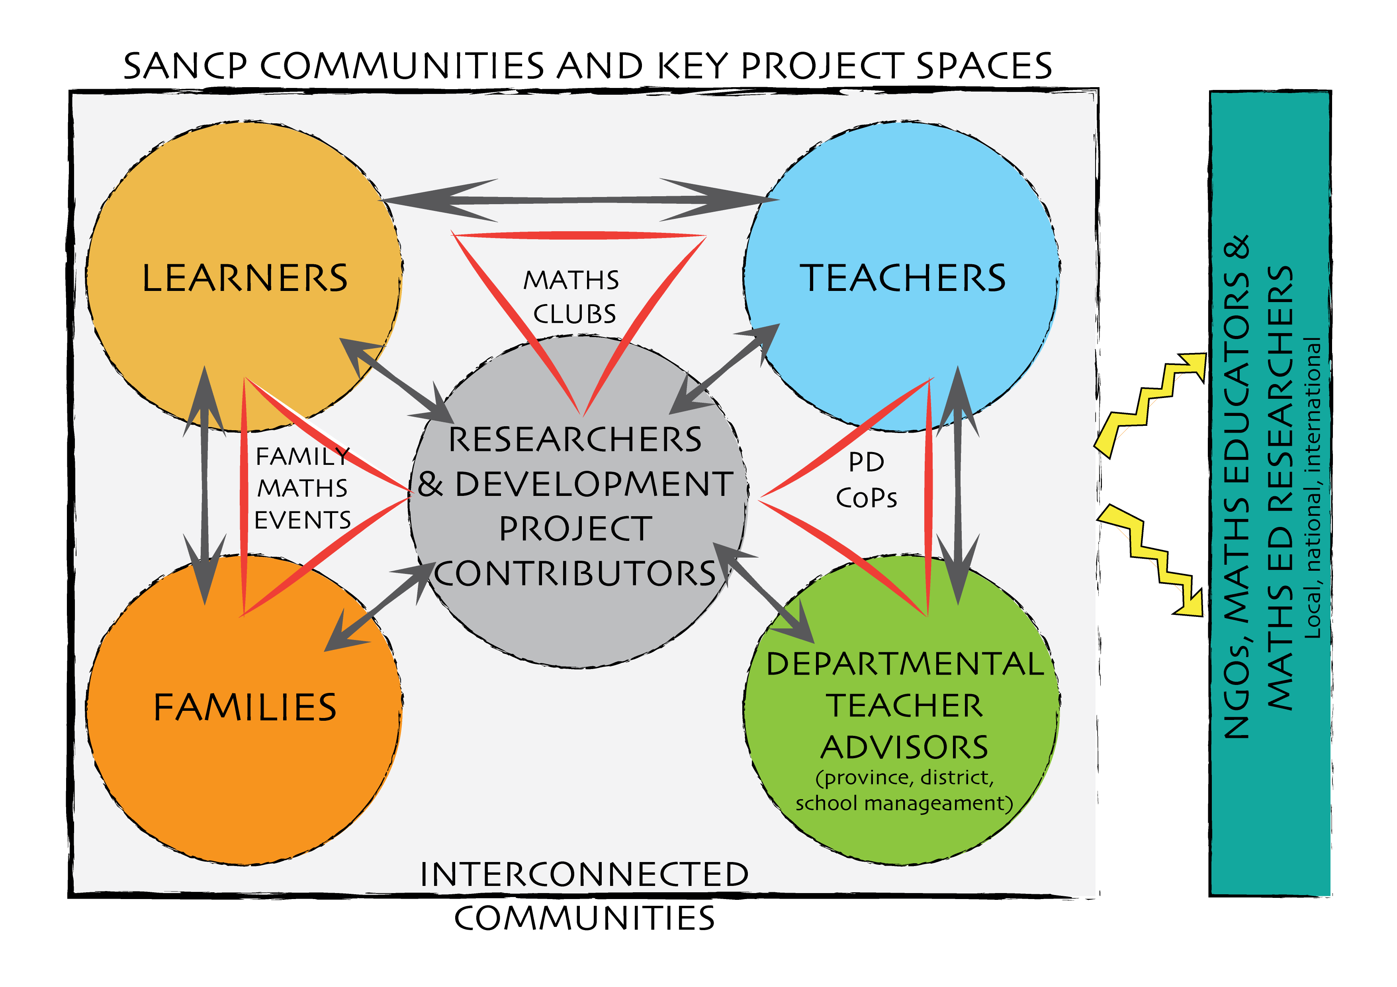
A hub of mathematical activity, passion and innovation
Engaging, serving and strengthening four key interconnected communities of practice

Slide 5
Apartheid legacy
Verwoerd quote – Maths not for all
Education under apartheid was about control - denied all learners agency
Learner dispositions display more teacher dependence and ‘helplessness’
BUT
Math Ed for 21stC demands:
  learner agency, critical, creative thinking, and productive learning dispositions
Productive disposition is one of the essential 5 strands of MP

Slide 6
Clubs opportune spaces to change mathematics learning dispositions
Free from curriculum compliance
(revisiting and moving beyond)
Smaller group allows increased individual attention; learner discussion and tailoring of activities
Free to develop new socio mathematical norms (be messy & mistakes are great!)
Volunteer nature & no assessment for ‘grades’ allows for development of self-motivation

Slide 7
Also spaces to shift learner MP
Evidence of clubs shifting learner dispositions (e.g. Hewana; Ndongeni; Graven; Stott)
Evidence of clubs shifting learner performance and (fluencies and strategies) – Stott; Graven
Widespread interest in clubs led to expansion (various provinces, districts and after care centres)
Initially ad hoc ‘training’ and material support (also available on website)

Slide 8
Push to expansion
In Phase 2 of SANC project
need to show projects taken ‘to scale’ - ‘expansion of sphere of influence’
Required clearer and session by session packaged design
Led to the ‘Pushing for Progression’ club programme

Slide 10

Pushing for Progression programme - overview

Slide 11
Design of club programme and evolution of the PfP
Club programme design origin:
  In Stott’s PhD research in 2 clubs
  Based on broad perspective of Vygotskian learning and development (see 2016 SAARMSTE paper)
    Sfard’s (1998) early work with learning metaphors
    Valsiner’s (1997) zone theory
    Kilpatrick et al. (2001) Mathematical proficiency
  PfP structure and content arose from:
    Experiences of working with after-care centres and other educators in Grahamstown & beyond
Five years on: learning programme design for primary after-school maths clubs in South Africa

Slide 12
Overview of the programme
16-week programme (approx 2 school terms)
  15-week programme can be run twice a year with different groups of learners or extended with same learners
1st workshop session - one week before the programme starts
Week 0 | Weeks 1 to 3 | Week 3 | Weeks 4 to 9 | Week 9 | Weeks 10 to 15
Workshop One | Run 3 weekly club sessions | Workshop Two | Run 6 weekly club sessions | Workshop Three | Run 6 weekly club sessions
Orientation Why progression? Progression spectra Assessments and profiling In-depth look at the programme for 1st 3 clubs | 1st session: administer assessment and profile learners | In-depth look at the programme for next 6 clubs with a focus on addition and subtraction | On-going informal assessment and profiling of learner progress | In-depth look at the programme for next 6 clubs with a focus on multiplication and division | On-going informal assessment and profiling of learner progress In 15th session: re-administer assessment and re-profile learners

Slide 13


Key idea 1: Understanding and fluency
Conceptual understanding:
  Comprehension of mathematical concepts, operations, and relations
  The ability to:
      use multiple representations
      estimate
      make connections and links
      understand properties of number systems (i.e. number sense)
Procedural fluency:
  Skill in carrying out procedures flexibly, accurately, efficiently, and appropriately
  The ability to
      solve a problem without referring to tables and other aids
      Use efficient ways to add, subtract, multiply and divide mentally and on paper
      understand when it is appropriate to use procedures or not

Slide 14
Key idea 2: Number sense

Slide 15
Key idea 3: Learner progression
(learning trajectories)
Addition and subtraction
Multiplication and division

Slide 16
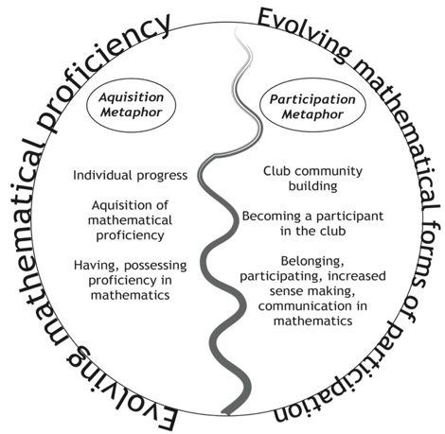
Key idea 4:Mathematical proficiency and participation

Slide 17
Gathering data and monitoring learner progression/impact
Assessment aspect of PfP

Slide 18
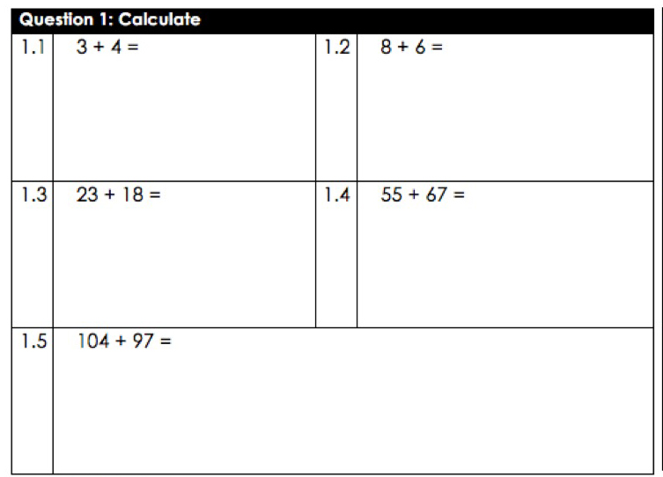
Instrument
Assesses each of the four basic operations
Each operation
  five sums
  single digit problems
  up to 3-digit by 2-digit problems
  carefully selected numbers aim to illicit some kind of strategy
For example

Slide 19
Data for teachers and researchers
Teachers gather the data for each learner in their club
  Pre: start of 15-week programme
  Post: end of 15-week programme
Teachers
  profile learners to inform club activities
  To gauge progress over 15-weeks
Researchers
  Variety of analysis methods

Slide 20
Profiling of learners and analysis …
Quantitatively:
  Learner scores out of 20
  Pre and post comparisons and % changes
  change with regard to the difference between pre and post-assessment percentage scores, which may be negative or positive

Slide 21
Profiling of learners and analysis …
Score change percentages analysed using frequency distribution ranges
  less than 9%
  10 to 49%
  50 to 100%
gauge no. of learners who have substantive differences in scores between the pre and post assessment
For example:
  learner scored 20% in the pre assessment
  scored 70% in the post assessment
  the percentage point difference would be 50
  learner made progress in the range 50-100%

Slide 22
Profiling of learners and analysis …
Using progression spectrum / learning trajectory
  Snapshot of learners positions along the spectrum
  Analysis of changes
Exapmles later

Slide 23
Sample
Research project and region (data code) | No. learners | No. clubs (1 per teacher) | Grade
Baart Uitenhage district (ECU) | 60 (12 / club) | 5 | 6
Hebe Maquassi Hills district (NWMH) | 144 (12 / club) | 12 | 3
Mofu King Williams Town district (ECK) | Gr 2: 12 (6 / club) Gr 3: 48 (6 / club) | 16 | 2 & 3
Totals | 300 | 33

Slide 24
Results

Slide 25
Learner progression data summary:
All clubs 237 learners
Biggest changes in multiplication and division

Slide 26
Pre and post-assessment averages by research project
Research project (Region) | Pre-assessment Average | Post-assessment Average | Overall % increase
ECK-Gr2 | 43.33% | 50.83% | 7.50%
ECK-Gr3 | 41.35% | 70.21% | 28.85%
ECU-Gr6 | 36.83% | 61.33% | 24.50%
NWMH-Gr3 | 41.49% | 58.29% | 16.97%
Average | 40.36% | 61.13% | 20.77%

Slide 27
Improvement by average percentage frequency distributions
All clubs 237 learners
% ranges | No. of learners | % of learners
<9% | 60 | 25.6%
10-49% | 150 | 64.1%
50-100% | 24 | 10.3%
 | 234 | 100.0%
60 learners achieved a change less than 9% (approx 25% of the learners)
150 learners achieved a change between 10 & 49% (approx 64% of the learners)
24 learners achieved a change between 50 & 100% (approx 10% of the learners)

Slide 28
Zanele Mofu
Eastern Cape

Slide 29
Overview of project
16 teachers starting new clubs
6 learners each = 96 Grade 2 & 3 learners
  (63 assessed both pre & post)
Focus:
  PhD study
    teacher learning in Community of Practice
But still collected learner data for
  Teacher’s to profile and track learner progression in their clubs
  broader SANCP

Slide 30
Mofu learner progression data:
GRADE 2 12 learners
Biggest changes in addition and multiplication

Slide 31
Mofu learner progression data:
GRADE 3 51 learners
Pleasing changes in all operations

Slide 32
Nolunthu Baart
Eastern Cape

Slide 33
Overview of project
6 teachers starting new clubs
12 learners each = 60 learners
Focus:
  Masters study
    learner progression, learner dispositions
    teacher experiences of working with the learners in the clubs

Slide 34
Baart learner progression data:
GRADE 6 60 learners
Pleasing changes in all operations

Slide 35
Gasenakeletso Hebe
North West

Slide 36
Overview of project
12 teachers starting new clubs
12 learners each = 144 learners
  (114 learners assessed both pre & post)
Focus:
  Masters study
    learner progression
    teacher experiences of working with the learners in the clubs

Slide 37
Hebe learner progression data:
GRADE 3 114 learners
Pleasing changes in all operations

Slide 38
Comparisons
Three cohorts of learners
Assessed in Grade 3 and again 12 months later in Grade 4
Versus
Club learners:
Overall average percentage point change of 21%
2011-2012 | 2012-2013 | 2013-2014
11.05% | 11.29% | 11.35%

Slide 39
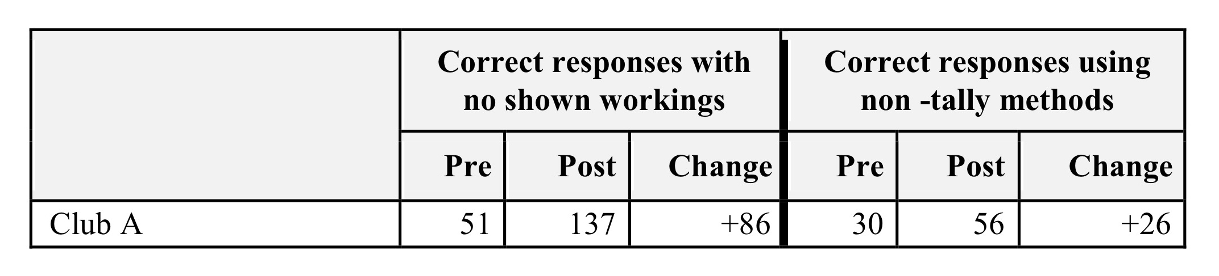
Other ways of analysising this data
Analysis of change in learners methods for correct responses
A

Slide 40
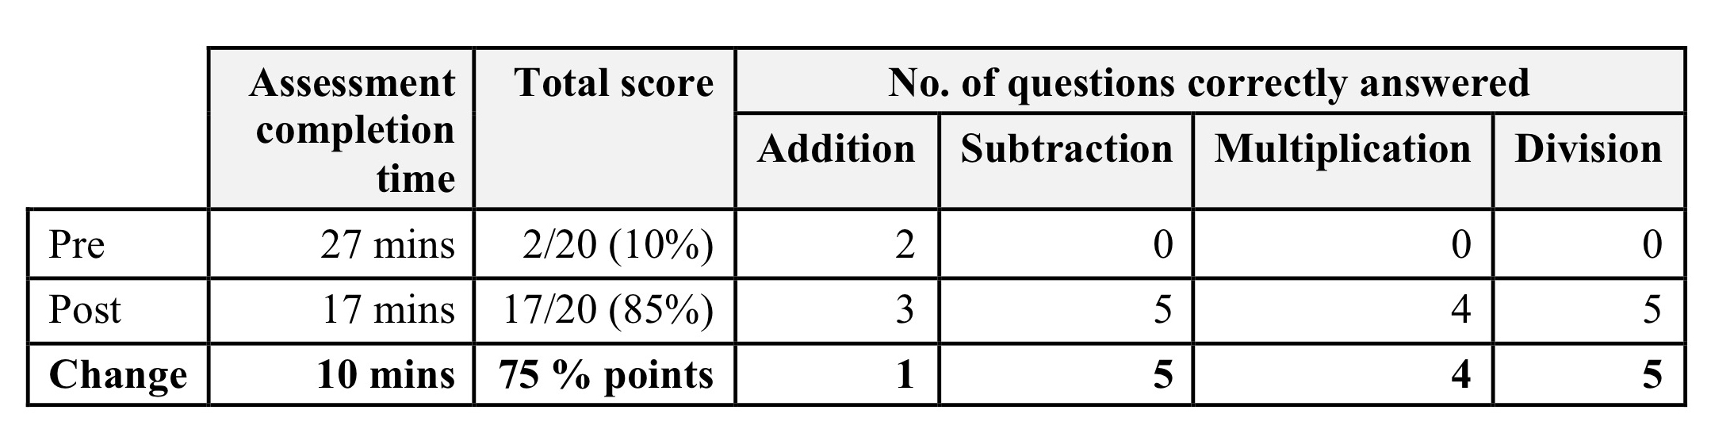
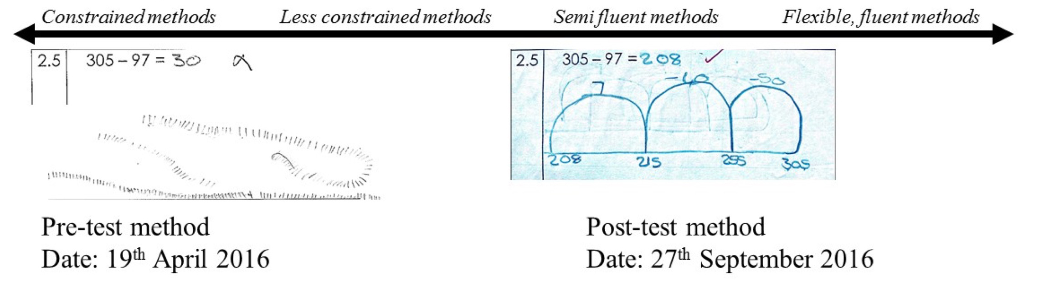
Other ways of analysing this data: future papers
Individual learner analysis change between pre & post
Detailed method analysis across a spectrum
B
C

Slide 41
Concluding remarks
Encouraging progress of club learners:
  over a relatively short time
  in clubs run by teachers rather than the SANC project team or researchers
  Districts / areas that are geographically far away from Grahamstown where the SANC project is based.
Clear emphasis on progression in the 4 basic operations in the PfP programme perhaps contributes to progression
points to the idea that results can be achieved beyond Grahamstown and to the possible expansion of the sphere of influence beyond Grahamstown
We suggest that the targeted intervention with groups of club learners and with a clear focus on progression in the four operations was highly successful.
Based on this success, we intend to continue to work with provincial and district partners to offer the PfP to more teachers in the coming years. This will enable us to increase the sample size of such research over time and to more clearly explore the usefulness of the PfP programme.

