Slide 1
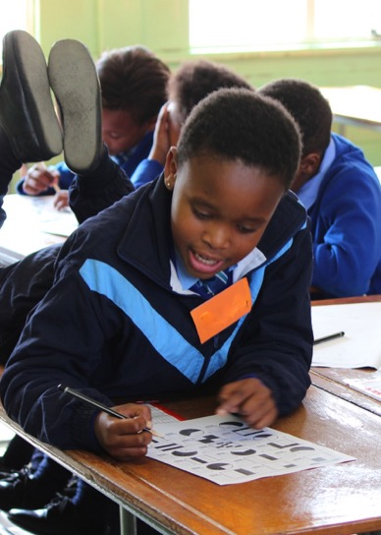


PROGRESSIVE DEVELOPMENT AND PROFILING: PROGRESSION SPECTRA FOR TEACHERS
AMESA Plenary
July 2017
Debbie Stott

Slide 2
Aim of the talk:
Research points to the need for coherence and progression in the teaching of mathematics.
Assessments our learners write, do not give teachers any diagnostic information about where our learners are at.
A need for tasks and assessments that allow teachers to understand exactly what level their learners are at
I present learner progression spectra that are accessible for teachers:
  to profile learners over time
  to provide useful ideas of ways to move learners along the spectrum from using constrained methods to more fluent ones

Slide 3
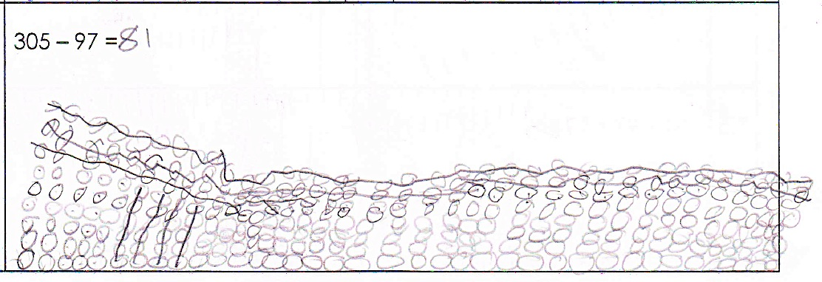
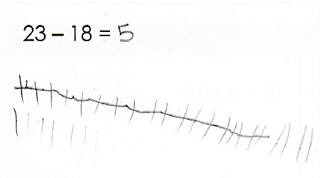
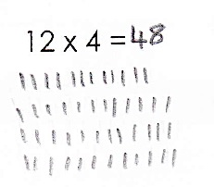
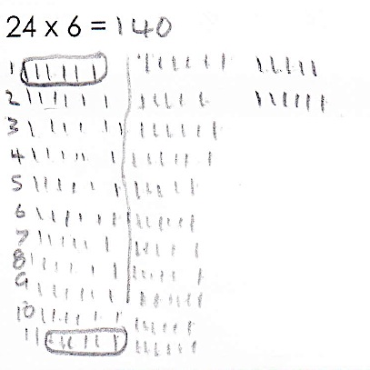
How many learners in your classes still use these methods?

Slide 4
Many learners ‘trapped’ in concrete one to one counting or dependence on using algorithms without understanding
the result - an absence of flexibility and fluency with operations and numbers

Slide 5
Mathematical proficiency
Conceptual Understanding:
Connect, use multiple representations, estimate, understand properties of number systems
Conceptual understanding:
  Comprehension of mathematical concepts, operations, and relations
Procedural fluency:
  Skill in carrying out procedures flexibly, accurately, efficiently, and appropriately
Compliment each other
Fluency:
Recall facts
Apply procedures
Work in different ways with numbers

Slide 6
Research shows that SA classrooms show either:
Missing piece…
Counting…
OR
Strong sense of numbers within numbers
NUMBER SENSE
Recall…
Notes:
Mike Askew at a conference in 2012 said

Slide 7
Number Sense example…
Think about what you know about the number
9

Slide 8
Number Sense example…
9 x 1
4 + 5
Half of 18
3 more than 6…
9
√81
10 - 1
Odd number…
90 ÷ 10
45 ÷ 5
Between 8 and 10…

Slide 9
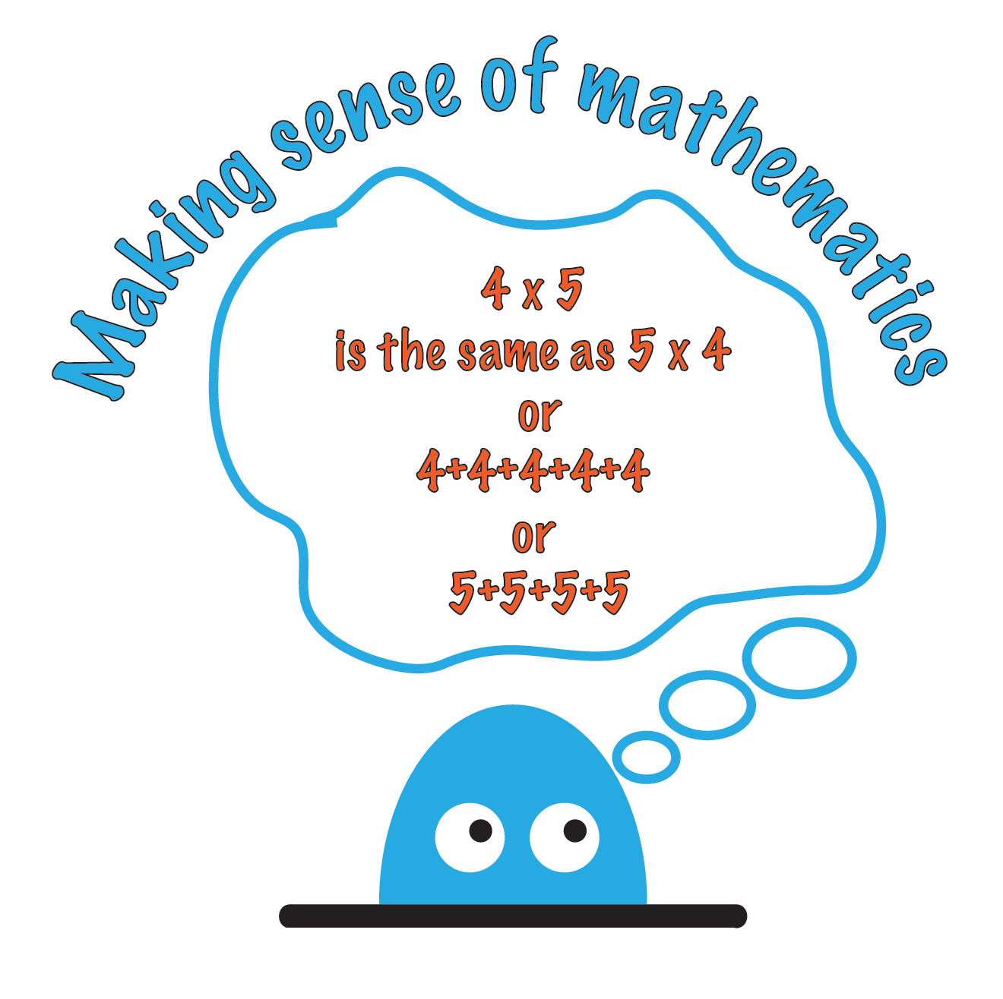
Notes:
A number sense approach - be useful to think about the relationship between these two strands
Foundation Phase: includes:
the meaning of different kinds of numbers,
the relationship between different kinds of numbers,
the effect of operating with numbers.
Intermediate Phase:
continue, extend the number range, kinds of numbers, and calculation techniques

Slide 10
Key problems or challenges
Numeracy Handbook for Foundation Phase teachers (Grades R-3) identifies:
“Too many children leave the Foundation Phase operating at Level 1”
  By the end of the Foundation Phase children should be working at Level 3.
“Too few teachers know the level at which each of the children in their class is working”
  It is crucial that a teacher has a very clear sense of the level at which each of her children is working so that she can provide differentiated activities (see below) that are appropriate to the needs of each child.
“Too few teachers are making deliberate plans to support the progression of children from one level to the next”
“Too many teachers believe that they are helping children by limiting the number range in which they are working”
(Page 26)

Slide 11
A need to push learners to make progress
Current assessments
  do not provide any diagnostic information about where our learners are at
  Simply tell us that our learners are not at the expected grade level.
Much research points to the need for coherence and progression in the teaching of mathematics
Early intervention “can be problematic” for teachers if they do not know what the learner is struggling with.
A need for tasks and assessments that allow teachers to understand exactly what level their learners are at, so that they can identify resources and tasks that will help to progress learners to where they should be.
Teachers are unlikely to identify useful resources or generate resources with carefully inlaid progression if they do not have an understanding of how learners progress through school mathematics from Grade R to Grade 7

Slide 12
How?
Let’s explore some ways this is done around the world…

Slide 13
Thinking about progressive progress = Learning trajectories
Describe the broad learning path that learners typically follow - not always linear
“what is learned in one phase, is understood
and performed at a higher level in a later phase”
(van den Heuvel-Panhuizen, 2008 p. 14).
Notes:
Benefits
1) The boundaries of the grade classes can be broken down and a language is provided for discussion for teachers and
2) the cohesion and connections between the mathematical work of the different grades is clearer

Slide 14
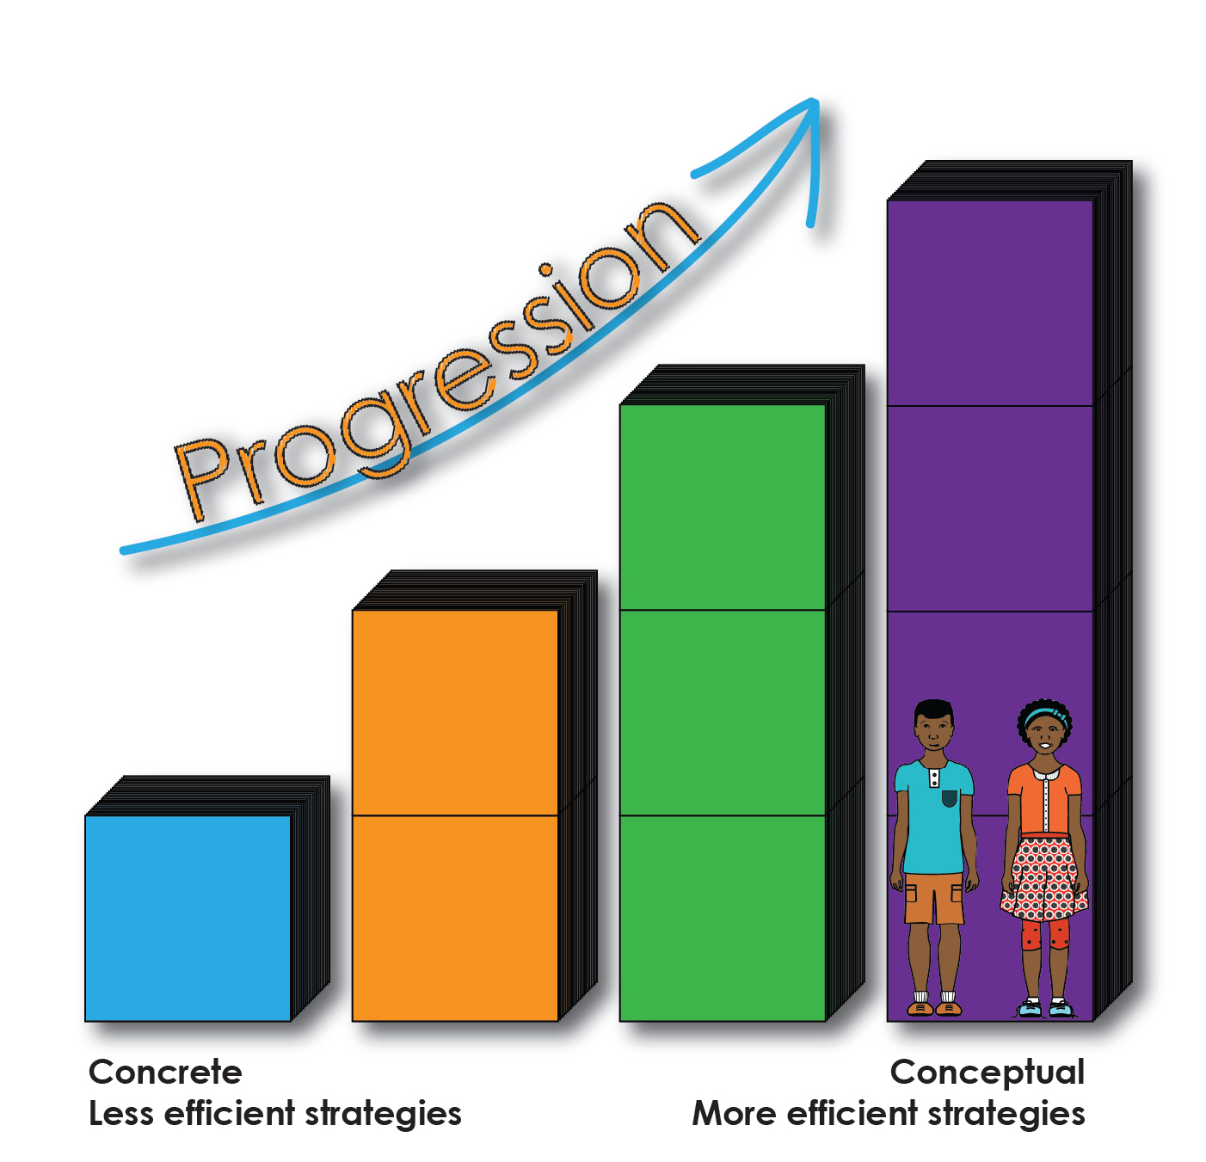
Progression models 1
Wright, Stafford, Stanger and Martland (2006) - Learning Framework in Number (LFIN)
  Analysis of learner levels of mathematical proficiency in order to design learning activities,
  to profile learners’ current mathematical proficient levels in various assessments
  teacher development.
Limitations:
  time for teachers to understand and learn the LFIN (including understanding of the levels and associated terminology),
  time to administer the individual assessment interviews
  time to profile the learners using the framework following the assessment

Slide 15
Progression models 2
TAL Learning-Teaching Trajectory
(book “Children Learn Mathematics”, van den Heuvel-Panhuizen, 2008)
originates from the Netherlands
Primary school mathematics trajectory
  covers whole number calculation from Grade R (kindergarten) up to Grade 6
  Grade R, focus on counting and elementary number sense,
  Moving towards ability to assign meaning to large numbers, insight into numerical patterns and rules, early knowledge of primes, square numbers and so on in Grade 6

Slide 16
Progression models 3
South Africa: Cranfield, Kühne, van den Heuvel-Panhuizen, Ensor et al. (2005)
  Framework to describe a pathway for learning and how learners learn, understand and solve number problems from Grade R to Grade 4,
  progressing through 4stages.
Framework drew on:
  TAL Learning-Teaching Trajectory
  the work of Steffe (1992)
  MR programme by Wright and colleagues
The combination of three models, framework highlights
  that learning trajectories have similar phases of progression.
  what differs is the terminology and the way the trajectories deal with subject matter in the mathematical domains.

Slide 17
Examples of progression models

Slide 18
What does curriculum say:
Numeracy Handbook for Foundation Phase teachers (Grades R-3) says that number sense develops as follows:
  Level 1: Counting all
  Level 2: Counting on
  Level 3: Breaking down and building up numbers (2012, p. 22)
So how is a spectrum different?
  Notable differences are:
    It’s VISUAL
    More DETAILED in thinking about level 3…
    By task, by operation, by concept
  Let’s have a look...

Slide 19
Visualising progression for individual assessment tasks
2012 Graven & Stott
Developed a procedural fluency spectrum (AMESA paper)
Visual form of procedural fluency for each different assessment task
  Show ranges of learner methods
  Range from:
    restricted / constrained procedural fluency
    towards more flexible fluency
Important point - our subsequent work with spectra
  shown that conceptual understanding is intertwined with procedural fluency and the distinction between these strands became progressively blurred
Notes:
overlapping learner methods as both procedural fluency and conceptual understanding
When analysing student learning - essential that the method of analysis records and reveals learner progress over time and allows one to compare learner responses
evident that as one moved to the upper end of the spectrum where flexibility and efficiency were high, conceptual understanding was increasingly intertwined with procedural fluency and the distinction between these strands became progressively blurred

Slide 20
OK.
So What is a spectrum?
Neither agree
Or disagree
Totally disagree
Slightly disagree
Slightly agree
Totally agree

Slide 21
Let’s do an example..
Add 10 to 92
How did you do it?

Slide 22
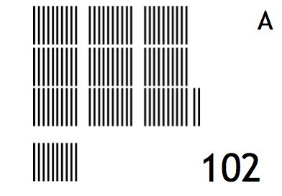
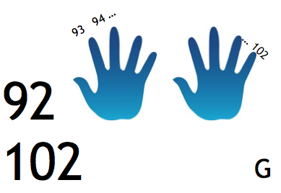
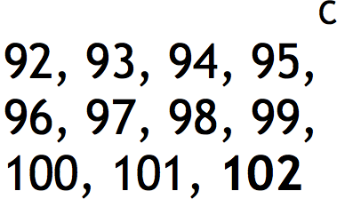
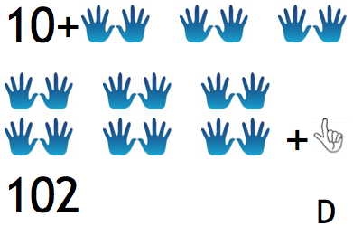
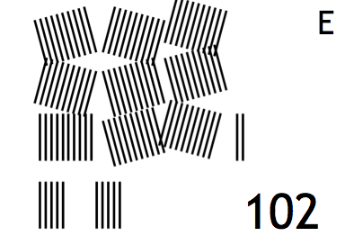
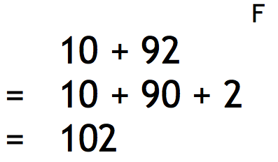
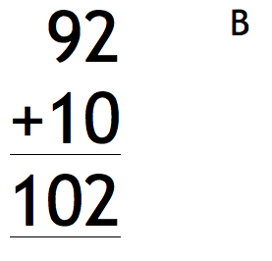
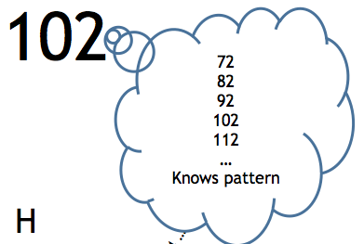
  Task: Add 10 to 92
  These cards show the types of answers we have received from learners

Slide 23
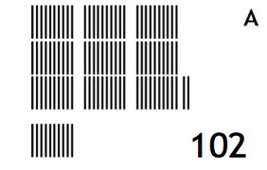
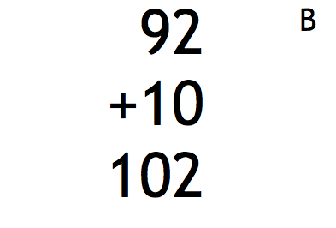
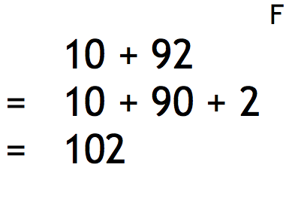

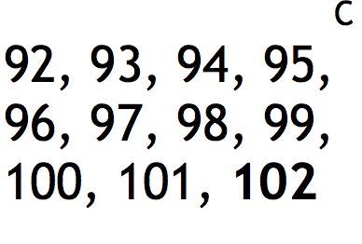
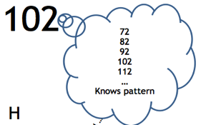
Add 10 to 92
Possible learner methods placed along the spectrum
Fluent
Efficient
Flexible
Constrained
Concrete
Less constrained
Semi-fluent

Slide 24
Further uses of spectra in research
SANC project research studies used spectra to analyse learner responses in different ways in different mathematical domains:
  Mofu (2013) adapted the procedural fluency spectrums to create a spectrum representing progression in early multiplication
  Young (2016) and Wasserman (2015) both developed spectra for understanding progression particularly in Early Arithmetic Strategies which are part of the LFIN in the MR programme
All these tools useful researchers in spite of the limitations highlighted
However, teachers need accessible and understandable tools such as these to enable them to identify:
  where their learners are
  what they are struggling with

Slide 25

Pushing for Progression programme (PfP)
To address this:
  2016, SANCP developed and began implementation of a Pushing for Progression (PfP) teacher development programme
  based around running afterschool maths clubs.
  Important aspect is for teachers to learn more about the development of Foundation and Intermediate Phase learner’s early number skills along a learning pathway and to be able to identify when children are learning securely along this pathway through effective assessment and focused mathematics activities.
  PfP includes:
    assessment and a simplified progression framework for the four basic operations of addition, subtraction, multiplication and division
    focus on number sense and the two strands of conceptual understanding and procedural fluency.

Slide 26
  PfP programme
    two spectrums to describe a learning trajectory for primary school learners that range from constrained methods to increasingly flexible and fluent methods
    in 4 operations
  Conceptual understanding and procedural fluency intertwined
Addition and subtraction
Multiplication and division
Notes:
Drawing on these ideas and earlier work:
integral in the spectra
Possible to see how CU and PF intertwined and develop as one progresses along the spectrum

Slide 27
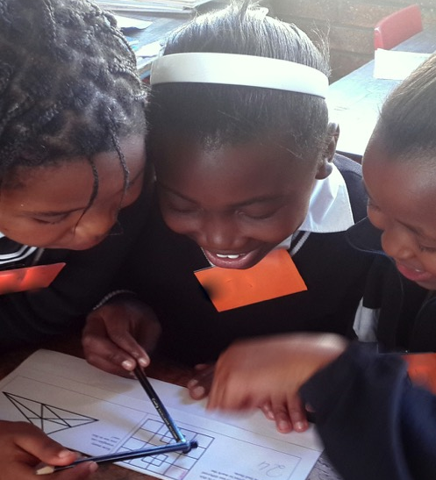
What does this look like using learner methods?
Last 3 years of work with both teachers and after school maths club facilitators over the last 3 years
Drew on data collected from research in the SANC project classrooms and after school maths club since 2011 with over 1500 grade 3 and 4 learners a year to illustrate examples

Slide 28
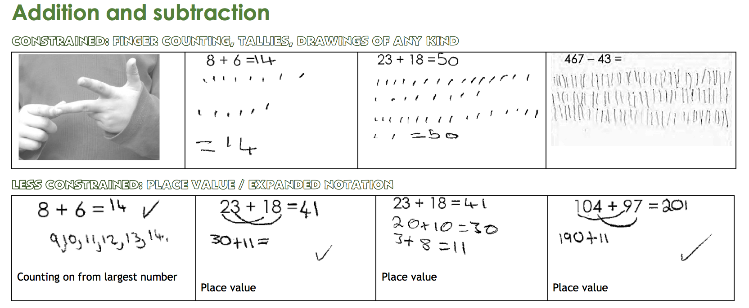
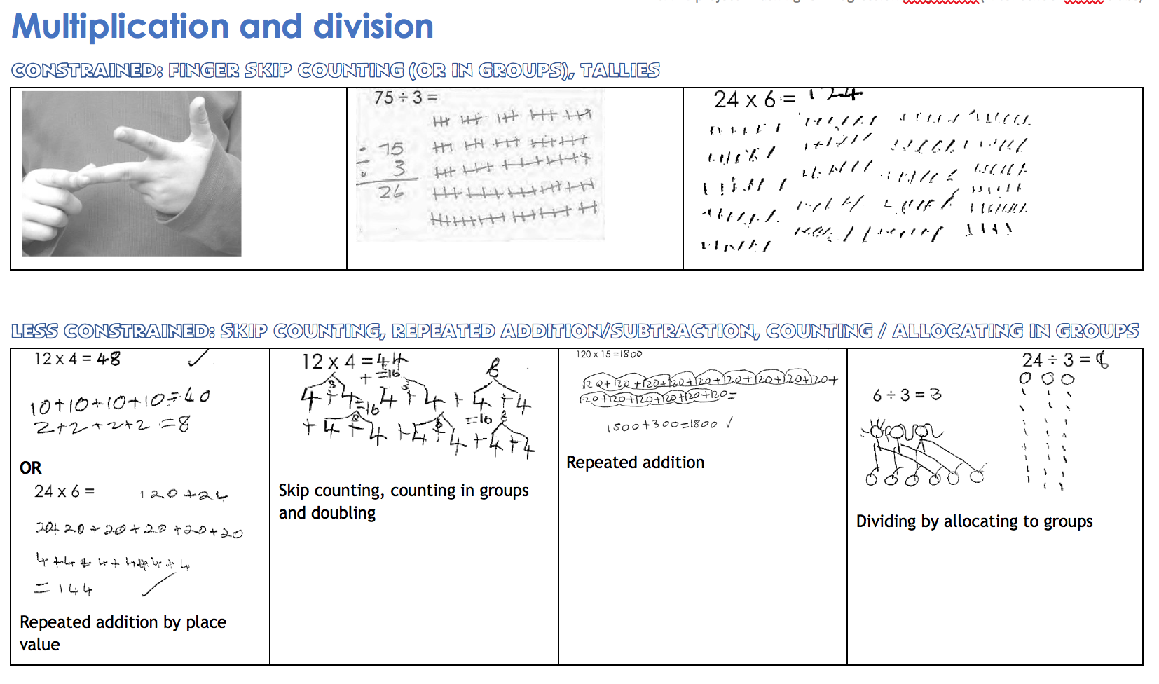

Slide 29
How are the spectra used by teachers?
Two ways:
  to both profile learners after an assessment (and during classroom tasks) over time.
  to provide useful ideas of ways to move learners along the spectrum from using constrained methods to more fluent ones.
van den Heuvel-Panhuizen (2008) pointed out:
  using the spectra allows the boundaries of the grade classes can be broken down and a language is provided for discussion between teachers.
  Also, the cohesion and connections between the mathematical work of the different grades is clearer.
Notes:
For example, if a teacher gives learners an assessment at the beginning of the term and asks them to show their working, the teacher is able to determine where the learner is along the spectrum. If the same assessment is administered at the end of the term, the teacher will be able to see if the learner methods differ and will be able to compare them.
For example, knowing that ‘count all’ is a constrained method, particularly with bigger numbers, teachers could suggest to learners that they ‘count on’ from the bigger number. This is a small but significant progression, as it can lead to understanding the commutative property in addition.

Slide 30
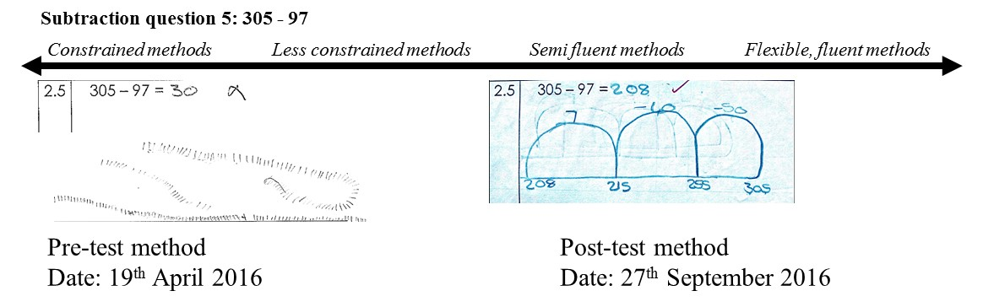
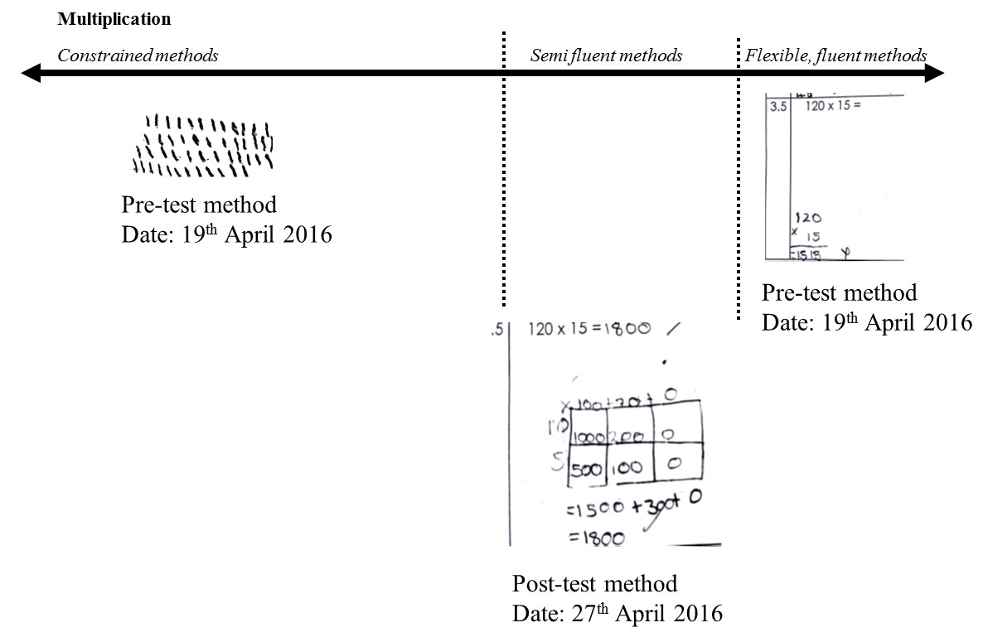
Examples from teachers’ data

Slide 31
What next for teachers?
2017:
  PGCE and B.Ed’s at RU investigating their usefulness
2016 - Eastern Cape Department of Education partners:
  implemented the PfP programme
  teachers who participated introduced to these ideas
  with an assessment and activities to help progress learners.
  They found the spectra useful
    to profile their learners and to understand the progress they made over time.
    in their own understanding of how learners learn mathematics.
  Feedback from our partners - spectra have been piloted in error analysis sessions at district level
Encourage you to assess your own learners work in terms of a spectrum of fluency
Design your own spectrums

Slide 32
Thank you!
www.ru.ac.za/sanc

