Slide 1
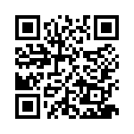
eNICLE Grade 1 & 2 programme Session 10 23rd October 2018
Prof Mellony Graven, Dr Debbie Stott, Dr Pam Vale, Ms Roxanne Long, Ms Samu Chikiwa, Mr Wellington Hokonya

Slide 2
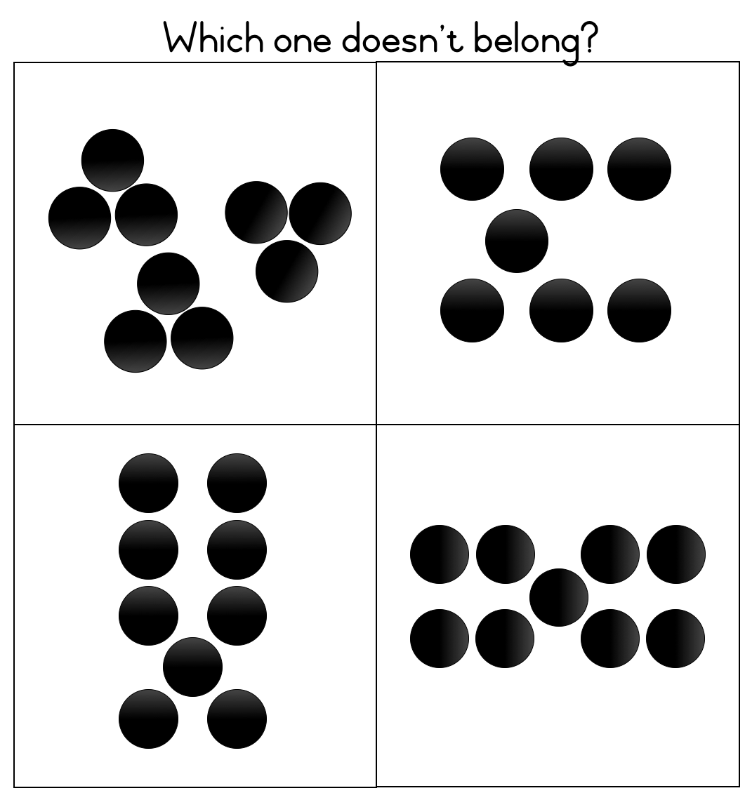
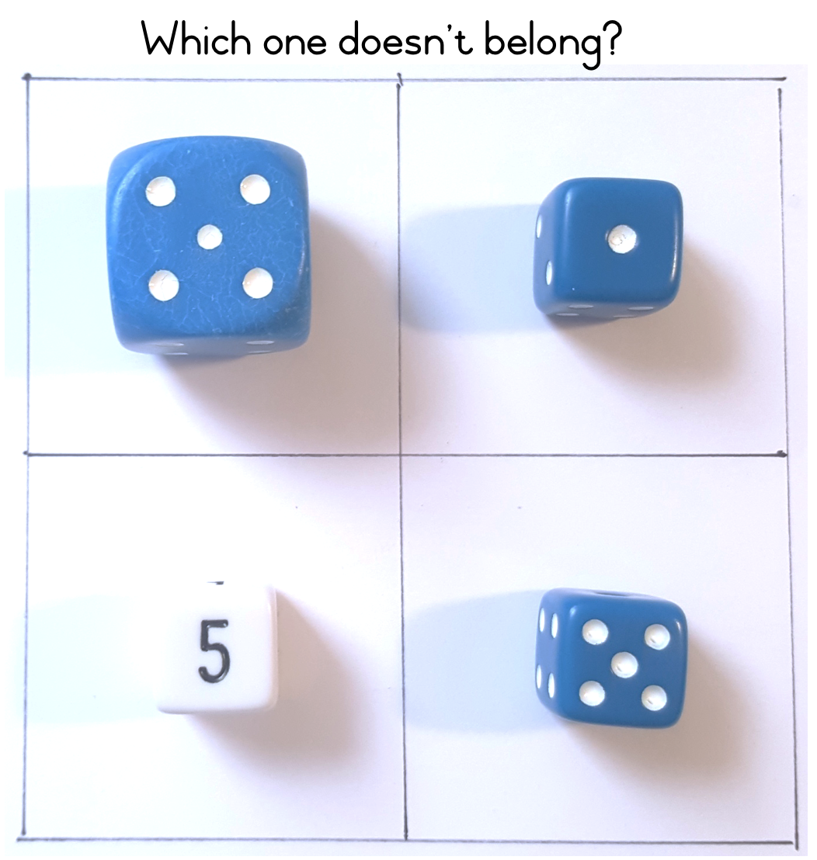
NUMBER TALKS: Which one doesn’t belong? Work with a partner and explain your thinking
1
2
Study the four images in each example.
Use your mathematical and reasoning skills to decide which of the four items does
not belong and to justify your choice.
Look for two ways to justify which one doesn’t belong.

Slide 3
What skills are we developing with activities like these? Write down at least 2.
If you to do these activities with your class…

Slide 4
They are designed to be interpreted in different ways in order to encourage deep thinking and classroom discussion.

Slide 5
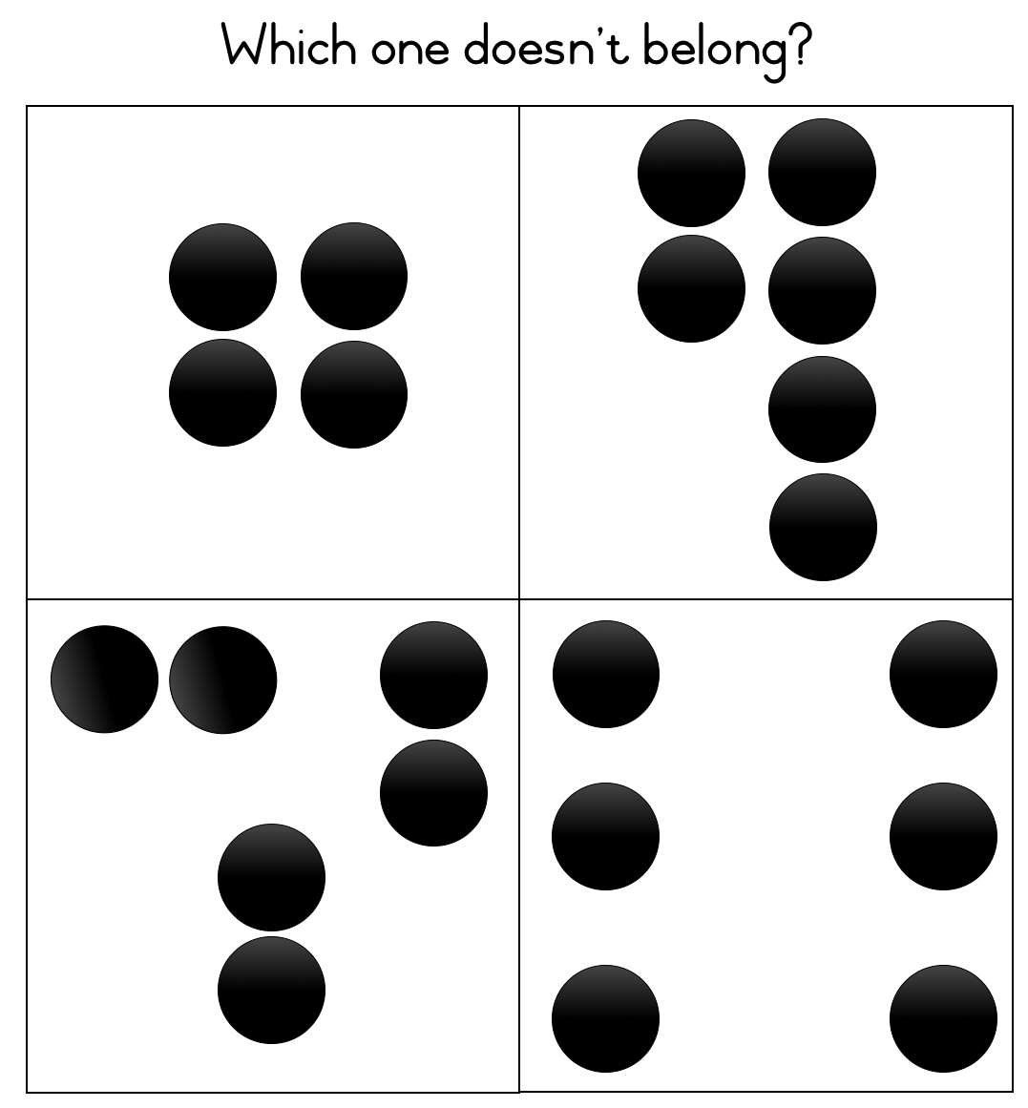
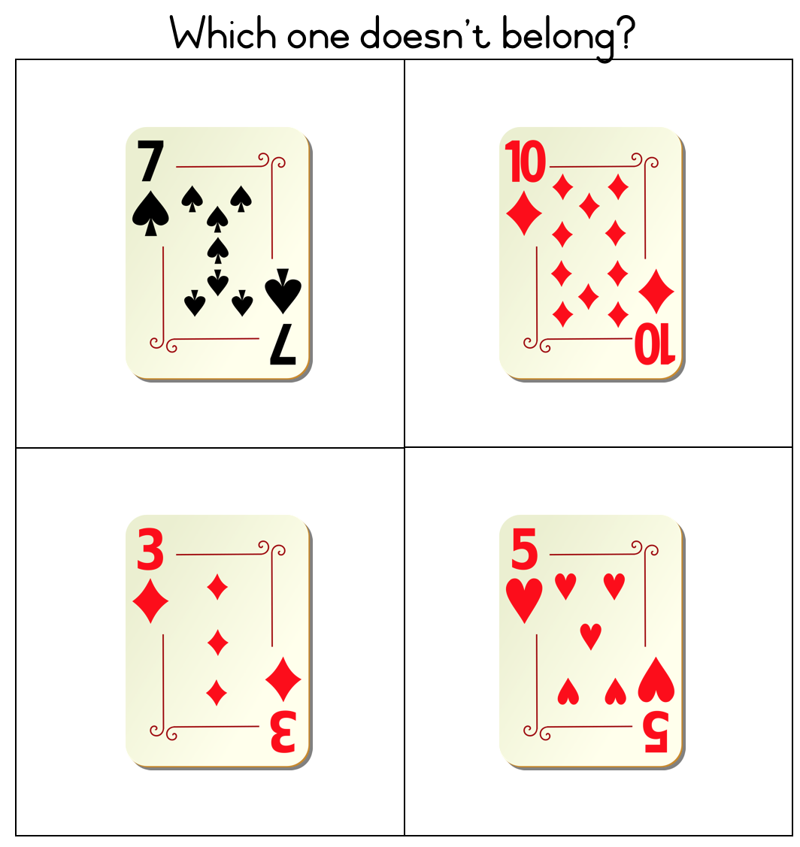
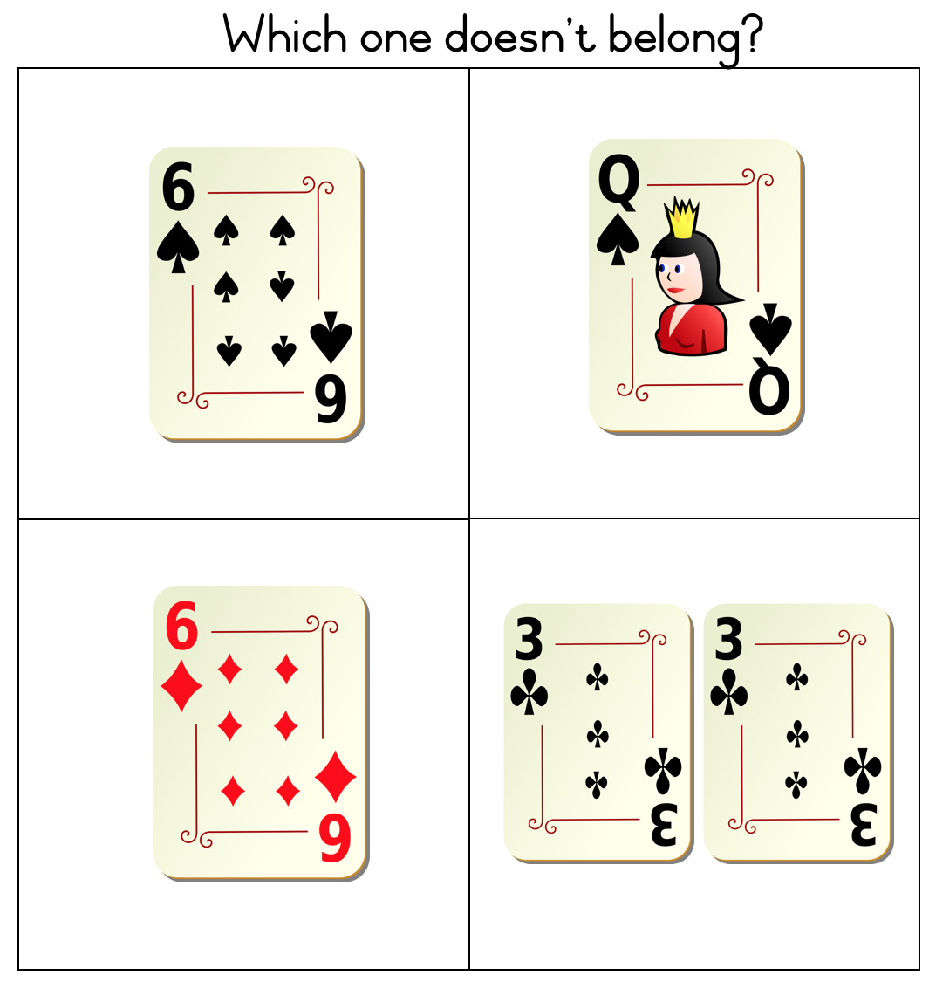
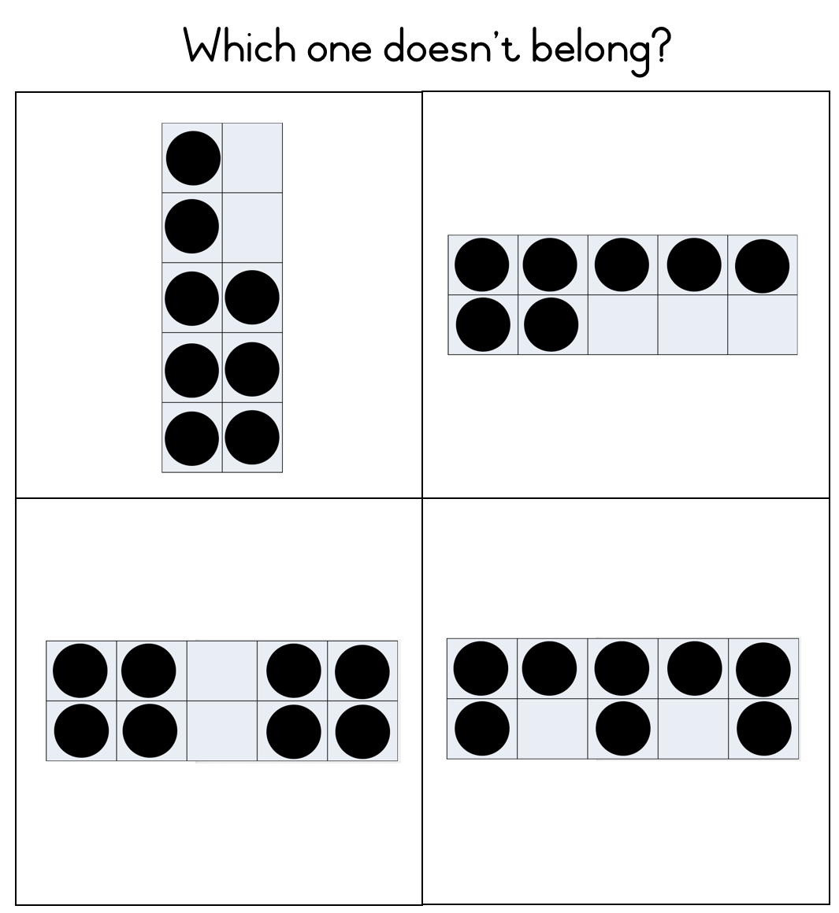
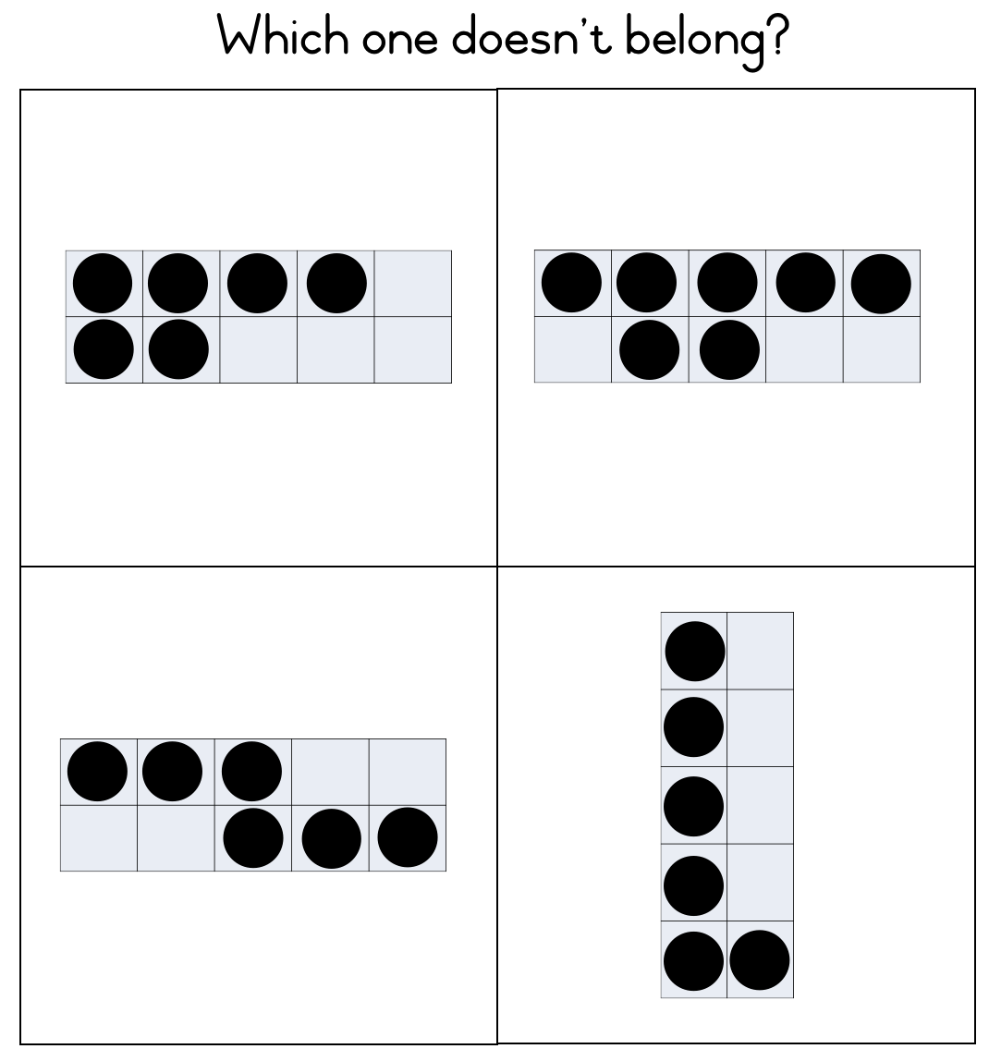
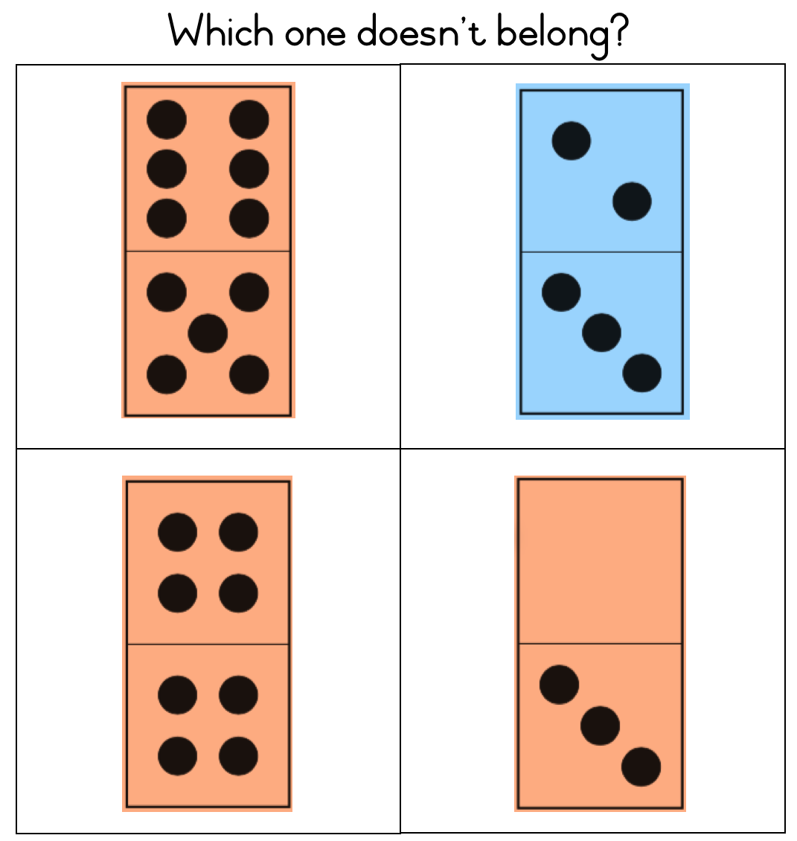
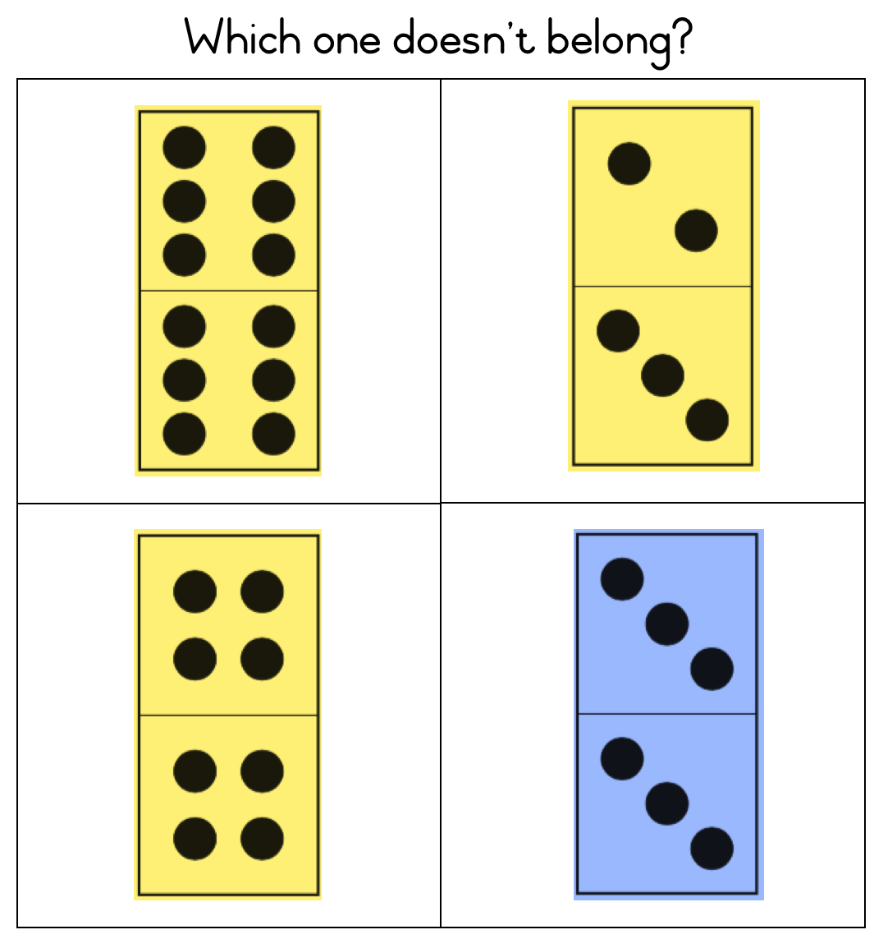
Other prompts

Slide 6
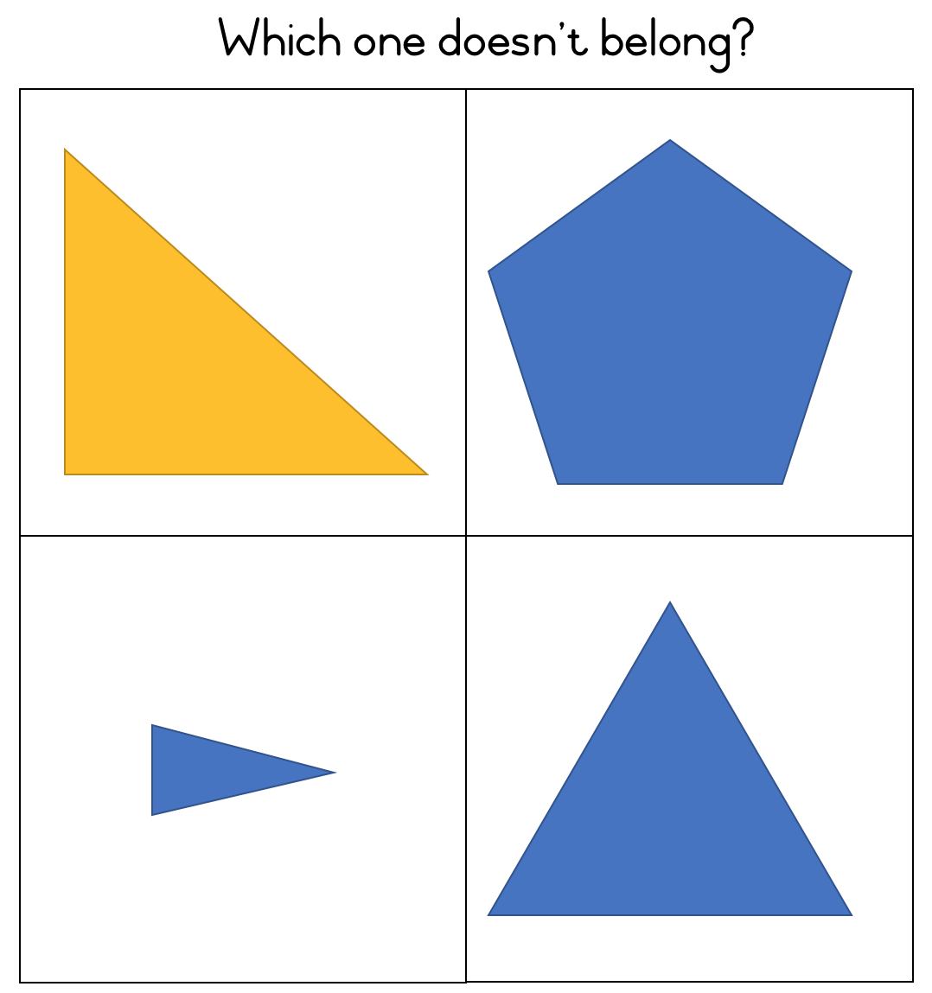
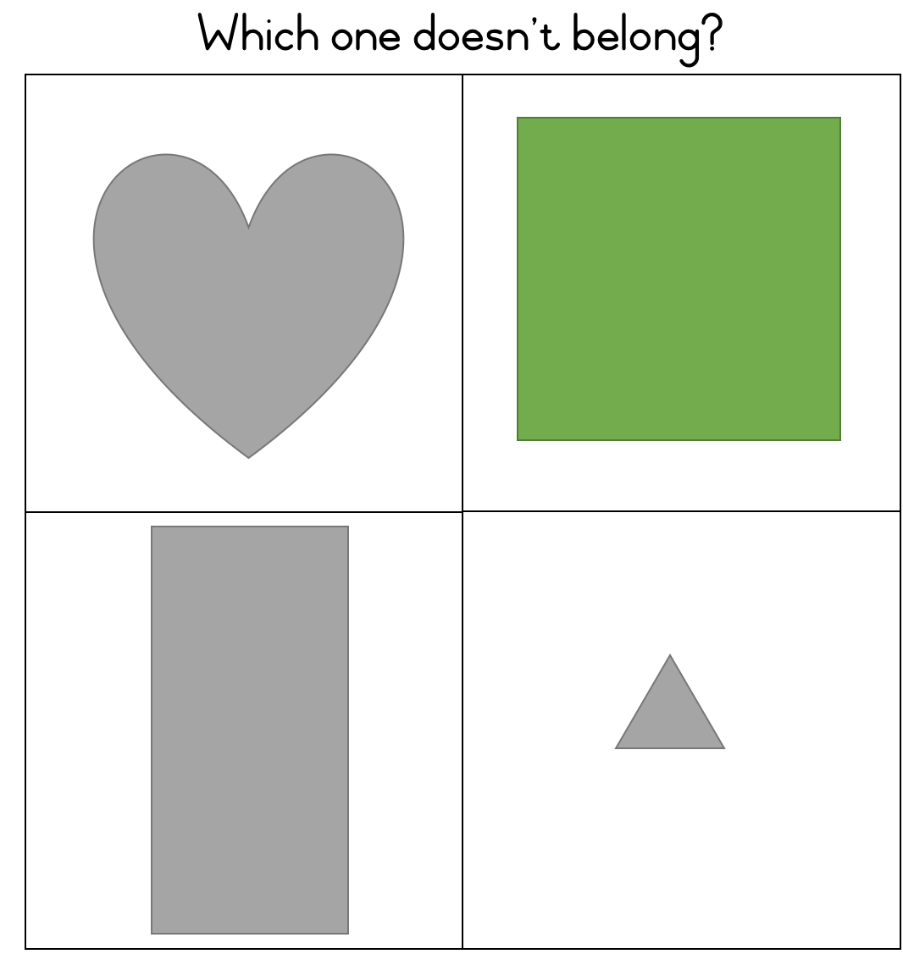
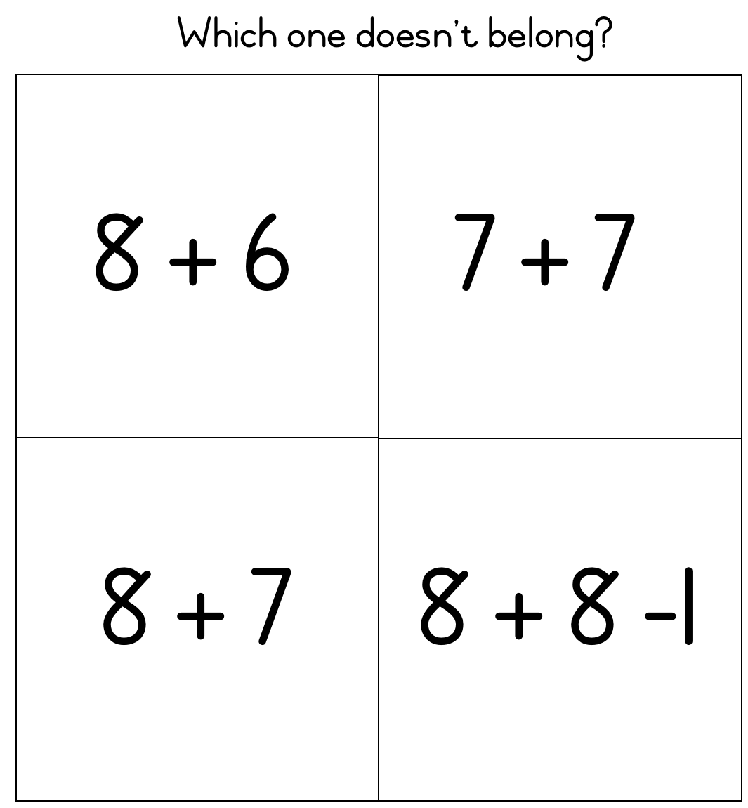
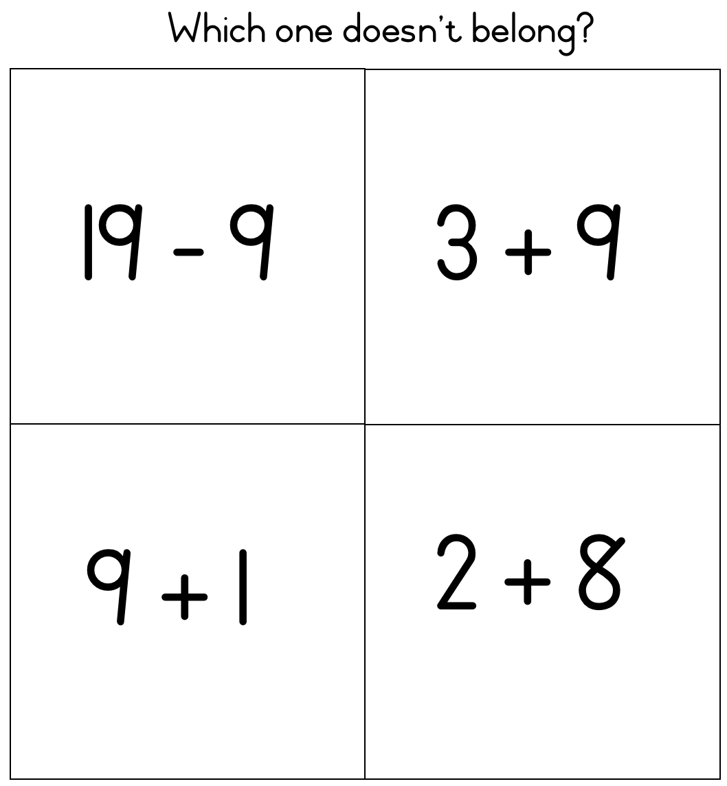
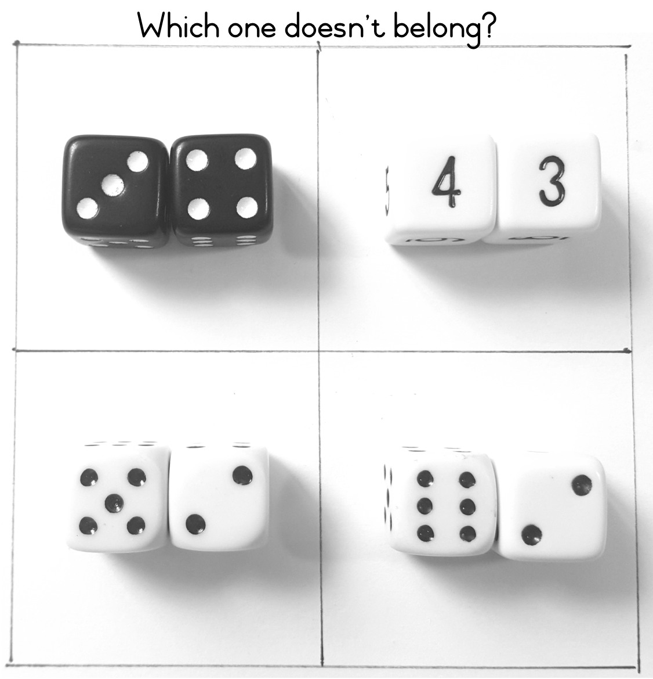
Other prompts

Slide 7
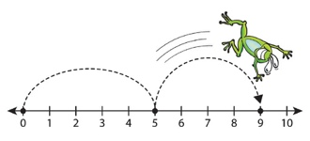
Group feedback: resources from session 8 & 9 Number Talks Structured & semi-structured number lines
Did you do any Number Talks with your class this month?
If so, what did you do?
How did you find the experience?
Did you learn anything about how your learners think?
Reflect on your experiences of using structured & semi-structured number lines.
Did you make any adaptations to the activities?
If so, show / explain to the members of your group.
What were the learner experiences of the activities?
Did you draw your number line in your school?
Did you find anyone to sponsor a permanent number line in your school?

Slide 8
We have seen there are many types of number lines
Closed
Beginning and end points
Open
Beginning point /no end point or vice versa
Structured
Defined partitions & labelled marks
Semi-structured
Some partitions and /or labelled marks
Empty
No points/marks

Slide 9
Linear representations of number
Regular use of a number line can help learners to form a mental number line
To help learners to calculate mentally
IMPORTANT
Start with:
→ BEAD STRINGS (session 7)
→ STRUCTURED NUMBER LINES (session 8)
→ Semi-structured number lines (session 9)
→ Empty number lines (session 10, this session)

Slide 10
Empty number lines
A tool for calculating by structuring
Develops good number sense
Visualise a mental number line in their heads for calculating with 2-digit numbers
Addition & and subtraction, later multiplication & division
Use and develop strategies such as:
Jumps of 10
Next friendly number (bridging through 10)

Slide 11
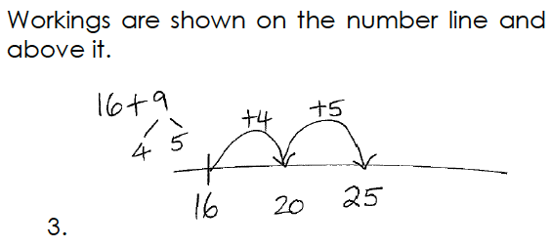
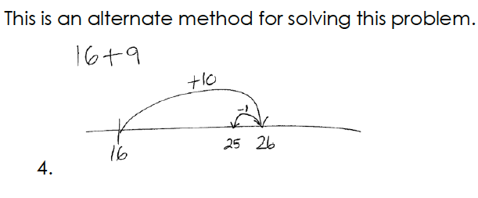
Solving 16 + 9 on an empty number line

Slide 12
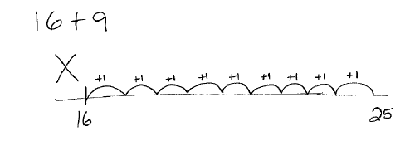
How many of your learners would try to solve it like this?

Slide 13
Before you work with empty number lines
Plenty of work with both structured and semi-structured number lines
Learners need to:
Know that they can put the larger number (as they do with counting on) first if it helps solve a problem
Add / subtract a multiple of 10 to or from any two-digit number up to 100 e.g.
Add 20 to 16 by counting on 2 tens
Recall addition and subtraction facts for all numbers to at least 10 e.g.
Knowing that 7 can be: 6 and 1; 5 and 2; 4 and 3 and so on
Know how many to get to the nearest 10 using their knowledge of bonds to 10 e.g.
Know that 6 must be added to 34 to make 40

Slide 14
What else do children need to know?
Children need to practise these skills and be confident with them before adding or subtracting using an empty number line.
Position a number on a semi-structured number line and explain their thinking (Session 9)
Jump to a number from zero in different ways e.g.
To jump to number 29, you could do two jumps of 10 and nine jumps of 1
OR
a jump of 20 and a jump of 9
OR
three jumps of 10 and a jump back of 1
OR
a jump of 30 and a jump back of 1

Slide 15
Strategies
Splitting
Jumps of 10
Next friendly number also known as bridging through 10

Slide 16
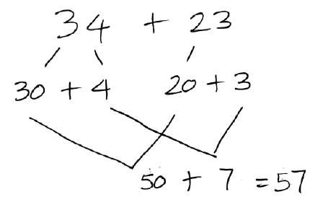
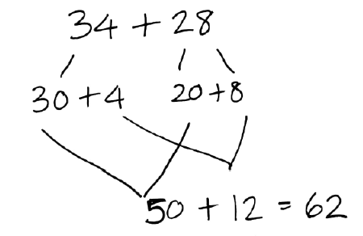
1. Splitting
Well-known strategy that works well for addition
What happens if we use this strategy to solve
34 – 28?

Slide 17
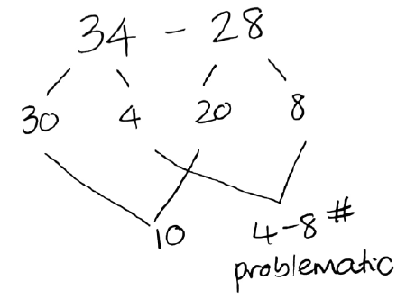
1. Splitting & subtraction
Try it using the splitting strategy!

Slide 18
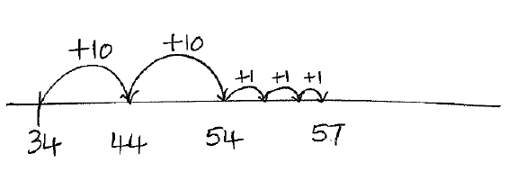
2a: ADDITION 23 + 34
JUMPS OF TEN
WITHOUT CROSSING A TEN
1 number is kept whole
Make jumps of 10 and then add the units
Makes sense for the whole number to be the larger number i.e. 34
You might try it like this first

Slide 19
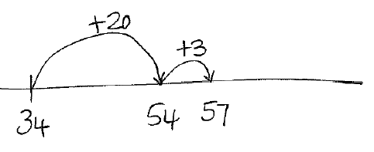
2a: ADDITION 23 + 34
JUMPS OF TEN
WITHOUT CROSSING A TEN
How could we use less jumps?
OR…

Slide 20
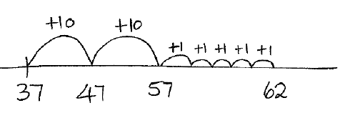
2b. ADDITION 25 + 37
JUMPS OF TEN
CROSSING A TEN
1 number is kept whole
Make jumps of 10 and then added the units
Makes sense for the whole number to be the larger number i.e. 37
You might try it like this first

Slide 21
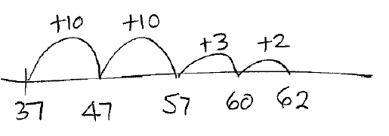
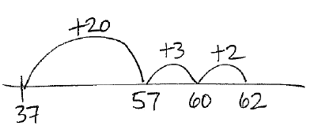
2b. ADDITION 25 + 37
JUMPS OF TEN
CROSSING A TEN
How could we use less jumps?
OR…

Slide 22
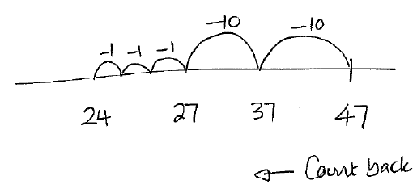
2c. SUBTRACTION 47 - 23
JUMPS OF TEN
WITHOUT CROSSING A TEN
1 number is kept whole
Make jumps of 10 and then subtract units
You might try it like this first

Slide 23
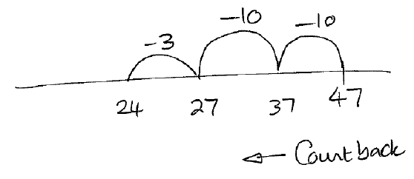
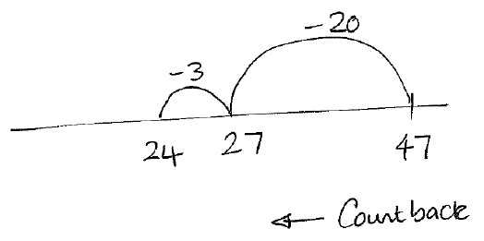
2c. SUBTRACTION 47 - 23
JUMPS OF TEN
WITHOUT CROSSING A TEN
How could we use less jumps?
OR…

Slide 24
2d. SUBTRACTION 42 - 25
JUMPS OF TEN
CROSSING A TEN
Try this one one your own
42 - 25
How might you do this to start with
Think about how you could do it in the LEAST amount of jumps

Slide 25
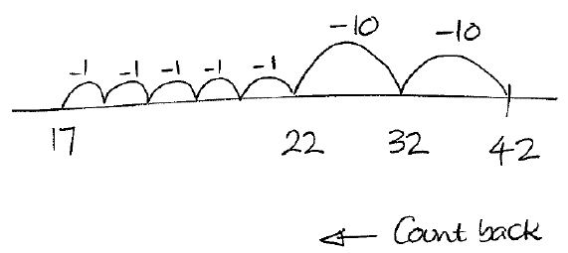
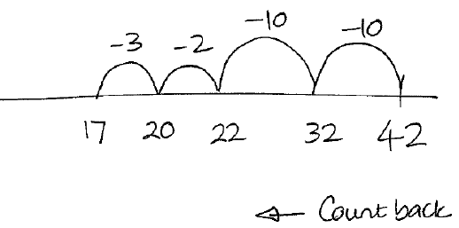
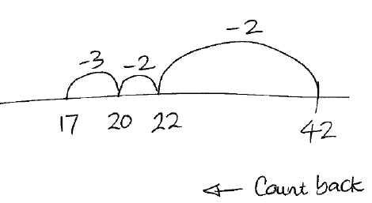
2d. SUBTRACTION 42 - 25
JUMPS OF TEN
CROSSING A TEN
OR…
OR…
0

Slide 26
3a. ADDITION 38 + 26
NEXT FRIENDLY NUMBER (BRIDGING THROUGH 10)
This is the opposite of “Jumps of 10” strategy
Work with units first and then the tens
Use the units first to jump forwards to the next friendly number (i.e. a decade number)

Slide 27
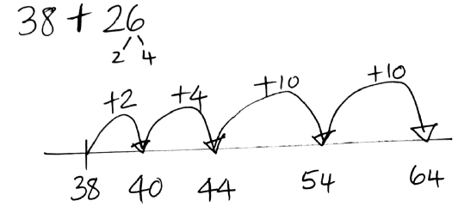
3a. ADDITION 38 + 26
NEXT FRIENDLY NUMBER (BRIDGING THROUGH 10)
Try it yourself first
Count forward to next friendly number which is 40 with a jump of 2.
The 6 is broken into 2 and 4.
A jump of 4 is next to 44
Then 2 jumps of 10 to 64

Slide 28
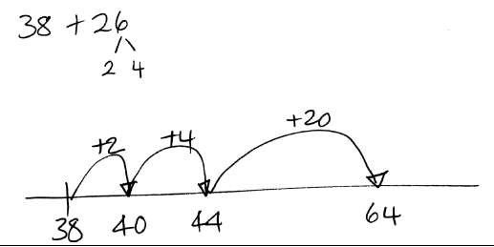
3a. ADDITION 38 + 26
NEXT FRIENDLY NUMBER (BRIDGING THROUGH 10)
How could we use less jumps?

Slide 29
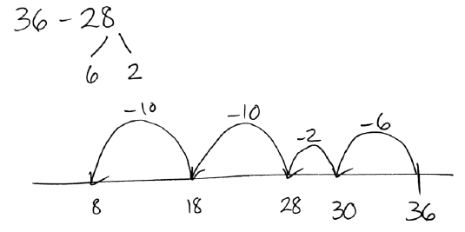
3b. SUBTRACTION 36 - 28
NEXT FRIENDLY NUMBER (BRIDGING THROUGH 10)
Try it yourself first
Count back to next friendly number which is 30 with a jump of 6.
The 8 is broken into 6 and 2.
A jump back of 2 4 is next to 28
Then 2 jumps back of 10 to 8

Slide 30
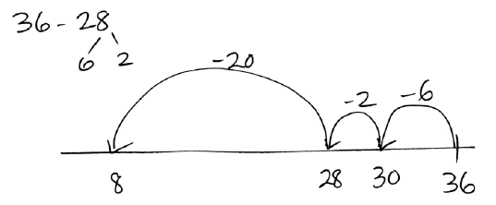
3b.SUBTRACTION 36 - 28
NEXT FRIENDLY NUMBER (BRIDGING THROUGH 10)
How could we use less jumps?

Slide 31
Think about these three different calculations:
130 – 17
130 – 118
130 – 49
How would you do them using the ENL?
Note: how this one has been worked
out using addition, not subtraction
Note: how this one has been worked
out using a jump of 50, and then adding 1

Slide 32
503 – 398 = ?
The numbers in this problem aren’t friendly
How could we estimate an answer?
How close is the answer to 100?
And do you think the answer is greater than 100 or less than 100?
How can we resolve this using an empty number line
Notes:
To trigger their thinking without focusing on the procedure they had learned I brought them to the rug, made sure each student had a partner, and wrote the problem horizontally on the board.
Making estimates is something I do regularly with students to give a ballpark solution against which they later can compare their answers. The students agreed that an easier problem to solve would be 500 – 400, which they knew was 100. I recorded this underneath.

Slide 33
Try these using empty number lines …
23 – 18
305 – 97
467 – 43
122 – 119
2014 – 1997
Compare your strategies with someone else at your table.
Discuss the similarities and differences in strategies.

Slide 34
One of the interesting things about using the empty number line is that it shows that we don’t all think the same way. The empty number line allows learners to see that there are many ways to solve the same problem.

Slide 35
Introducing the empty number line in the classroom
Step One:
Practice moving using the fewest number of jumps
Step Two:
Use the empty number line to calculate i.e. solve addition and subtraction problems
Model how learners solve addition and subtraction problems

Slide 36
You model learners’ thinking using the number line
Start using a semi-structured number line if you wish
Then move to hand-drawn lines
You model learner’s methods for the rest of the class
Learners start to use empty number lines themselves to solve problems

Slide 37
Sample teaching sequences Pages 27 and beyond

Slide 38
Teaching sequence: Addition
NEXT FRIENDLY NUMBER (BRIDGING THROUGH 10)
This example uses a semi-structured number line to solve this addition problem:
16 + 7 =

Slide 39
Teaching sequence
NEXT FRIENDLY NUMBER (BRIDGING THROUGH 10)
Record 16 + 7 = on the board
Ask: “Where is 16 on this number line?”
Get a learner to come and mark the line.

Slide 40
Teaching sequence
NEXT FRIENDLY NUMBER (BRIDGING THROUGH 10)
We have to jump 7 forwards.
Let’s make one jump to the next ten rather than jumping in 1s.
Ask: “What is the next ten after 16?”
Learners to answer.
Ask: “16 plus what gives 20?”
Learners to answer.
Record on the number line.

Slide 41
Teaching sequence
NEXT FRIENDLY NUMBER (BRIDGING THROUGH 10)
We have added 4. We need to add 7. 7 splits into 4 & what?
Learners to answer.
Split the 7 in 16 + 7 into 4 and 3
How many more do we need to add?
Learners to answer.
Record on the number line.

Slide 42
Teaching sequence
NEXT FRIENDLY NUMBER (BRIDGING THROUGH 10)
“What is 20 plus 3?”
“So, 16 + 7 = 16 + 4 + 3 = 23”
Record on the number line & number sentence

Slide 43
Teaching sequence
NEXT FRIENDLY NUMBER (BRIDGING THROUGH 10)

Slide 44
Teaching sequence
NEXT FRIENDLY NUMBER (BRIDGING THROUGH 10)

Slide 45
Teaching sequence: Subtraction
NEXT FRIENDLY NUMBER (BRIDGING THROUGH 10)
This example uses a semi-structured number line to solve this subtraction problem:
23 – 7 =
See pages 31 to 33

