Slide 1


eNICLE programme
Session 2
1st August 2017
Prof Mellony Graven; Dr Debbie Stott, Ms Carolyn Stevenson-Milln;
Ms Roxanne Long;

Slide 2
Community of co-learners
Who are we in the SANCP?
What is our brief?
Who are we accountable to?
Like NICLE this is a partnership of teachers, teacher educators, researchers, district/ provincial specialists to form a learning/inquiry community
Our joint enterprise: to all learn about how to support South African Grade Rs better and how to support teachers better (both pre and inset)
Resources are research informed and curriculum informed – experience of them and adaptations are teacher informed - concrete testing and trialling, discussion and sharing
Meet once per month – greatest resource will be our interactions

Slide 3
Suggested dates 2017
Tues 5th Sept (1:30 -4:30 pm)
Tue 17th October (1:30 -4:30 pm)

Slide 5
Big ideas: Whole-part-part (fact families), relating numbers to 5 and 10 | Instructional strategies | Count by 1s from 1 and other numbers (Fwd/Bwd) Making numbers (number facts & fact families 10,20..100) Skip counting in 5s and 10s addition and subtraction strategies such as counting on / counting back 1 more / 1 less (2 more ..) conceptual place value | Count by 1s from 1 and other numbers (Fwd/Bwd) Count by 10s, on and off the decade (Fwd/Bwd) Making 10 – flexible partitioning | Locating numbers in relation to other numbers | Jump strategies for 2-digit addition and subtraction
 | Progression | Counting all / by ones Counting on / counting down | Counting all / by ones Counting on / counting down |  | Progression from count by one strategies to more sophisticated strategies Encourage verbalisation and symbolic recording to encourage progression to more abstract thinking
 | Resource / representation
 | Information | Tactile, concrete resource to explore early number work and operations. Using the string can help to picture a number line in our heads. Good pre-cursor to work with number line | Linear representation of number Measurement model Lengths/proportions are important | Proportional reasoning | Counting model Visual representation for recording and sharing learners’ thinking strategies Presented without numbers or markers Not meant to be proportional Potential to foster development of more sophisticated strategies in learners
 | Notes and cautions |  |  |  | No, nos! Over regulation of the use of the ENL Providing pre-drawn lines with numbers Drawing neatly
 | Janette Bobis “The Empty Number Line”
Bead strings
Structured number line
Partial number line
Empty number line

Slide 6
Guiding assumptions
Active construction
Build on existing knowledge
Activities should be at ‘cutting edge’
Activities should encourage
  language development and learner talk
  story telling
  development of number sense
  learner progression in counting & EAS

Slide 7
Learning at the cutting edge
A teachers job is not to make all learning easy.
It is to help children rise to the challenges of learning and to enjoy the learning process with all the mistakes along the way

Slide 8
Progressive numeracy learning focus on Counting / Early arithmetic Strategies

Slide 9
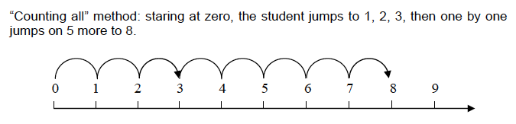
Learning to count / establishing how many
1
1st stage in learning to count
Also known as ‘perceptual counting’:
  counting objects that can be seen or touched
Children count from one
“one, two, three … four, five, six, seven, eight!”
Count All

Slide 10
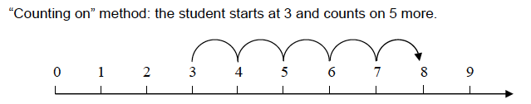
Counting on
2
Child can conceptualise at least one of the numbers without having to see it
Recreates the other number
children count on from one number
“three … four, five, six, seven, eight!”
Count On

Slide 11
Calculation by counting
Developing Advanced counting-by-one strategies - using screened objects
3
Count-up-from
  Example: 6 plus 3
  Six, ... seven, eight, nine, ... nine!
Count-up-to
  Example: 6 plus what equals 9 or 6 + ☐ = 9
  Six, ... seven, eight, nine, ... three!
Count-down-from
  Example: 9 take away 3
  Nine, ... eight, seven, six, ... six!
Count-down-to
  Example: 9 take away what equals 6 or 9 - ☐ = 6
  Nine, ... eight, seven, six, ... three!
Concealed objects:
  children find other ways to count using fingers or other representations
  Counting is no longer tied to the object, but to mental representations of the objects
Child pushed to work out how many items in two collections:
  one or both collections are screened from the child’s view
Tasks can be:
  additive (as in how many altogether)
  subtractive task (as in how many taken away or how many remaining when the number taken away is given)

Slide 12
Counting by structuring (1)
4a
Child begins to use strategies that work with the structure of numbers
Not related to counting up or down
Two common approaches:
  partitioning or splitting both numbers based on place value
  47 + 36
  40 + 30 = 70; 7 + 6 = 13; 70 + 13 = 83.
  sequencing or jump (of 10) method:
  47 + 36
  47 + 30 = 77; 77 + 6 = 83
Encourage the sequencing method
lends itself more readily to subtraction
For example:
83 – 47 as 83 – 40 = 43; 43 – 7 = 36

Slide 13
Counting by structuring (2)
Other strategies include:
  Using the structure and number facts of 5 and 10
  Doubles and near doubles
  Making friendly numbers
  Jump via 10
  Jump of 10
  Place value

Slide 14
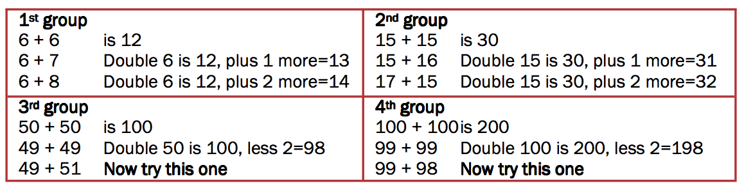
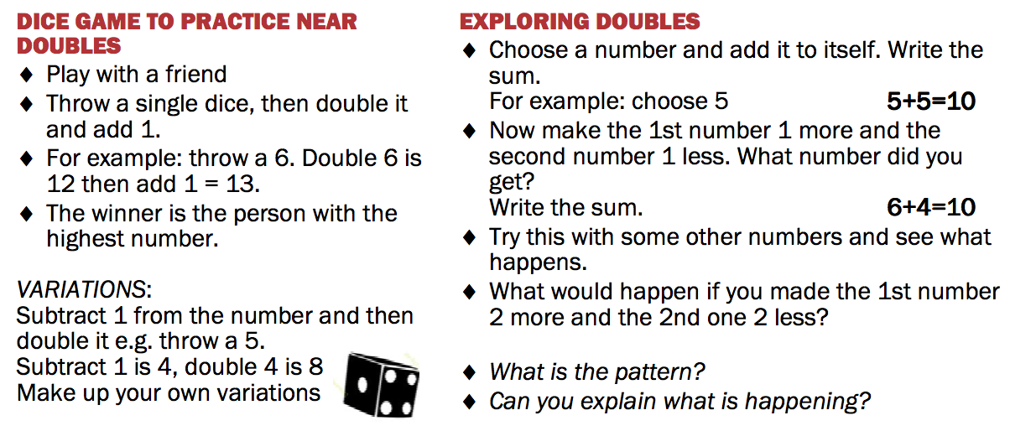
Near Doubles

Slide 15
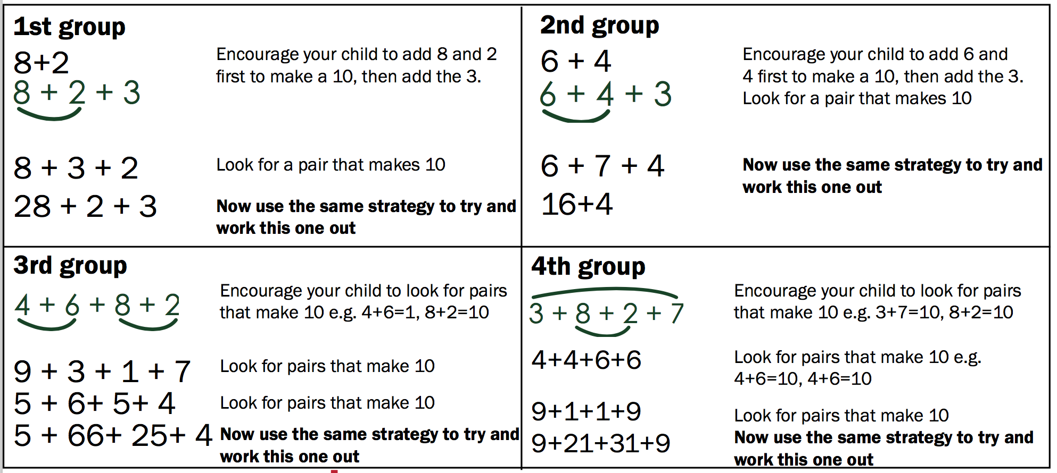
Making friendly numbers
Throw 1 dice ten times
Write each number that is thrown
Find ways to add the numbers quickly
Here’s an example for the numbers: 2; 3; 8; 6; 7; 2; 3; 4; 9; 1

Slide 16
Jump via 10

Slide 17
Formal calculating
4b
learner uses variety of different strategies to solve problems
using flexible calculation
learners able to do:
  some calculations mentally
  others noting down intermediate steps where necessary
Variety of strategies for addition & subtraction
No. relationships
What already learnt
Already understood
Without need for representations

Slide 18
Progression in other areas of numeracy learning

Slide 19
Key representations help to progression

Slide 20
Growth mindset
Research on mindsets overwhelmingly strong

Slide 21



Mindset posters for your classrooms

Slide 22
Cognitive control (Executive functioning)
Neurological research on executive functiong informs many activities we have chosen
3 key aspects – influence school readiness and performance more than IQ
  Working memory
  Inhibition
  Shifting attention

Slide 23
Example game for working memory
Here is a picture of 10 objects on a plate
You have 30 seconds to try to remember them without writing them down
How many can you remember?
Learners will use real objects that they bring from home
The game can be made harder by:
  More items
  Asking to remember colours, size, quantity…

Slide 25
Example game for Inhibition
Simon says – change to isiXhosa or Afrikaans
Play it

Slide 26
Examples for Shifting attention

Slide 28
How many ways can you sort a pack of cards?

Slide 29
‘I spy with my little eye’ activities
Work with a group of learners.
Each learner is given a specific object to find.
They have to remember the item they are looking for and when they find it to record it on scrap paper
  Grade R can draw it
  Grade 1 and 2 can try and write the object’s name
This can be done for different objects in succession on the same “I Spy” box
The objects can be arranged in many different ways
Other objects from around the classroom can be added:
  pencils, beans, counters, leaves, sticks, paper clips, anything and everything!

Slide 30

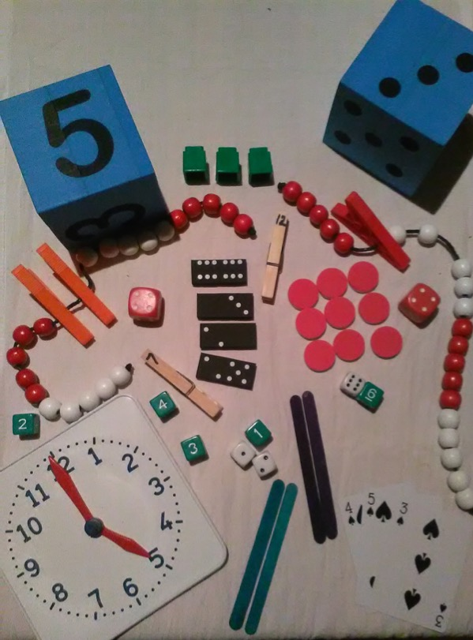
I spy…
  the number 5
  something green
  9 of the same thing
  the number 6
  something purple.
How many did you find?

Slide 31
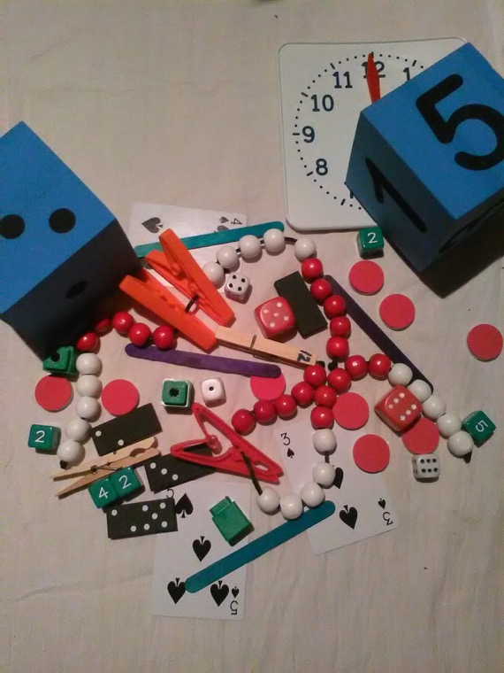
I spy…
  a bead string with two pegs on it
  a five and a two together
  something with two 3’s
  a 12 who is hiding
  something that when added together makes 6
  three things that make 12 altogether
  one less than 4
  one more than 4

Slide 32
‘Egg carton counting’ activities
Work with a group of learners in a circle or seated at a table.
Each learner receives an egg carton and enough counting objects (beans/pasta/beads/buttons etc)
Learners work individually.
They are expected to look at the visual number presented on the pegs and then place the correct number of items on top

Slide 33
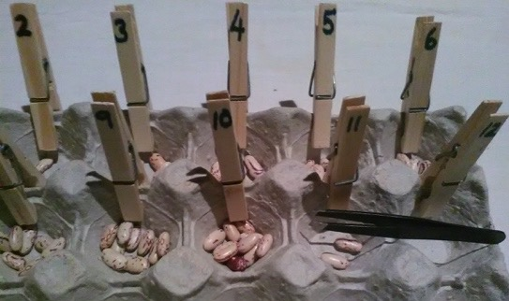
‘Egg carton counting’ activities
Name the numbers they see in their carton
Ask properties about them for example:
  What is one more?
  What is one less?
  What is half?
  What is two more?

Slide 34
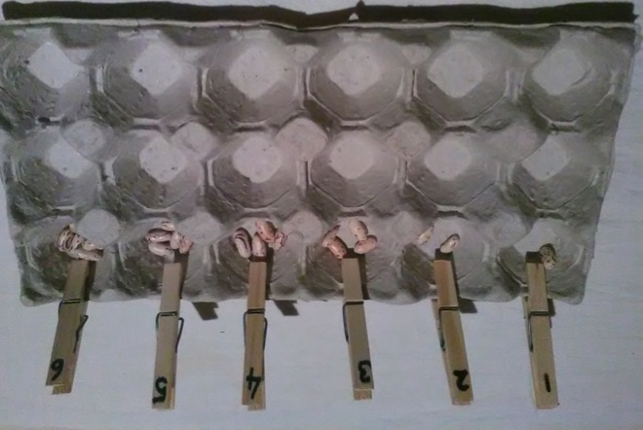
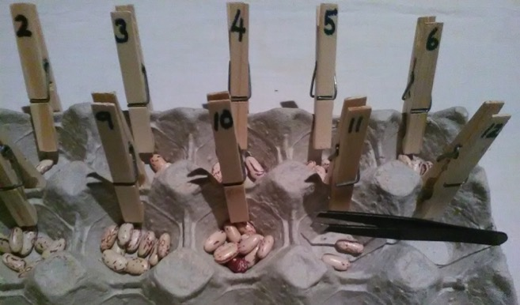
‘Egg carton counting’ activities
Matching objects (beans) to number symbols (up to 6)
  In numerical order
Matching objects (beans) to number symbols (up to 12)
  In numerical order, using tweezers to pick up beans

Slide 35
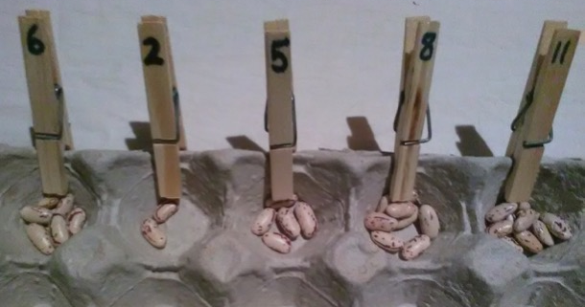
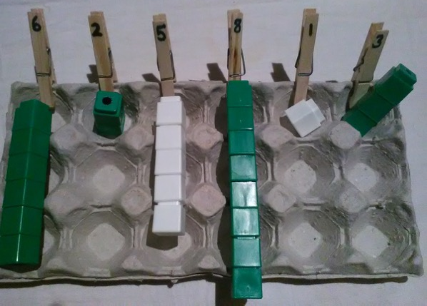
‘Egg carton counting’ activities
Matching objects (beans) to number symbols
  In any order
Matching other objects to number symbols
  Such as unifix blocks or counters

Slide 36
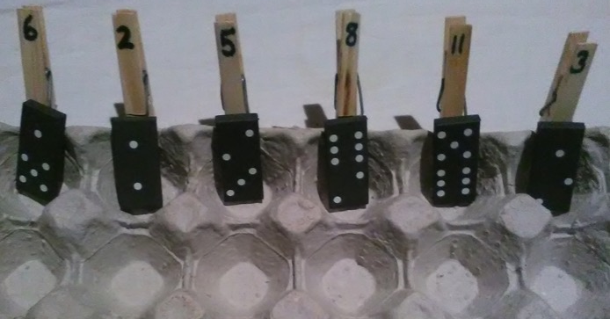
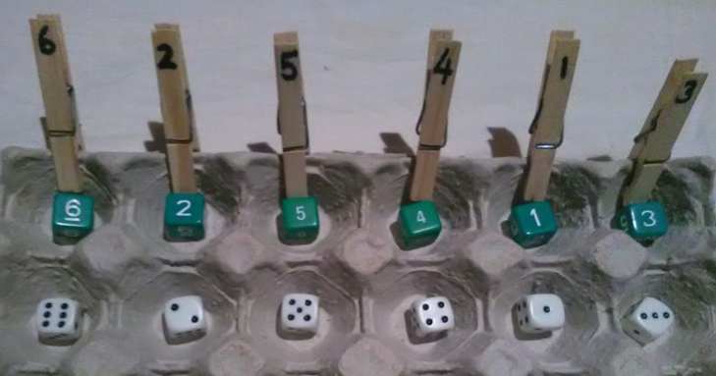
‘Egg carton counting’ activities
Matching dot patterns (dominoes) to number symbols
  Using dominoes
Matching dot patterns AND number symbols to number symbols
  Using dot pattern and numeral dice

Slide 37
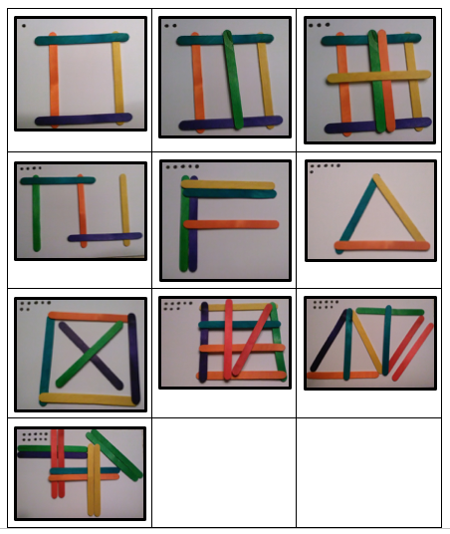
‘Copy Cat’ activities
examples of 10 possible picture combination that you can make with coloured lollipop sticks on your black boards, progressing from simple shapes to more complex ones

Slide 38
‘Copy Cat’ activities
Look at the example layout
Describe what they see and how they plan to copy the example:
  Can you see a shape (a cross, a square, a letter, a triangle etc.)?
  How many lollipop sticks do you need?
  Are they all flat or do they sit on top of each other?
  How will you copy this shape?

Slide 39
Self-evaluation by learners (with support from the teacher) after completion of the task
Ask learners:
  Is your picture the same as the example?
  If not, what is different?
    “Count the lollipop sticks and show me where each one is in your picture”
    “Show me where is the top and bottom of your picture”
    Is anything missing in your picture?

Slide 40

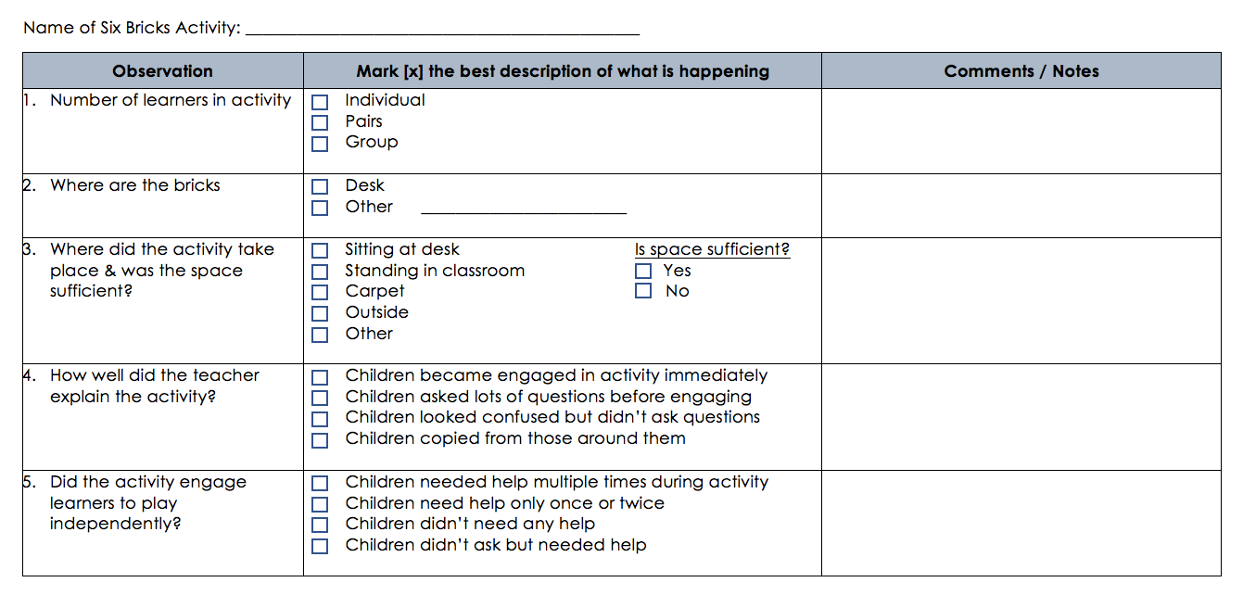

Slide 41
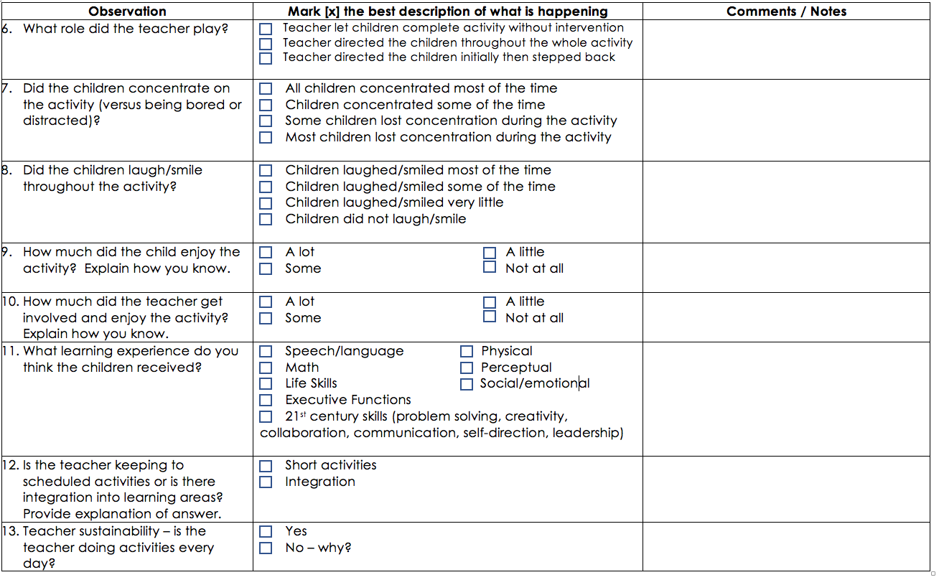

Slide 42
Six Bricks observations
In your school, from Grades R to 2
Decide
  when you will do the observations
    Before June 2018
  how many you will do of each other – suggest 2 observations per teacher
Carry out observations
  Return the forms to SANCP at your next session

Slide 43
Each month
Resources relating to each of the above aspects
Teacher handbook to build up into a library
This session resources have focused on those needed for assessment
  Focusing on learner progression is essential but can’t be done without individual assessment

Slide 44
Ongoing research about what we are learning
Our accountability involves us sharing what we are learning about how to strengthen Grade R learning with others at conferences and through research and publications
All schools and teachers names are anonymous
We are researching whether the support we are giving and bringing helps
For this we will draw on questionnaires, interviews (occasional), classroom visits and learner assessment forms
NOT assessing you as teachers – researching how key resources and activities may or may not be helping

Slide 45
Next month: 5th Septemeber
Assessment resources
First story based book

