Slide 1


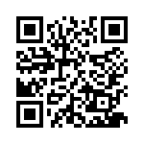
eNICLE
Grade 1 & 2 programme
Session 3
5th September 2017
Prof Mellony Graven; Dr Debbie Stott, Ms Carolyn Stevenson-Milln;
Ms Pam Vale; Ms Roxanne Long; Ms Samu Chikiwa

Slide 2
Group feedback on:
Session 2 activities
Get into groups of 3-5 teachers who are from a different school to you.
Reflect on your use of the following activities from the last session.
  Duplo (Six Bricks) activities
  Egg carton activities
  “I Spy” activities
  Waku-Waku game
Use these questions to guide your reflection and discuss:
  Have you tried the games/activities in your classroom?
  Explain - discuss
  How did you organise the children to play the games?
  Explain - discuss
  Were there any aspects of the activities/games that you adapted that you would like to share with the community?
  Explain - discuss
  Will you use the activity/game again? Why?
  Explain - discuss

Slide 3

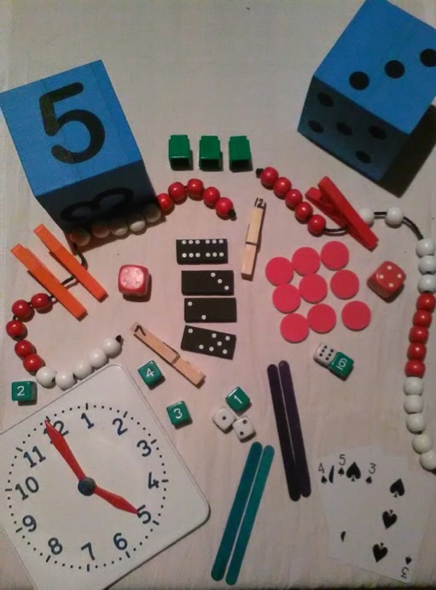
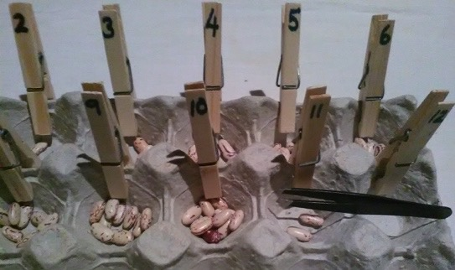
A reminder of activities from session 2
I spy….
Memory game
Egg carton activities
Simon
says…

Slide 4
Dialogical reading using number story books
(pages 12)
Progression foci

Slide 5
Number story activities: Key numeracy skills
(pg. 4)
Context bound counting and calculating
(1-5 in the first story; 1-10 in the 2nd)
Object bound counting and calculating
(1-5 in the first story; 1-10 in the 2nd)
Numeral recognition
(numerals 1-5 in the first story; 1-10 in the 2nd)
Compare quantities and develop language of more/ less/ many/ none
Develop comparative language for size – big and small; more and less
Recognition of words like ‘more’ ‘less’ ‘big’ ‘small’
Develop a patterned / structured sense of bonds
(i.e. 5-0; 4-1; 3-2; 2-3; 1-4; 0-5 and bonds to 10 – 2nd story)

Slide 6
Number stories – key literacy skills
Love of stories and reading
Listening and prediction skills
Comprehension skills
Develop comparative language for size:
  big and small; more and less
Common word recognition:
  ‘more’ ‘less’ ‘big’ ‘small’
Imagination and own story telling
Logic, structuring and organisation of ideas

Slide 7
Method
(pg. 4)
Focus on pictures, numerals and words and speak the key words and number names as the story unfolds
Act out with facial expressions emotions and feelings communicated in the story
Have a conversation with the reader
Predict what might happen next
Tell their own stories using story-boards and puppets
Tell their own stories using their fingers to represent the number of monkeys/frogs/children in different trees/lily pads/places etc.
Do imitative reading where they ‘read’ the story to others in the class

Slide 8
Piloting and demonstration
Method was piloted with 3 learners in an after care centre
Piloting with a small group of learners first can help to adapt you method and needs to the learners in your class
Today we have 3 learner volunteers to share with you a demonstration of using the books
Of course each situation will be different according to your learners input but we hope the demonstration illuminates some aspects of the method

Slide 9
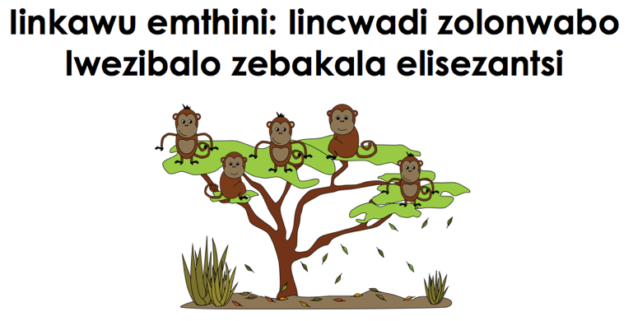
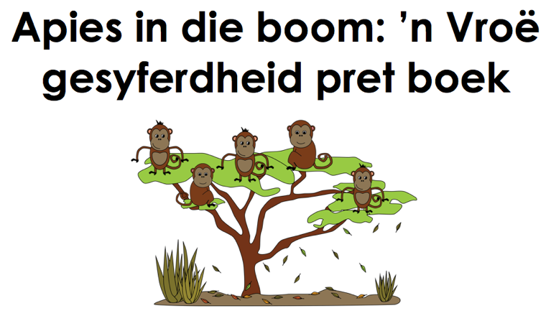
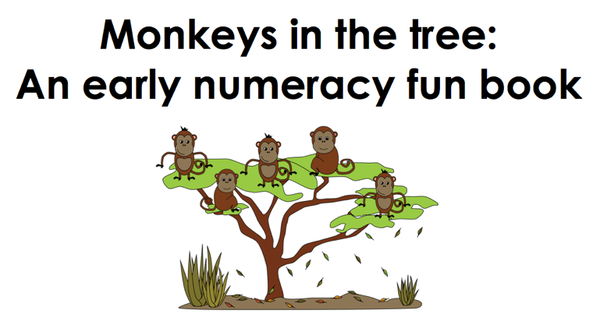
isiXhosa
Afrikaans
English

Slide 10
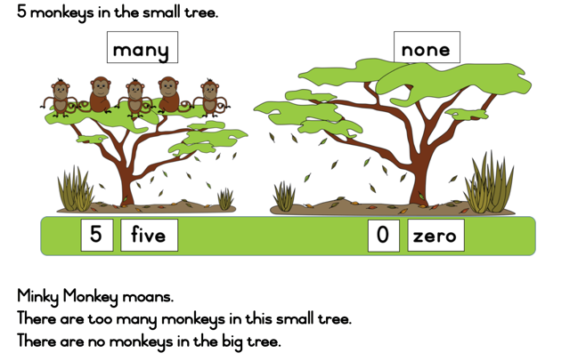
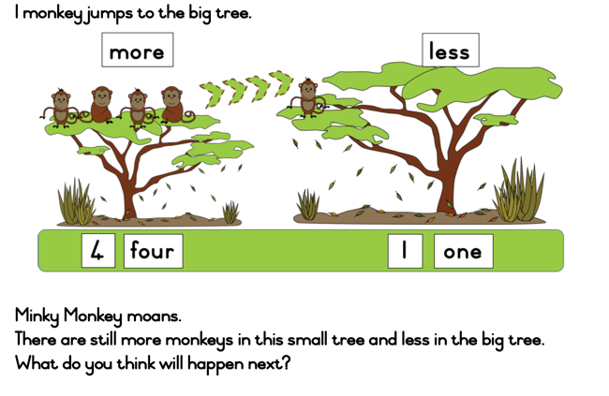
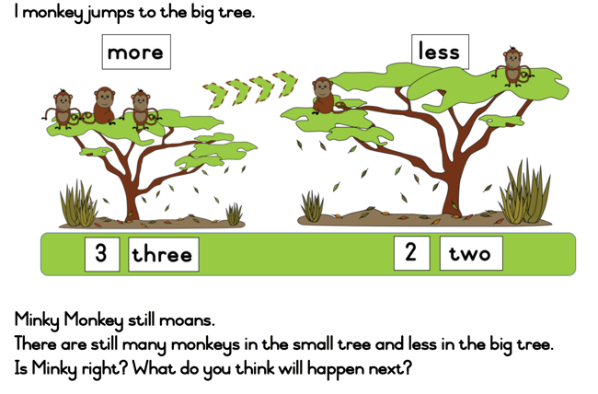
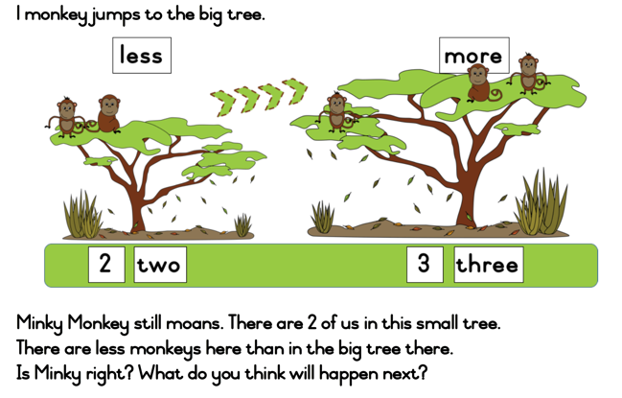

Slide 11
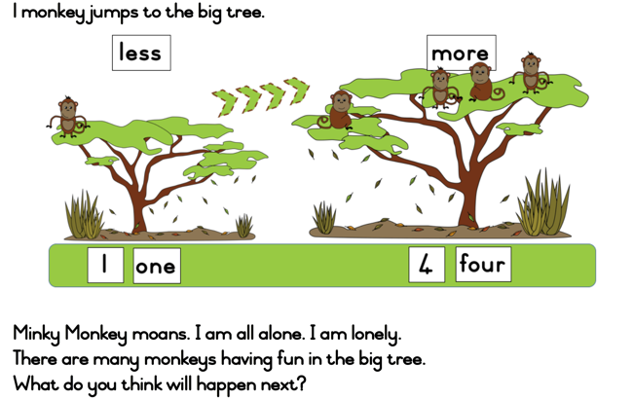
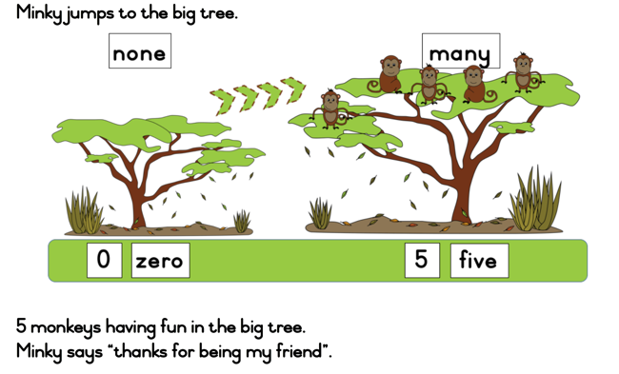
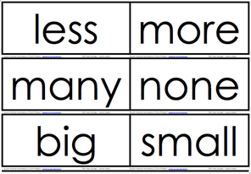
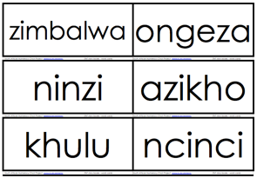
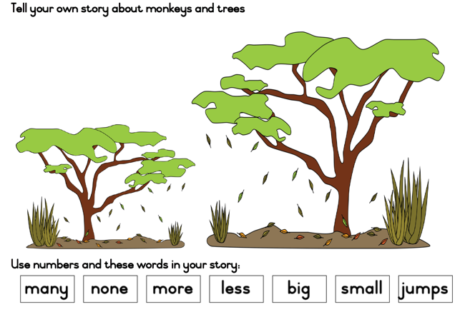
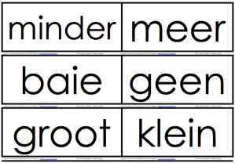

Slide 12
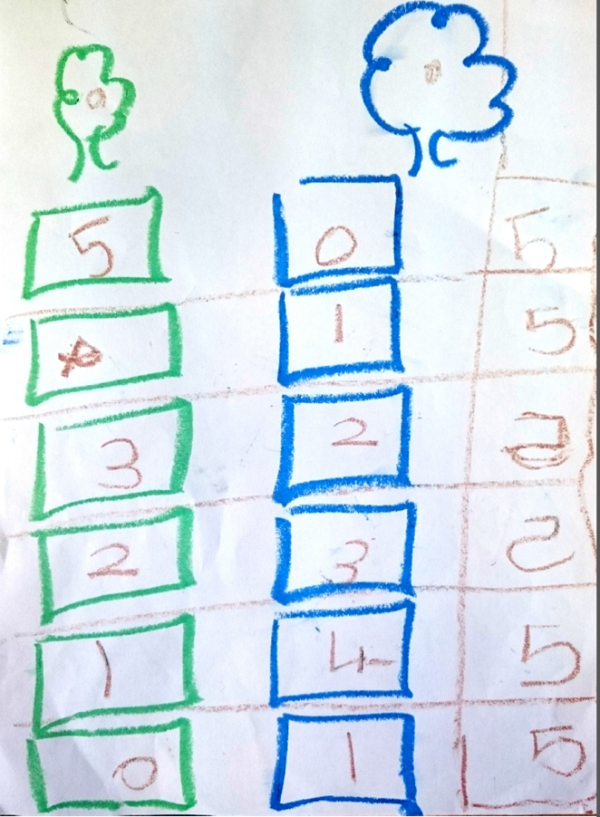
Example extension activity

Slide 13
Reflection and possible adaptations
Based on what you saw in the reading demonstration discuss the following:
  What numeracy skills were being developed?
  What other skills were being developed?
  What would you do differently with your learners? Explain.

Slide 14
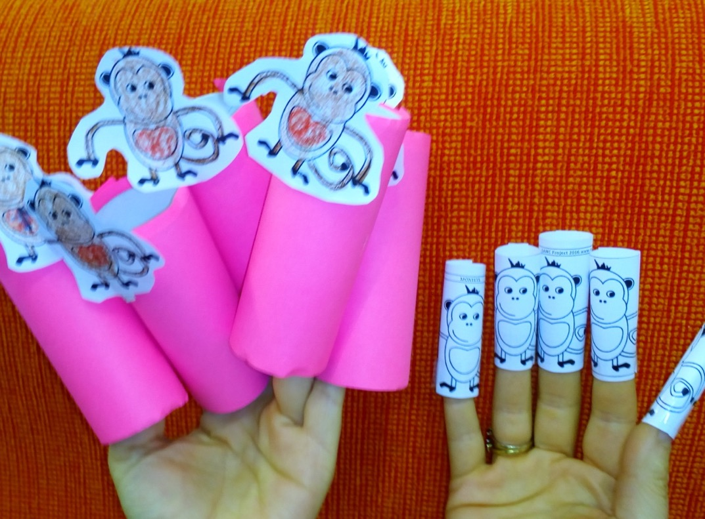
Creative activity – Making finger puppets
(pg. 22)

Slide 15
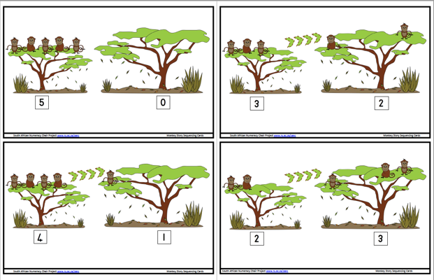
Supplementary 5 Monkeys in the Tree activities
Sequencing cards (page 19)
Skills
  Ordering and sequencing in a logical way
  Working with the ordinal sequence
  Reinforcing mathematical concepts from the story
  Encourages language development
  Encourages learners to express their thinking

Slide 16
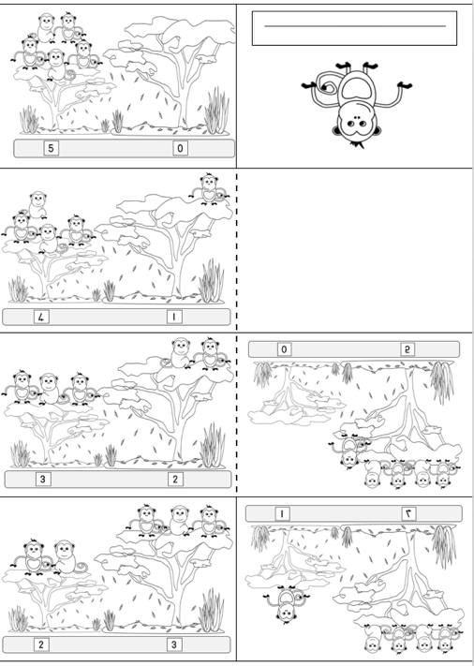
Supplementary 5 Monkeys in the Tree activities
Mini-folded books (page 20)
Skills:
  Listening
  Fine motor skills (in the folding and colouring process)

Slide 17
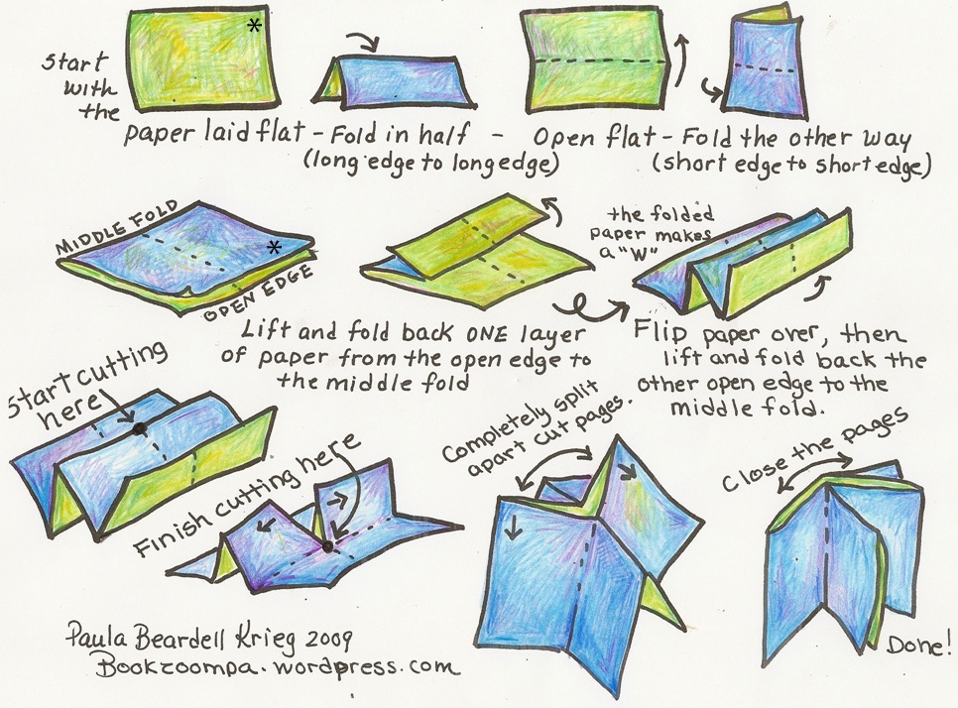

Slide 18
Assessments for progression in Grade 1 and 2
The assessments
  are formative
  help you establish where your learners are in their mathematical learning
  how to encourage them to progress
Remember, not all children will be able to do all the tasks, this is the point of the assessment.
The assessments assess a variety of concepts:

Slide 19
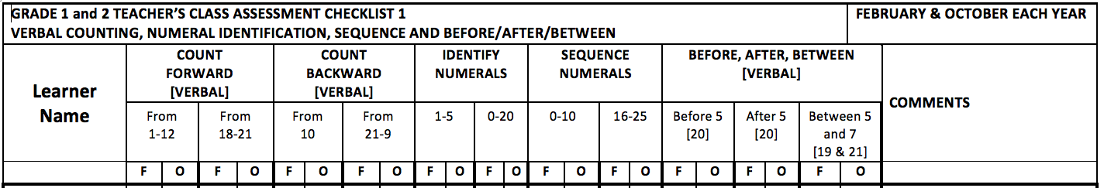
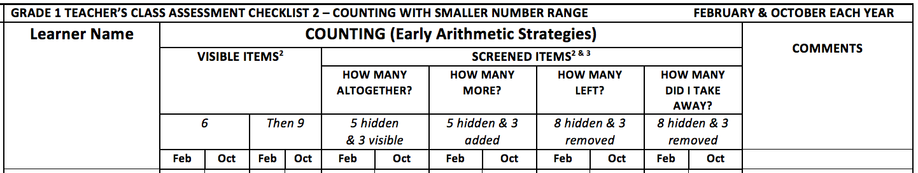
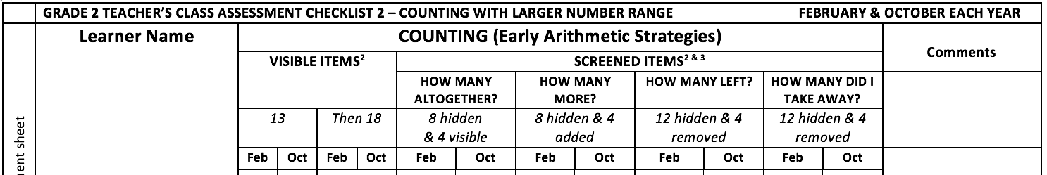
Assessment schedules
Grades 1 & 2: Verbal counting, number identification and sequences, before/after/between
Grade 1: Counting strategies
Tasks
Months
Grade 2: counting strategies

Slide 20
Assessment: Preparation
(pg. 11)
Photocopy the assessment sheets for yourself. You have master copies in your folders.
Assemble the resources needed for the assessment onto a tray or into a box:
  Counters (approximately 20)
  A piece of paper or card to screen counters
  Small numeral cards
  Clipboard / something hard to lean on
  Pen or pencil
  Place assessment schedule on clipboard and write down the learner names

Slide 21
Assessment: Administering
(pg. 11)
Suggest that you can do these assessments with children on a one-to-one basis.
  selecting 3 of your strongest learners,
  3 of your average learners,
  3 of your weakest learners.
  This should give you a general indication of the abilities of the class as a whole.
  Assess the same 9 children in March and again in October.
Find a spot in the classroom where you can work with one learner on the mat or at a desk.
  Bring your tray of assessment resources to that spot
  Bring learners to the spot where you will be asking them the questions
Fill in the assessment schedule according to learner responses

Slide 22
Assessment: Administering for 2017 / 2018
(pg. 11)
Suggest:
  Try out the assessment with 3 learners to get the idea of how it works
  Feed back to us in next session (October)
2018:
  Administer for 9 learners in March
  Administer for same 9 learners in October
  Using same sheet for Feb and Oct

Slide 23
Instructions for each task:
What to observe for each task
What to record on the sheet
What to say to the learner in [ ] and italics e.g. [WHAT NUMBER COMES BEFORE 5?]
How to determine where the child is on the spectrum

Slide 24
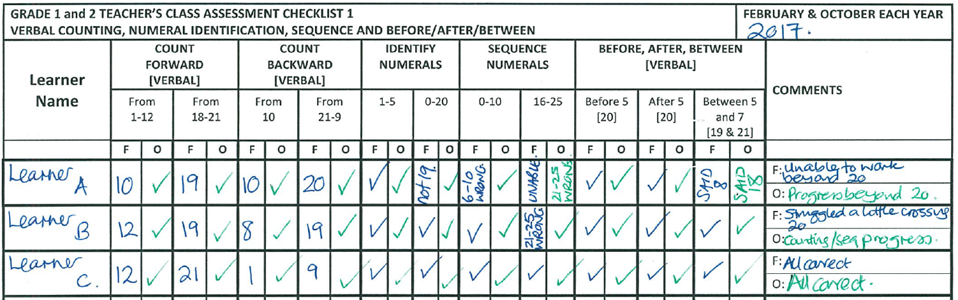
Assessment: Sample completed schedules
One:
weak,
average
strong
learner
Blue: Feb observations
Green: Oct observations
Task observations

Slide 25
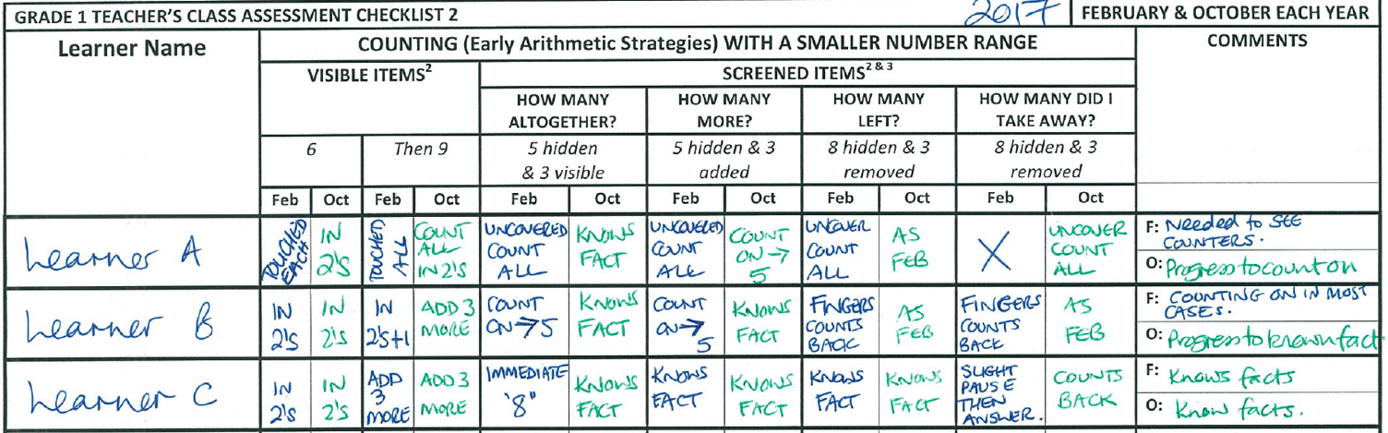
Assessment: Sample completed schedules
Sample observations

Slide 26
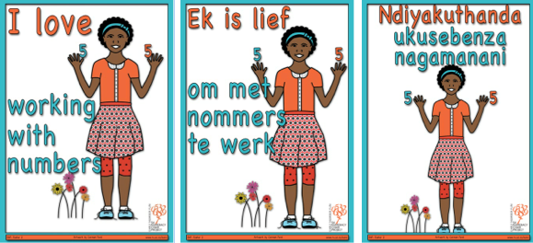
Next mindset poster for your classrooms
(pg. 10)

Slide 27
Love of learning – love of numbers
(pg. 10)
As you put this poster up, you could have a discussion with the learners about this.
Perhaps you and your class could think of a name for this girl such as Busi
Ask the learners:
  “How many fingers does Busi have up?”
  “How many fingers on one hand?”
  “Can you show me the same number of fingers as Busi?”
  “How do you think Busi uses numbers in her life?”
  Why do you think Busi loves working with numbers?”
Ask the learners:
  “Do you love working with numbers?”
  “How do you use numbers?”
Point out the ‘5’ number symbol above her hands
Ask the learners to count the flowers and talk about their colours
Talk about Busi’s positive attitude and ask the learners to read along as you point to the words “I love working with numbers”.

Slide 28
Ongoing research about what we are learning
Our accountability involves us sharing what we are learning about how to strengthen Grade 1 & 2 learning with others at conferences and through research and publications
All schools and teachers names are anonymous
We are researching whether the support we are giving and bringing helps
For this we will draw on questionnaires, occasional classroom visits and learner assessment forms
NOT assessing you as teachers – researching how key resources and activities may or may not be helping

Slide 29
Next month: 17th October
Next month’s session – Tuesday 17th October
Travel well and we are really excited to be partnering with you all!

