Slide 1


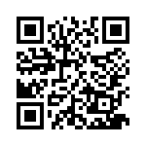
eNICLE
Grade 1 & 2 programme
Session 4
17th October 2017
Prof Mellony Graven, Dr Debbie Stott, Dr Pam Vale, Ms Carolyn Stevenson-Milln, Ms Roxanne Long, Ms Samu Chikiwa

Slide 2
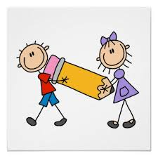
Group feedback on:
Session 3 activities
Get into groups of 3-5 teachers who are from a different school to you.
Reflect on your use of the following activities from the last session.
  Assessment activities
  Monkeys in the tree story books and related activities
  Growth mindset posters
Use these questions to guide your reflection and discuss:
  Have you tried the games/activities in your classroom?
  Explain - discuss
  How did you organise the children to play the games?
  Explain - discuss
  Were there any aspects of the activities/games that you adapted that you would like to share with the community?
  Explain - discuss
  Will you use the activity/game again? Why?
  Explain - discuss

Slide 3
How?
Learners need a sound base of quickly known or quickly derived number bonds
The ‘sevenness’ of seven becomes visible as a structure by visually seeing five (undivided) finger on one hand and tow on the other. This offers an opportunity to develop a part-whole relationship. Structuring numbers promotes number sense whereas counting single objects could lead to math-difficulties
(Runesson and Kullberg 2010, p.4).

Slide 4
Part-part-whole model
Children can count meaningfully by counting out a certain number of objects
BUT: Nothing in counting a set of objects
to cause a child to focus on the fact that it could be made of two parts
For example, 8 counters could be separated into two piles such as 2 and 6 or 7 and 1 or 4 and 4 and so on.

Slide 5
Part-part-whole relationships
Helpful for thinking
about the structure of numbers
about the relationships between numbers
about the relationship between addition and subtraction
“Probably the major conceptual achievement of the early school years is the interpretation of numbers in terms of part and whole relationships. With the application of a Part-Whole schema to quantity, it becomes possible for children to think about numbers as compositions of other numbers.”
(Lauren Resnick, 1983).

Slide 6
Part-part-whole is DYNAMIC
8
7 | 1
8
6 | 2
8
5 | 3
and more…
Part A + Part B = Whole (7 + 1 = 8) | Whole – Part A = Part B (8 – 7 = 1)
Part B + Part A = Whole (1 + 7 = 8) | Whole – Part B = Part A (8 – 1 = 7)

Slide 7
8
7 | 1
Aim
  To write down all the equivalent number sentences for any addition or subtraction fact
If 7 + 1 = 8 then the following are also true:
7 + 1 = 8 1 + 7= 8 8 – 7 = 1 8 – 1 = 7 | 8 = 7 + 1 8 = 1 + 7 1 = 8 - 7 7 = 8 - 1
  4 more number sentences can be written to help understand EQUAL SIGN as relational
  The 4 most common number sentences

Slide 8
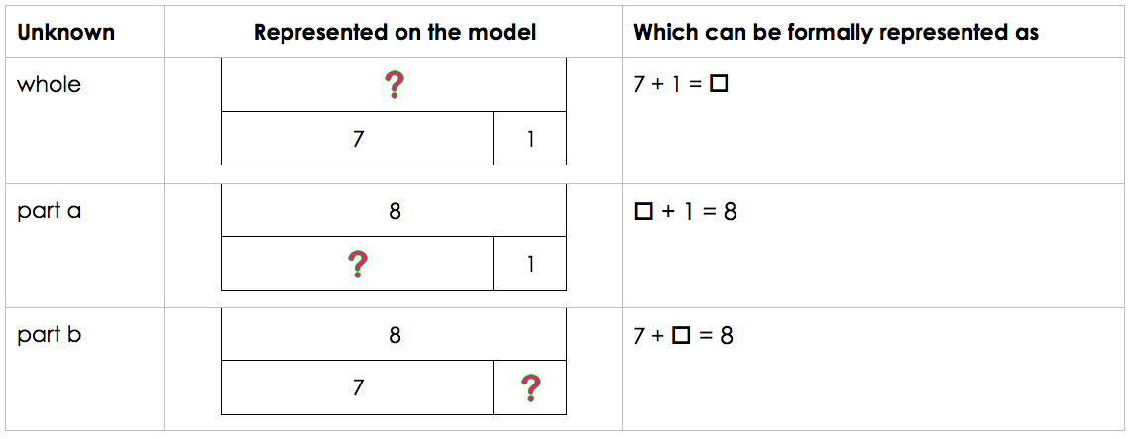
Missing parts
(shifting the unknown)
  NOTE:
  the position of the UNKNOWN / MISSING PARTS
  Represented with □ in number sentence

Slide 9
Part-part-whole summary

Slide 10
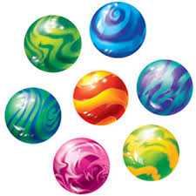
Introductory story:
Siya and the marbles
Today I want to tell you about a boy named Siya, who loves to play marbles with his friends at school. Every day, Siya puts his 7 favourite marbles in the front pockets of his school trousers so that he remembers to take them to school. On some days, Siya puts all his marbles in one pocket. And on other days, he puts all his marbles in the other pocket. Most of the time, he uses both pockets and puts some marbles in each one.
Work out how many different ways you can tell stories about Siya and his marbles.

Slide 11
Part-part-whole activities:
Stories
There are several ways of developing these stories over a number of days / lessons:
Day one:
  Learners work alone or in pairs to model this with concrete objects (counters, stones etc.)
  Encourage them to draw or represent all the different ways they find.
  After some time, ask learners for contributions.
  Write these on the board.
  Ask if any have been left out.
Day two / three:
  Use the same story, but use a different number of marbles e.g. 9, 11
  Repeat the above process
Day four:
  Introduce the learners to the part-part-whole model using the first story as an example.
  Learners then draw rough models to show how the marbles can be distributed (still using counters if necessary).
  At some point, push the learners to try and work without the counters
Days five / six / seven and beyond:
  continue using the model and the story as context for exploring other numbers in the range 7 to 12, or in Grade 2 in the range 1 to 20.

Slide 12
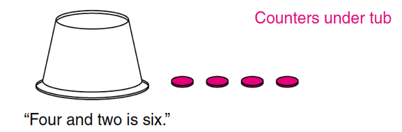
Part-part-whole activities:
Missing parts
COVERED PARTS
Work in pairs or with the teacher
Count out a number of counters e.g. 6
Ensure all learners agree with the count
One child places all the counters under a plastic container or piece of paper
Some of the counters are then pulled out to be visible e.g. 4
The other child must say how many are hidden to make the target number
For example: “Four and two is six”
Encourage the children to share their reasoning:
For example: “There were six, I can see four, so there must be two hidden”
If the child does not know the hidden part, then it can be shown by lifting the screen

Slide 13

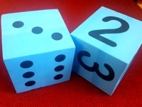




Part-part-whole activities:
Games
I WISH I HAD… 6
Hold up less than six fingers i.e. 4
  Say “I wish I had 6”
Children think about what part is needed to make 6
  i.e. 2 more needed to make six
Encourage learners to say:
  “4 and 2 make 6”
Staying with the number 6:
  repeat above steps
  hold up a different number of fingers each time
  e.g. 2; 3; 5; 1 and so on
  Can also use blue dice

Slide 14
Equivalence and the equals sign
Learners interpret the equal sign as an operational symbol meaning “find the total” or “put the answer”
BUT: is a relational symbol of mathematical equivalence
Means “equivalent to” and is crucial for later work in algebra
For example
  6 + 4 = 10
  10 = 6 + 4
  5 + 5 = 6 + 4
Empty box problems (missing parts) and the part-part-whole model support the development of this
Altering where the equals sign is placed develops fluency and flexibility
The Equal Sign
Means “equivalent to”
Crucial for later work in algebra

Slide 15
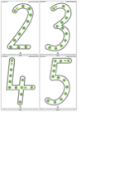
Number Symbol Reversals
Common for pre-schoolers, Grade R and 1 learners to reverse letters and numbers
By 7 children should only be making occasional reversals
Making reversal errors hinders learner’s progression in reading, numeracy and general academic performance and often show:
  poor visual-motor skills
  a tendency towards poor visual perception

Slide 16
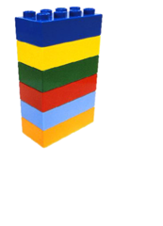
Number Symbol Reversals
BODY AWARENESS AND DIRECTIONALITY
Important to get children familiar with their right and left hand and other body parts to increase their body awareness, sense of directionality and to assist with written reversals of numerals.
For example:
  Show me your right hand/ show me your left hand/right leg/left leg/right ear/left ear etc.
  Also encourage children to identify the parent/teacher’s left hand/right hand etc.
How You Can Help:
These Six Bricks activities are particularly useful:
  Good Morning High Five!
  Listen & Do
  Tricky Towers
  Topsy Towers
  Refer to the Six Bricks teacher handbook for information on these
Forwards
Backwards
Up
Down
Over
Under
Left
Right

Slide 17
Number Symbol Reversals
7 / 9 / 3 | These are the most difficult numbers to recognise
2 / 3 / 7 | Numbers which should start at the top and in which the initial direction of movement in writing the number is to the right can be most problematic.
5 | The number 5 depends on the way a child forms the number. Learners who consistently reverse the number 5 are the ones who start forming it by beginning at the horizontal line at the top, rather than by beginning with the vertical stroke.
6 / 9 | These tend to be reversed because learners often confuse these numbers with the letters b / d and q / p which appear to look the same, and thus cause confusion in letter writing as well.

Slide 18
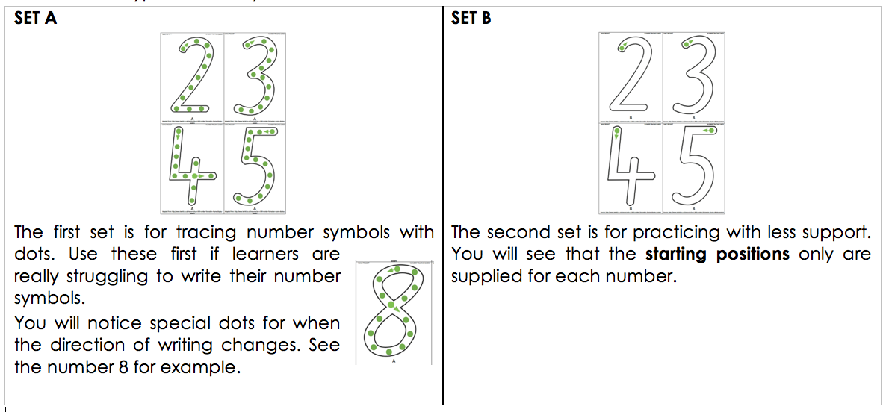
Two types of activity

Slide 19
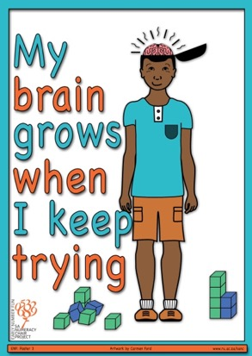
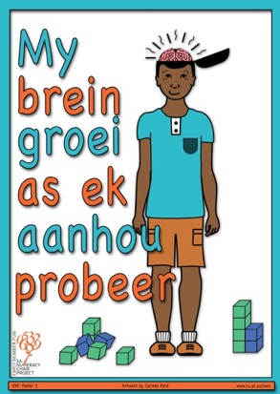
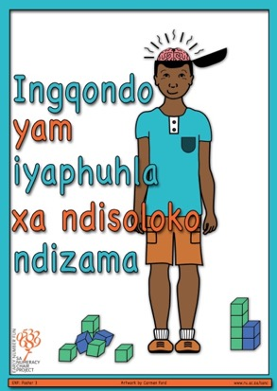
Next mindset poster for your classrooms
(pg.23)

Slide 20
My brain grows when I keep trying
(pg. 23)
As you put this poster up, you could have a discussion with the learners about this.
Perhaps you and your class could think of a name for this boy such as Thabo
Refer the learners back to poster one: My brain grows when I think hard
Remind them about revisiting mistakes and grappling with it because the brain grows from the experience of struggle. When learners struggle with mathematics, their brains grow.
Being outside their comfort zone is important and learners must develop to resilience in the face of unfamiliar challenges.
The harder you work at something, the more you keep trying, the better you will be at it.
Ask the learners:
  How do you get better at sport (running, swimming, or some other sport they are familiar with)?
  How do you get better at throwing and kicking a ball?
Point out that the important thing is to ‘practice’ and keep trying.
Ask the learners:
  What do you think Thabo is trying to do in this picture? Gather some ideas
Talk about Thabo’s positive attitude and ask the learners to read along as you point to the words “My brain grows when I keep trying”.
Look up and watch the following Jo Boaler YouTube clips on how the brain grows when we make mistakes
Jo Boaler: The Brain Science On Growth Mindset: https://www.youtube.com/watch?v=s4xqzgBy-lM
How you can be good at math, and other surprising facts about learning | Jo Boaler | TEDxStanford https://www.youtube.com/watch?v=3icoSeGqQtY

Slide 21
Cognitive control
Focus on FINGER DIFFERNTIATION
(pages 8 & 9)
Build finger differentiation
  important for developing numerical and visual mathematical understanding
Skills:
  Inhibition and shifting attention
  Colour differentiation
  Descriptive vocabulary such as up, down, left, right, curved, straight, around

Slide 22
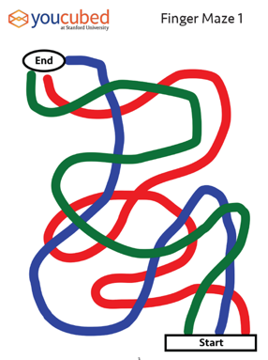
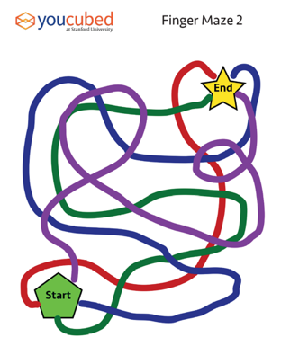
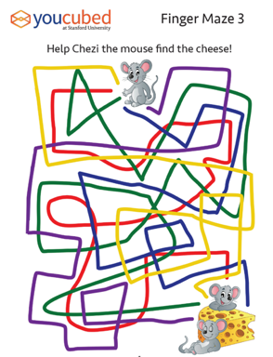
Finger Differentiation
Put a coloured dot on each child’s fingernail as shown in the diagram.
Have the child match their red index finger to the red path in the maze and slowly trace the path to the end. Help the child focus on the path and not speed along.
Each path should be traced slowly and take several seconds.
Next trace the green path with the matching finger.
After a child uses their dominant hand to trace all of the paths in the maze ask them to use their other hand.
Starter maze
Once mastered
move onto →
Slightly more
difficult maze
Once mastered
move onto →
Most
difficult maze

Slide 23
Number stories – key literacy skills
Love of stories and love of reading
Listening and prediction skills
Comprehension skills
Develop comparative language for size:
  big and small; more and less; same and equal
Common word recognition:
  ‘more’ ‘less’ ‘big’ ‘small’ ‘same’ ‘equal’
Imagination and own story telling
Logic, structuring and organisation of ideas

Slide 24
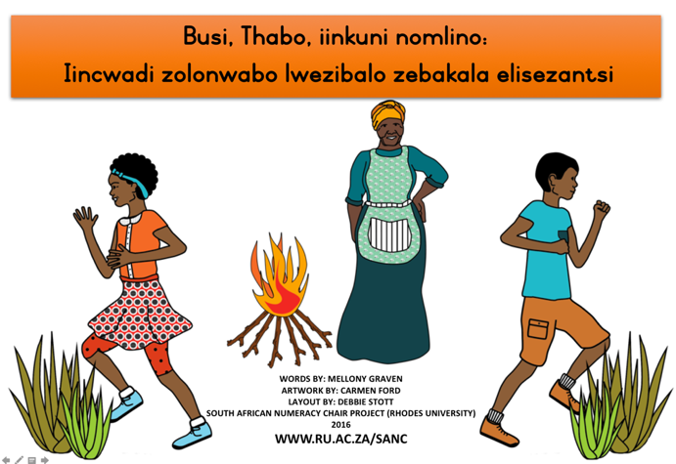

isiXhosa
Afrikaans
English

Slide 25
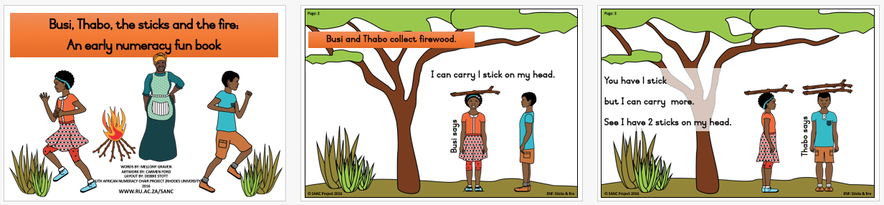
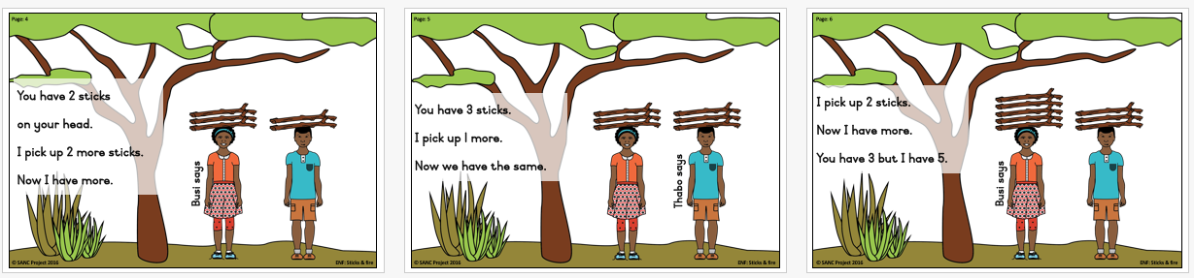
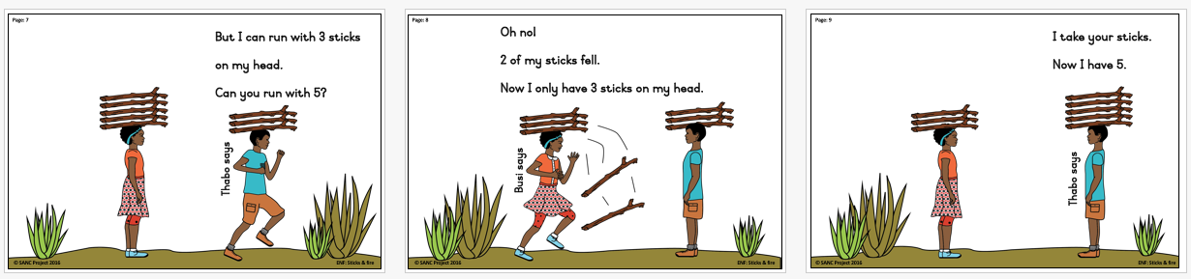
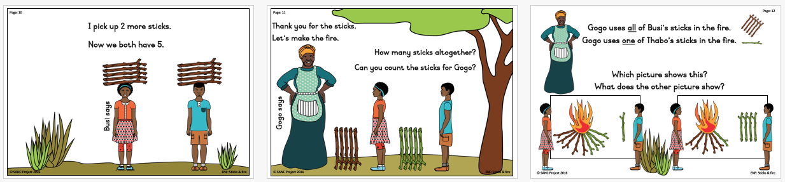

Slide 26
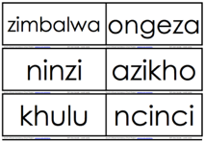
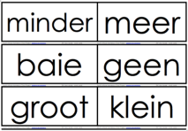
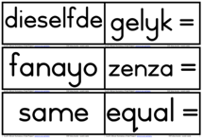
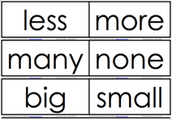

Slide 27
Next month: 21st November
End of year celebration
Watch your SMS for details

