Slide 1


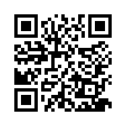
eNICLE
Grade 1 & 2 programme
Session 6
24th April 2018
Prof Mellony Graven, Dr Debbie Stott, Dr Pam Vale, Ms Carolyn Stevenson-Milln, Ms Roxanne Long, Ms Samu Chikiwa

Slide 2
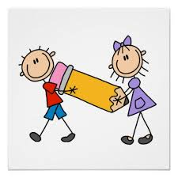
Next session
Change of date for next session:
  29th May

Slide 3
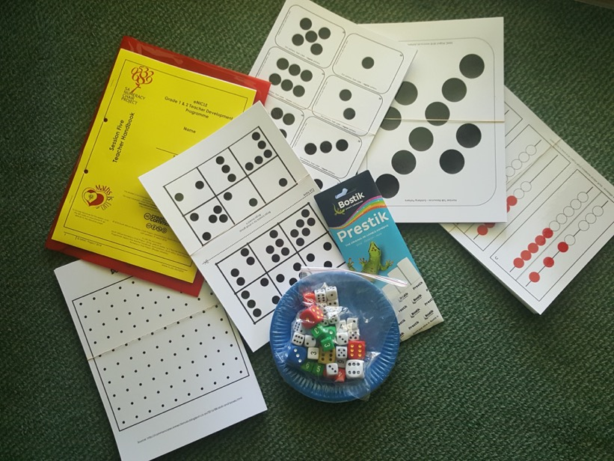
Group feedback on: resources from session 5
In groups discuss the questions in the handbook
Select a scribe to jot down main ideas and points of discussion

Slide 4
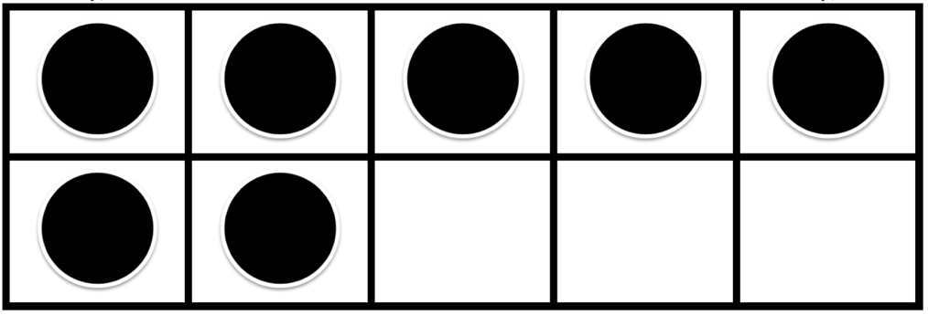
Today’s Number Talk
Questions as learners
How many do you see?
How do you see it?
Can you convince me?
Can you give at least 2 different ways of checking how many there are?

Slide 5
Today’s Number Talk
Questions as teachers
How many different ways can you see these dots?
Can you think of some ways that might involve subtraction?
What words could be added to the classroom word bank from this talk?

Slide 6
Today’s Number Talk:
Ways to see the dots

Slide 7
5 and 10-frames for developing a sense of 5 and 10
allows learners to “see” numbers
useful for developing number sense within the context of ten and 20
help to form mental images of the numbers represented
Understanding that numbers are composed of tens and ones is an important foundational concept, setting the stage for work with larger numbers.
A strong sense of "ten" is a prerequisite for place-value understanding and mental calculations.

Slide 8
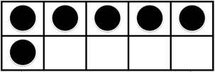
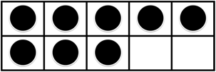
Look at these 10 frames. Can you ‘see’ these number facts?
6 is 1 more than 5, or 4 less than 10
8 can be seen as "5 and 3 more" or as "2 less than 10”

Slide 9
Working with the 5 and 10-frame
Grades R and One explore numbers with a 5-frame to start with
Then move onto 10-frame
Introduce the 10-frame with the following rule, a standard way to fill the frame:
  Always fill the top row first, starting on the left, the same way you read.
  When the top row is full, counters can be placed on the bottom row, also from the left.

Slide 10
Number talks using 10-frames
Helpful to build
  number sense
  mathematical vocabulary
  a strong understanding of 10 (for later place value)

Slide 11


Number talks using 10-frames
To build number sense ask and discuss:
What numbers do not fill one row?
(Those less than 5)
What numbers fill more than the first row?
(Numbers larger than 5)
How many spaces are left in the frame?
(i.e. building numbers less than 10)

Slide 12

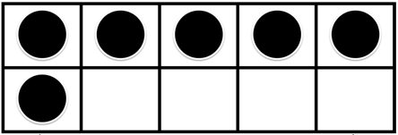
Number talks using 10-frames
Look at numbers as sums including five:
Have learners make the numbers to 10 and write them as sums of 5 and another number.
For example:
  8 = 5 + 3 OR 5 + 3 = 8
  6 = 5 + 1 OR 5 + 1 = 6

Slide 13

Number talks using 10-frames
Look at numbers in the context of ten:
Make learners aware of the spaces in the frame as this can be used to answer the question how many more to make ten?
Helps to decompose addition greater than ten:
i.e. 8 + 8 is 8 + 2 + 6, or 16.
This can be extended to explore subtraction too.
For example
There are four spaces in the frame.
These could be filled with 4 more counters to make up the 10.
Ask: “How many do you need to add to 6 to make ten?”
Learners could say:
“There are six dots in the frame. There are four spaces in the frame. Six plus four more makes 10.”

Slide 14
“Trusting the Count”
Knowing that when you count a set of objects:
  the last number you say represents the total number in the set – the “how many” or quantity.
  And then count it again, you’ll get the same answer ... every time.
  if you move the objects around, but nothing is added to, or removed from the set, you’ll get the same answer ... every time.
Why is it important for children to trust the count?
It helps children to:
  Read, write or hear a number and imagine what it looks like as a collection / set
  Instantly recognise a set without counting, no matter how it is arranged (subitise)

Slide 15
“Trusting the Count”
Common misconceptions about trusting the count
There are a number of misconceptions about whether children have this ability. These can affect their learning in mathematics.
Misconception: If a learner can count verbally to 100, they “trust the count”
Fact: Learners who can count may not know what those numbers mean
Misconception: If a learner can add small numbers, they “trust the count”.
Fact: If a learner adds 5 + 8 but counts out 1-2-3-4-5-6-7-8-9-10-11-12-13, they do not trust the count. They are recounting both numbers, using the ‘counting all’ strategy.

Slide 16
Building “Trust the Count”
Place a number of objects such as counters, beans in front of the learner
Ask: “How many are there?”
Wait for a response
Ask: “How did you know?”
Learners may count each individual object, or they may give an immediate answer (using subitising)
Move the items around
Make it obvious that you have not added any or removed any objects
Ask: “Did I add anything?”
“Did I take anything away?”
Ask: “How many are there now?”
Wait for a response

Slide 17
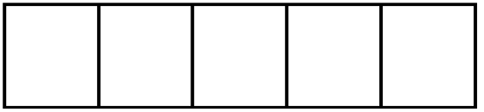
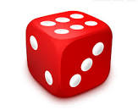
5-frame activities
Five Frame Tell About
page 11
Building Sets
page 12
Roll and Build
page 12

Slide 18
10-frame Activities
Crazy Mixed Up Numbers
Basic: Page 13
Aim: all children make their 10-frame show the same number
What do children need to think about in this activity each time they change their 10-frame to match the number? How do they decide to change the frame?
  Some will take off all the counters and start again, building always from one (COUNT ALL)
  If they do this every time, encourage them to start thinking about how many MORE OR LESS they need for the next number (see activity 4)
  Others will know what each number “looks like” and will add or subtract counters to make the pattern (SUBITISING)
Observe the learners to see how they do it.
This will help you to assess their level of understanding of the numbers

Slide 19
10-frame Activities
Crazy Mixed Up Numbers
Basic: Page 13
Call out random numbers between 0 and 10
After each number is called (or shown), the children change their 10-frames to show the new number using beans, counters etc

Slide 20
10-frame Activities
Crazy Mixed Up Numbers
Variations: Page 14
1. Show a number card
Instead of verbally saying a number, you can show a number symbol card.
The learners build that number on their frame.
2. Show fingers
Instead of verbally saying a number, you can show a number of fingers.
The learners build that number on their frame.

Slide 21

10-frame Activities
Crazy Mixed Up Numbers
Variations: Page 14
3. Match 10-frames and fingers
Once they have built the called-out number, ask them to show you the same number of fingers.
4. One more, two more / one less, two less
Once they have built the number called out, ask:
What will be one more? Two more?
What will be one less? Two less?
For example:
If the frame currently shows 6
What will be one more? Two more?
Response: “One more is 7” or “Two more is 8”.
What will be one less? Two less?
Response: “One less is 5” or “Two less is 4”.

Slide 22
10-frame Activities
Crazy Mixed Up Numbers
Variations: Page 14
5. Making 10: How many spaces?
Important variation – being aware of the spaces in the frame.
Once they have built the number called out, ask:
How many more will we need to make 10?
For example:
If the frame currently shows 6
Ask: How many more will we need to make 10?
Response: “We will need four”.
“How do you know that?”
Discuss ideas and methods

Slide 23
10-frame Activities
Crazy Mixed Up Numbers
Variations: Page 15
6. Making 10: Saying the facts
For example:
If the frame currently shows 6
Ask: How many more will we need to make 10?
Response: “We will need four”.
Ask: “What number fact could this be?”
Response: “6 and 4 make 10”

Slide 24
10-frame Activities
I Wish I Had Page 16
Purpose:
  to get learners to think about the concepts of more and less and how many more or less they need to make a number
They can be used as an early introduction to addition and subtraction using the 10-frame

Slide 25
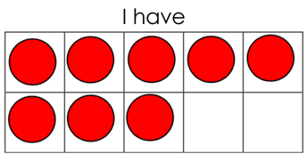
10-frame Activities
I Wish I Had… Page 16
Activity One: More (Addition)
Hold up one of the I Wish I Had cards
Say: “I have eight. I wish I had 9.”
Response: “One more will make 9”
i.e. the part that is needed to make 9.
Counting can be used to check

Slide 26
10-frame Activities
I Wish I Had… Page 16
Activity Two: Less (Subtraction)
Hold up one of the I Wish I Had cards
Say: “I have eight. I wish I had 5.”
Response: “If we take away three, we will have 5”
i.e. the part that is needed to be taken away to make 5
Counting can be used to check

Slide 27
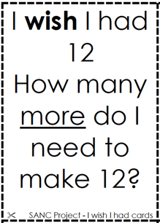
10-frame Activities
I Wish I Had… Page 16
Activity Three: More / Less with numbers 11 to 20 (+ & -)
Hold up one of the I Wish I Had cards
Say: “I have eight. I wish I had 12. How many more do I need to make 12?”
Response: “One more will make 9”
i.e. the part that is needed to make 12
Counting can be used to check

Slide 28
10-frame Activities
Ten and Some More
Page 17
When learners are comfortable with how to use a 10-frame and have done plenty of activities with numbers to 10, can use the frames to structure numbers up to 20
This activity uses two 10-frames to develop numbers in the range 11 to 20

Slide 29
10-frame Activities
Ten and Some More
Page 17
Give each child two 10-frames
Call out numbers from 1 up to 20 e.g. 11, 13, 15, 16
Learners build the numbers on their frames using counters or beads
Once they have built their numbers, look at the different methods learners have used
Discuss how the numbers can be placed on the frame so it is easy to see how many there are i.e. using a standard method to fill the frames

