Slide 1



eNICLE
Grade 1 & 2 programme
Session 7
29th May 2018
Prof Mellony Graven, Dr Debbie Stott, Dr Pam Vale, Ms Carolyn Stevenson-Milln, Ms Roxanne Long, Ms Samu Chikiwa

Slide 2
Unscramble these words
SIUITBNISG
------I--
PATT PAHR RWOLE
-A-- ---- ---L-
NUNSER SEEBM
------ ----E
MRAZY RXIEDUSPUN MCEB
----- --X-- -- -------
AUNBERKTML
----E- ----
ORUST TET CHUNT
-R--- --- -----
ENUIVQLEECA
-Q--------E
TMN FERAE
--- --A--
NOUITCNG
------N-
TAT ORTDEPNS
-O- --------
ENIFT OTH UKSNHWN
S---- --- --K----

Slide 3
Unscramble these words
SIUITBNISG
SUBITISING
PATT PAHR RWOLE
PART PART WHOLE
NUNSER SEEBM
NUMBER SENSE
MRAZY RXIEDUSPUN MCEB
CRAZY MIXED UP NUMBERS
AUNBERKTML
NUMBER TALKS
ORUST TET CHUNT
TRUST THE COUNT
ENUIVQLEECA
EQUIVALENCE
TMN FERAE
TEN FRAME
NOUITCNG
COUNTING
TAT ORTDEPNS
DOT PATTERNS
ENIFT OTH UKSNHWN
SHIFT THE UNKNOWN

Slide 4
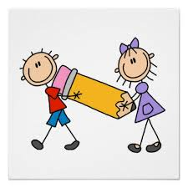
Next session
14th August

Slide 5


Slide 6
Welcome
To
BINGO!

Slide 7
Bingo Board
Draw a quick freehand 3 by 3 grid
(no ruler required)
Copy 9 random words from the next slide

Slide 8
CHOOSE 9 RANDOM WORDS FROM THIS LIST
GROWTH MINDSET | COGNITIVE CONTROL or EXECUTIVE FUNCTIONS | HAND SIGNALS | SCATTERED DOT PATTERN
COUNT ALL | NUMBER TALKS | 10 FRAME RULE | SUBITISING
RELATIONAL UNDERSTANDING | COUNT ON | NUMBER SENSE | NUMBER SYMBOL
10 FRAME | EMPTY BOX PROBLEMS | REGULAR DOT PATTERN | PART-PART-WHOLE

Slide 9
Number symbol or number name?
BINGO
QUESTION
8

Slide 10
Five- to fifteen-minute conversations around problems that learners solve mentally. Useful tools to include in your lessons to help learners to make sense of mathematics.
BINGO
QUESTION
This is a definition of: ________ _________

Slide 11
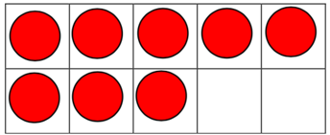
Part-part-whole model
OR
10-frame?
BINGO
QUESTION

Slide 12
People with a
------ ------- believe
BINGO
QUESTION
that qualities like intelligence and ability are growable: they can change and flourish or wither depending on how one engages with learning opportunities

Slide 13
This is a definition of …?
BINGO
QUESTION
the ability to recognise dot arrangements in different patterns

Slide 14
Name this model…
BINGO
QUESTION
8
6 | 2

Slide 15
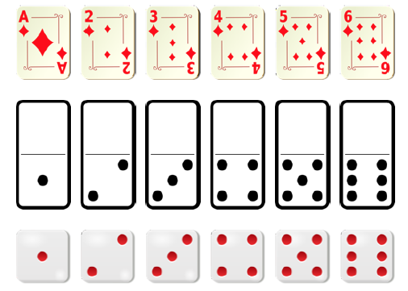
Regular or alternate?
BINGO
QUESTION
The dot patterns from 1 to 6 are the easiest to recognise.
Commonly seen on dice, dominoes and playing cards

Slide 16
This is a definition of…
BINGO
QUESTION
The ability to work flexibly with numbers, observe patterns and relationships and make connections to what they already know, to make generalisations about patterns and processes

Slide 17

Scattered or linear dot arrangement?
BINGO
QUESTION

Slide 18
What TYPE of COUNTING is this?
BINGO
QUESTION
When you add two numbers and you begin counting from the largest number and add the second number to it.

Slide 19

Together, these are known as:
________ _______ skills
BINGO
QUESTION
SHIFTING ATTENTION
WORKING MEMORY
INHIBITION / SELF CONTROL

Slide 20
These problems are known as…
BINGO
QUESTION
☐ + 2 = 8
6 + ☐ = 8
☐ + 10 = 80
70 + ☐ = 85

Slide 21
BINGO
QUESTION
When presented with 5 + 3, some children may count from one – “one, two, three, four, five – six, seven, eight!”
This is referred to as: ----- ---

Slide 22
Always fill the top row first, starting on the left, the same way you read.
When the top row is full, place counters on the bottom row, also from the left.
BINGO
QUESTION

Slide 23
Relational or Operational understanding?
BINGO
QUESTION
Knowing what to do (how) and being able to explain why

Slide 24
These are _____ _______ used in Number Talks
BINGO
QUESTION
Thumbs - I have an answer
Thumb and finger shake - I agree / I did the same / Me too

Slide 25
A
Number Sense
Development
Sessions
4 to 6
7 to 10
E
B
Growth mindsets / productive dispositions
Story (narrative) approaches to learning numeracy
Sessions
1 to 4
Sessions
3 & 4
KEY IDEAS
D
C
Cognitive control (Executive functioning)
Learner progression
Sessions
1 to 4
Sessions
2 & 3

Slide 26

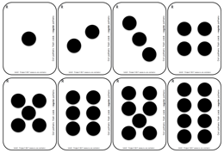
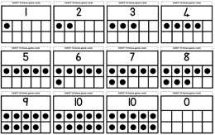

Slide 27
Today’s Number Talk [1]
Instructions
Use any combination of addition, subtraction and multiplication to make 24
You may combine 2 or more numbers

Slide 28
Today’s Number Talk [2]
Instructions
Work out the value of the numbers on the left.
Then find other combinations of two numbers that are equal to this number
Use any operation you like

Slide 29
Today’s Number Talk:
Discussion
Addition
10 + 14
10 + 12 +2
Subtraction
34 – 10
Multiplication
12 x 2
8 + 8 + 8
20 + 4
10 + 10 + 4
12 + 12
26 – 2
8 x 3
Combinations
(10 x 2) + 4
(20 - 8) + 12
(14 x 2) – 4
etc
etc
etc
etc
Do any of the addition solutions relate to a multiplication solution?
How could you explain the use of brackets to learners?

Slide 30
Today’s Number Talk:
Discussion
Addition
10 + 2 + 2
8 + 6 or 6 + 8
Subtraction
24 - 10
16 - 2
10 + 4 or 4 + 10
8 + 3 + 3
4 + 4 + 4 + 2
7 + 7
13 + 1 or 1 +13
12 + 2 or 2 + 12
18 - 4
20 - 6
34 - 20
Can you think of any that might use multiplication?
How could you encourage the learners to find all the combinations that add to 14?
How could you do the same thing with subtraction?

Slide 31
Number Talk Prompts
These prompts can add variety to your Number Talk sessions.
They are not based on any particular model or representation.
To use these prompts:
  Select a number talk prompt from the templates below.
  Follow the instructions in the second column to prepare for the talk.
  Draw the template on the board or on flipchart paper.

Slide 32
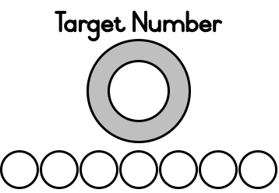
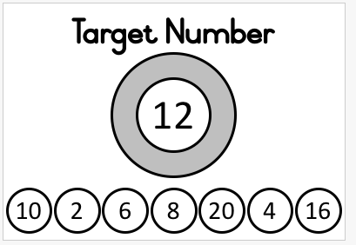
Number Talk prompts [1]
Page 7
Choose a target number for the number range you are working with and 7 numbers that combine to make the target number.
Mathematical focus:
  Addition and / or subtraction in any number range you are working with
  Multiplication by 2, 3, 5 and 10 if the numbers are carefully selected (see 22 in the Other Examples)

Slide 33
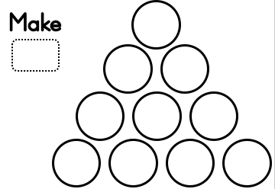
Number Talk prompts [2]
Page 8
Choose a target number for the number range you are working with and 10 numbers that combine to make the target number.
The numbers are in an ordered pattern and are easier to choose from.
Mathematical focus:
  Addition and / or subtraction in any number range you are working with
  Multiplication by 2, 3, 5 and 10 if the numbers are carefully selected (see the Other Examples)

Slide 34
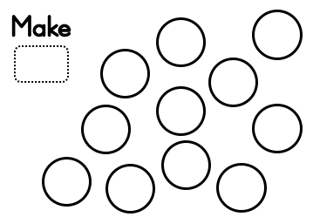
Number Talk prompts [3]
Page 9
Choose a target number for the number range you are working with and 11 numbers that combine to make the target number.
The numbers are in a scattered pattern, making them slightly harder to choose from.
Mathematical focus:
  Addition and / or subtraction in any number range you are working with
  Multiplication by 2, 3, 5 and 10 if the numbers are carefully selected (see the Other Examples)

Slide 35
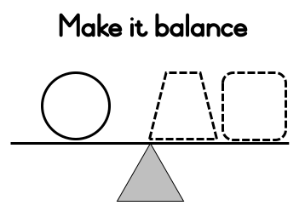
Number Talk prompts [4]
Page 10
Choose one number for the left.
Learners find 2 numbers on the right that will make the scale balance.
Mathematical focus:
  Work with one number and find 2 other numbers that equal the number on the left
  Addition and / or subtraction in any number range you are working with
  Multiplication by 2, 3, 5 and 10 if the numbers are carefully selected

Slide 36
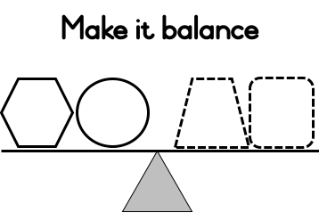
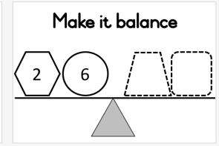
Number Talk prompts [5]
Page
10 & 11
Choose two or three numbers for the left.
Learners find 2or 3 numbers on the right that will make the scale balance.
Mathematical focus:
  Addition and / or subtraction in any number range you are working with
  Multiplication by 2, 3, 5 and 10 if the numbers are carefully selected

Slide 37
Number Talk prompts [1]
Page 7
Choose a target number for the number range you are working with and 7 numbers that combine to make the target number.
Mathematical focus:
  Addition and / or subtraction in any number range you are working with
  Multiplication by 2, 3, 5 and 10 if the numbers are carefully selected (see 22 in the Other Examples)

Slide 38
Linear representations of number
Page 13
Regular use of a number line can help learners to form a mental number line
This can help learners to calculate mentally

Slide 39
BUT!
Page 13
Many learners cannot use a number line very well
Important to introduce number lines as early as possible
One way - introduce number line work is to start with bead strings
Then connect these to a counting line and then move on to a number line

Slide 40
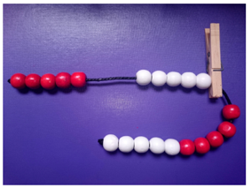
Bead strings
Page 13
Bead strings can be used for:
  Making / structuring numbers up to 10 and 20
  Skip counting in 5s and 10s
  Early addition and subtraction
  Counting on / counting back
  1 more / 1 less (2 more / 2 less etc)
  Conceptual place value

Slide 41

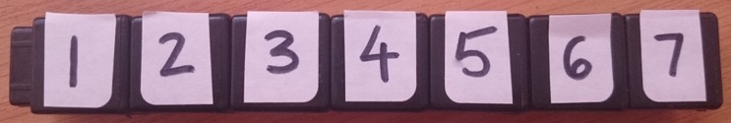
Bead stings to
Counting lines or number tracks
Page 14
“Counting line”
An excellent way to support learning to count.
It can also be used for learning to add and subtract small numbers
Over time, use a more abstract counting line - a numeral (number) track - a printed set of objects that can be counted

Slide 42
Bead string to Number Line
Page 15
Counting lines are useful, but are NOT number lines
Move carefully from bead strings or counting lines to number lines, because learners find them challenging
Number lines go beyond counting individual objects
  They can be used to measure from a fixed point
  Fractions can be shown on the number line

Slide 43
How to progress from a counting line to a number line
Page 15
Important to help the learners to understand that the number marker on a number line indicates where one object finishes
For example, the numeral 1 on the number line shows where bead one finishes

Slide 44
Moving onto measuring
Page 16

Slide 45
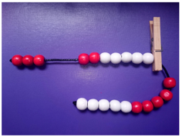
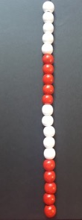
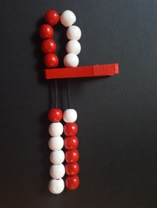
Bead strings and Number Sense
Pages 19 & 20
Number recognition
Same and different
More and less
1 more and 1 less
Counting vertically
Bigger and smaller
Doubling

Slide 46
Bead Strings and Number Facts
Page 21
Number facts for numbers up to 10
Number facts for numbers up to 20

Slide 47
Bead Strings and Ordinal Numbers
Page 22
Working from left to right on the string, ask:
  How many red beads are there here? [show the first red group of 5]
  How many white beads are there? [show the first white group of 5]
Hold your bead string with the red beads starting in your left hand
Using a pattern of prompts, first ask the group a question, then ask individual learners “how they know” type questions (see more about this on the next page)

Slide 48
Why ask
“How do you know?” questions
When learners describe why they think that it is, for example, the 6th bead or finger…
Focuses on development of:
  mathematical language
  reasoning language
Some learners might point to their strings by counting in ones and say:
  Because look… one, two, three, four, five, six’.
Other learners might begin to see the structure of 6 as 5 + 1
  ‘Because 6 is 5 red and 1 white’ or, ‘Because the 6th is the one after the 5th and I know the last red one is the 5th’.
Learners don’t always explain their thinking this clearly.
Rephrase their explanations and share what they ‘notice’ with other learners
This shows other learners how seeing and using the structure is quicker than counting by ones.
If learners still count in ones, encourage them to find quicker ways to know without counting
  for example by noticing and emphasising which beads are the 5th and 10th

Slide 49
Bead Strings and Ordinal Numbers
Page 22
Examples:
  One:
    T to group: Show me the 5th bead
    T to a learner: How do you know that's the 5th bead?
    T to group: Any other ways you know that is the 5th?
  Two:
    T to group: Show me the 11th bead
    T to a learner: How do you know that's the 11th bead?
    T to group: Any other ways you know?

Slide 50
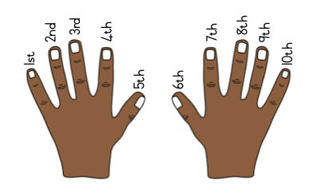
Bead Strings and Ordinal Numbers
Page 23
Learners place both hands in front of them
Children say the order of the fingers from left to right as:
  1st finger
  2nd finger
  up to the 10th finger
Use the same questioning sequence from the previous activity
  Stop at 10
Example of questioning sequence
  T to group: Wiggle your 2nd finger.
  T to a learner: How do you know that's your 2nd finger?
  T to group: Wiggle your 5th finger (yes, it's a thumb but a thumb is also a finger).
  T to a learner: How do you know that's your 5th finger?
  T to group: Any other ways you know that's the 5th finger? (e.g. answer because there are 5 fingers on each hand and this is the last finger on my left hand)
And so on…

