Slide 1



eNICLE
Grade 1 & 2 programme
Session 8
14th August 2018
Prof Mellony Graven, Dr Debbie Stott, Dr Pam Vale, Ms Roxanne Long, Ms Samu Chikiwa, Mr Wellington Hokonya

Slide 2
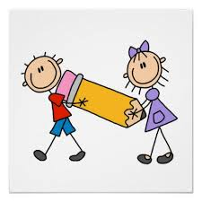
Next session
18th September

Slide 3
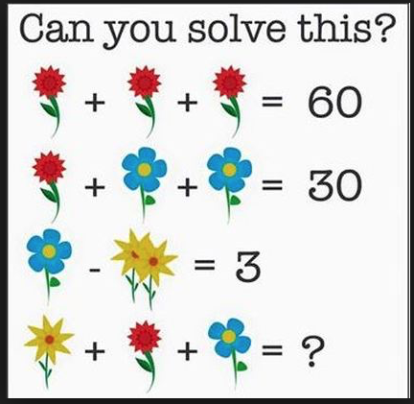
Can you solve these?
Work with a partner and explain your thinking
Watch out for the operations signs!

Slide 4
Can you solve these?
Work with a partner and explain your thinking
Find the value of each icon in the MULTIPLICATION tables below
Puzzles FREE from: http://mashupmath.com

Slide 5
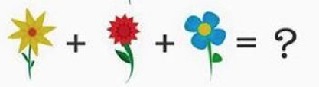
Solutions?
27?

Slide 6
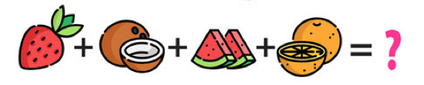
Solutions?
21?

Slide 7



Solutions?
Find the value of each icon in the MULTIPLICATION table
2
3
4

Slide 8
Solutions?
Find the value of each icon in the MULTIPLICATION table
2 18 54 6 3 27

Slide 9
What skills are we developing with activities like these?
Write down at least 2.
If you to do these activities with your class…

Slide 10
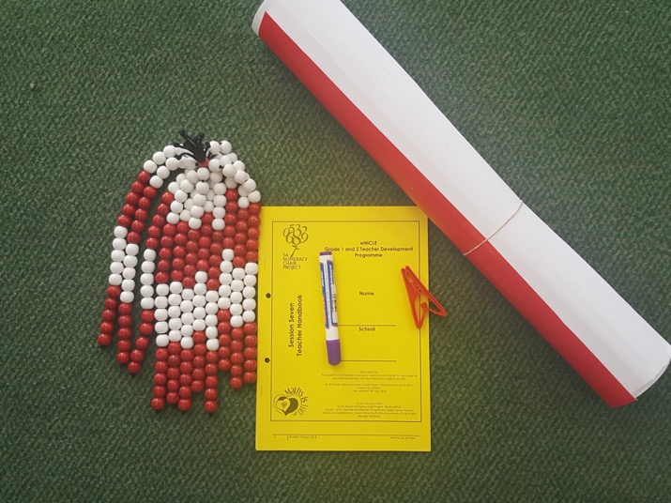
Group feedback on: resources from session 7
Number Talks & Bead String Activities
In groups discuss the questions in the handbook on Page 7
Select a scribe to jot down main ideas and points of discussion

Slide 12
Today’s Number Talk [1]
Instructions
Look at the numbers with circles. What numbers come before and after?
Explain how you know what comes before and after.
Fill in the missing numbers.

Slide 13
Today’s Number Talk [2]
Instructions
What is the number shown by each arrow?
Explain how you know this.

Slide 14
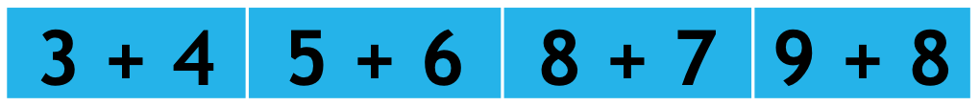
Today’s Number Talk [3]
Instructions
Calculate these using the printed number number lines (see page 28)
Share your methods

Slide 15

Today’s Number Talk:
Discussion
Think about:
What mathematics are we trying to develop with each type of talk?
What kind of vocabulary will learners need for the talks?
Discuss with your colleagues

Slide 16
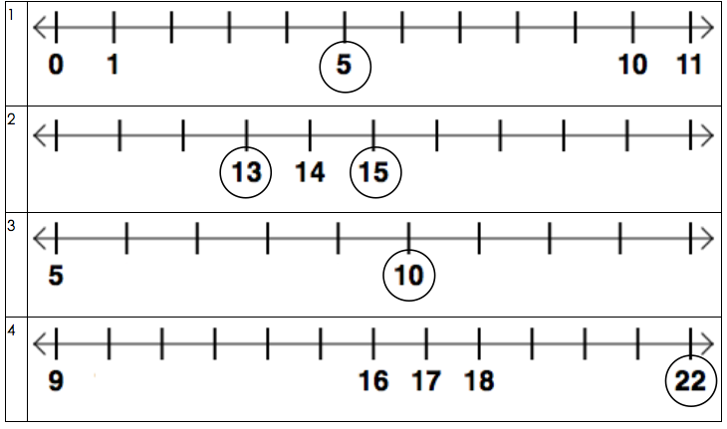
Number Talk Prompts [1]
Before & After

Slide 17
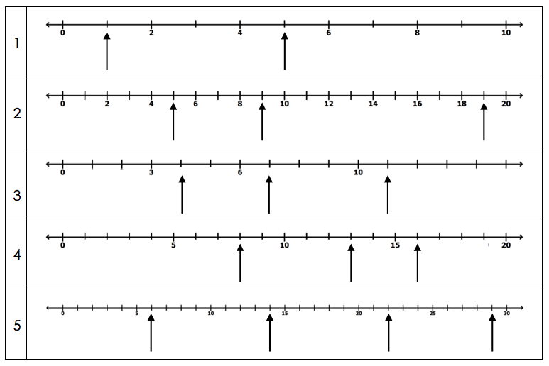
Number Talk Prompts [2]
Finding Missing Numbers

Slide 18
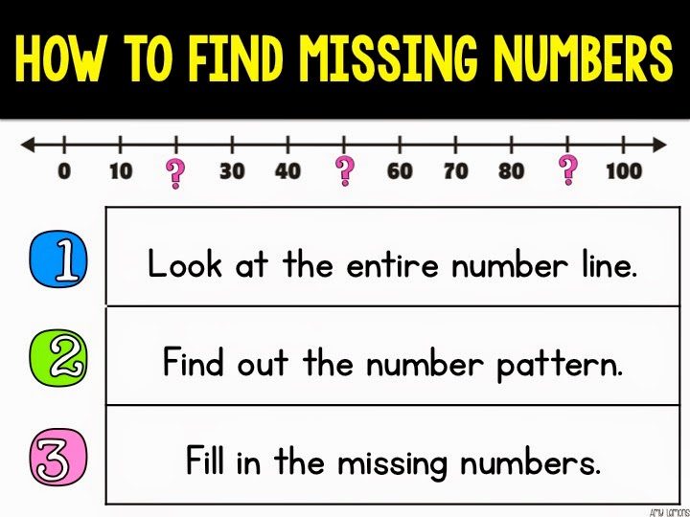
Number Talk Prompts [2]
Finding Missing Numbers
If learners struggle with these:
  encourage them to try this.
Use this to help them explain their thinking too.

Slide 19
Number Talk Prompts [3] using the number line to calculate
Doubles and near doubles
Aim:
Children are able to recall doubles. This strategy makes the most of this.
These carefully selected sequence of prompts → apply the same strategy to all the prompts
Making tens
Aim:
Developing fluency with the number combinations that make ten.
This is done by breaking numbers apart to make ten.
These carefully selected sequence of prompts → apply the same strategy to all the prompts

Slide 20
Number Talk Prompts [3] using the number line to calculate
Doubles and near doubles
3 + 3 3 + 4 | 5 + 5 5 + 6 | 8 + 8 8 + 7 | 9 + 9 9 + 8
12 + 12 12 + 13 | 15 + 15 15 + 16 | 10 + 10 10 + 11 | 20 + 20 19 + 19
Making tens
9 + 1 9 + 3 + 1 9 + 5 + 1 | 8 + 2 8 + 3 + 2 2 + 5 + 8 | 4 + 6 4 + 6 + 4 6 + 5 +4 | 2 + 8 2 + 5 + 8 8 + 6 + 2

Slide 21
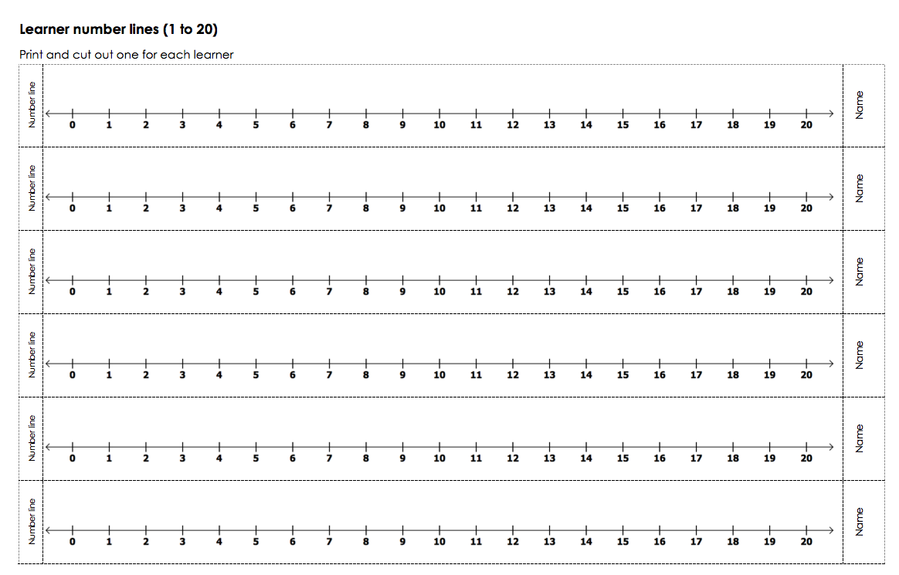
Page 28 in your handbook

Slide 22
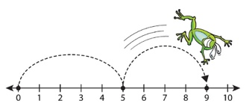
Linear representations of number
Page 4
Regular use of a number line can help learners to form a mental number line
To help learners to calculate mentally
IMPORTANT
Start with:
→ STRUCTURED NUMBER LINES
(this session)
→ Semi-structured number lines
(session 9)
→ Empty number lines
(session 10)

Slide 23
BUT!
Many learners cannot use a number line very well
Important to introduce number lines as early as possible
Introduce number line work with bead strings (session 7)
Then connect these to a counting line and then move on to a number line

Slide 24

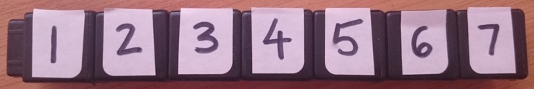
Bead stings to
Counting lines or number tracks
“Counting line”
An excellent way to support learning to count.
It can also be used for learning to add and subtract small numbers
Over time, use a more abstract counting line - a numeral (number) track - a printed set of objects that can be counted

Slide 25
Bead string to Number Line
Counting lines are useful, but are NOT number lines
Move carefully from bead strings or counting lines to number lines, because learners find them challenging
Number lines go beyond counting individual objects. They can also be used:
  To measure from a fixed point
  To work with fractions

Slide 26
How to progress from a counting line to a number line
Important
Help the learners to understand that the number marker on a number line indicates where one object finishes
Use your bead string to make this transition
For example, the numeral 1 on the number line shows where bead one finishes

Slide 27
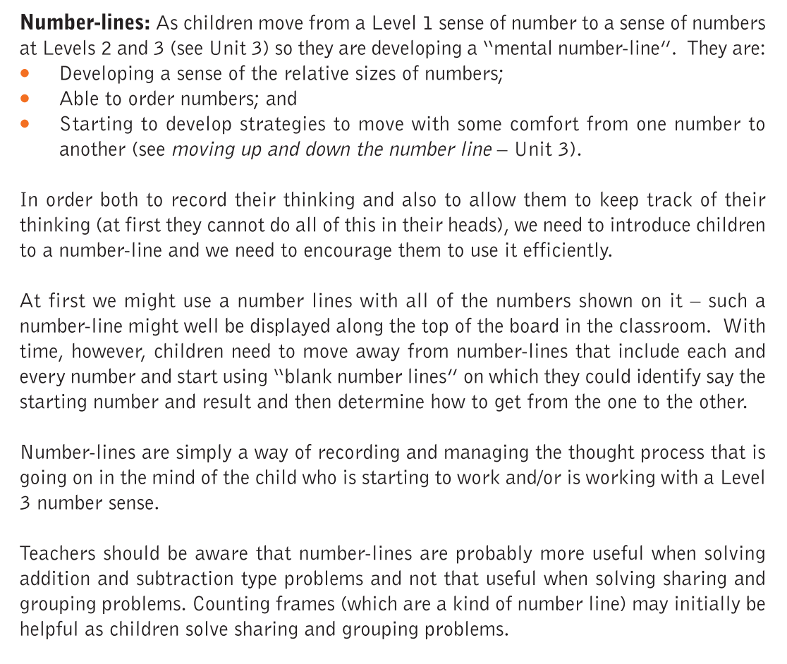
Number Lines in Numeracy Handbook
Numeracy Handbook for Foundation Phase Teachers: Grades R–3, page 86

Slide 28
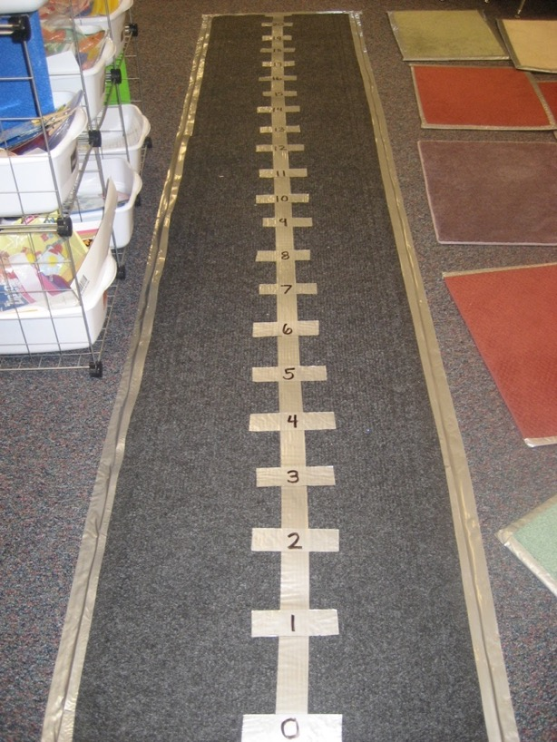
Preparing your number line
Decide on your number range (i.e. 1 to 10; 1 to 20; 1 to 30)
Prepare the number line on the floor using tape before class
IMPORTANT NOTES
Make sure that the spaces between the numbers are equal. This is important for learners to understand.
Add the arrows at each end. You could discuss that numbers keep going beyond the end of the number line.

Slide 29
TAKE SOME TIME NOW TO THINK WHERE YOU MIGHT CREATE / DRAW A NUMBER LINE IN YOUR CLASSROOM OR SCHOOL

Slide 30
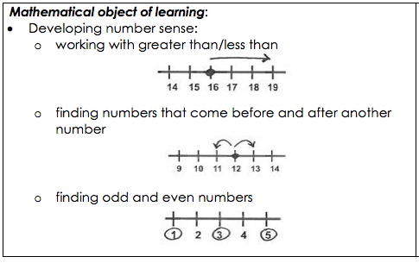
Number Line Activities:
Number Sense
Page 13

Slide 31
Number Sense Activities
Before and After
Ask a child to stand at zero & jump to a specified number e.g. 5
Ask another child to go and stand on:
    The number before
    The number after
Repeat with a different number and different children
More and less (1 and 2 more)
Ask a child to stand at zero & jump to a specified number e.g. 5
Ask another child to go and stand on:
    1 more than that number
    1 less than that number
Repeat with a different number & different children
Introduce 2 more and 2 less
How Many More To…
Ask a child to stand at zero & jump to a specified number e.g. 5
Ask the class how many more they will need to jump to get to a number e.g. 8
Ask the child on the number line to jump to the number and check
Repeat with other numbers moving forward and backwards
More Number Sense
Jump on all the odd numbers
Jump on the number that is 1 less than 9
Jump on a number smaller than 12
Lots of learners can do this one to see how many can squeeze onto the available numbers
Jump on a number between 5 & 8
Combine two or more instructions:
"Jump on an even number that is greater than 6."

Slide 32
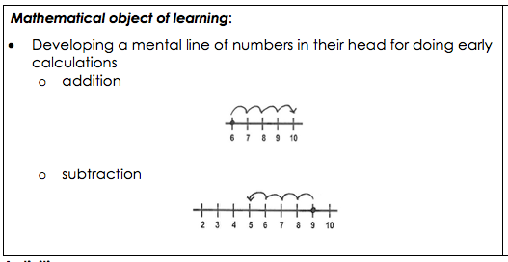
Number Line Activities:
Early Calculation
Page 14

Slide 33
Early Calculation
Addition
"Jump on a 7. Add 3.
What did you get?"
Repeat
Give the class an addition problem to solve on the number line.
For example 5 + 3
Ask for learners to show how the problem could be solved using the number line
Subtraction
"Jump on a 15. Subtract 4.
What did you get?"
Repeat
Have two learners stand at zero.
Ask one learner to walk 8 spaces along the line and the other to walk 3
Example questions:
  How many steps farther did learner one walk than learner two?
  How many more steps did learner one walk than learner two?
  What is the difference in the steps walked by learner one and learner two?

Slide 34
Birthday Line-up
Page 15
A fun activity to use the number line to find class birthdays.
You could develop this into a Data Handling task in you wanted to.
PREPARATION
Use chalk to make a large number line from 1 to 31
ACTIVITY
Ask learners to think of their birthday number, then stand on it on the number line
For example: A child who was born on May 7 and one who was born on December 7 would both stand on the 7
Ask learners to look around and see who else has a birthday on their same date and share what month they were born in
Other options:
  "If you have a birthday on an odd number stand up. If your birthday is on an even number, sit down."
  "If your birthday date is greater than 20, stand up. If it is less than 20, sit down.”
  “If your birthday is on the 20th, jump up and down."
  "If your birthday is between 3 and 7, put your hands in the air."
  "Mpho, what is your birthday plus 2?”
  “Siya, what is your birthday minus three?"
  And so on…

Slide 35
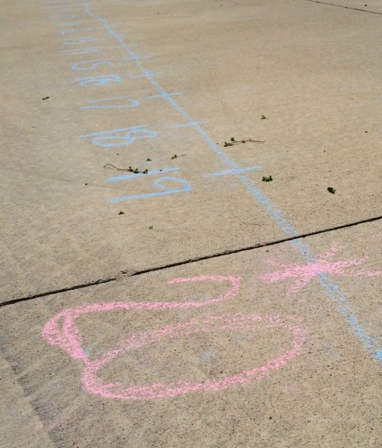
Number line variations
Page 16
You can repeat all the above activities with other number lines:
Draw a number line outside using sidewalk chalk → →
Use the yellow number lines These are two sided:
  One side is marked from 0 to 100 with tick marks at every 5
  The other side is blank – good for proportional reasoning work (see Session 9 handbook)

Slide 36

COULD YOU GET SOMEONE TO DONATE SOME PAINT AND HAVE A PERMANENT NUMBER LINE ON THE PLAYGROUND?

Slide 37
“Up and Down the Number Line” Activities
Page 17
Completing tens
I have 17, what do I get if I add 3?
What must I add to 27 to get 30?
Bridging tens
I have 17, what do I get if I add 8?
The child should first complete the ten and then add on the remainder. Their thinking could be: “I have 17, I need 3 to make 20. 8 – 3 = 5 so the answer is 20 + 5 = 25.”
What must I add to 27 to get 32?
Adding to multiples of ten
I have 17, what will I get if I add 33?
What must I add to 27 to get 60?
Adding and subtracting multiples of ten
Children need to know that if 2 + 3 = 5 then 20 + 30 = 50 and 200 + 300 = 500
I have 30, what will I get if I add 50?
I have 70, what will I get if I take away 30?
What must I add to 10 to get 70?
What must I take away from 90 to be left with 30?
Subtracting to multiples of ten
I have 27, what do I get if I take away 7?
What must I take from 45 to get 40?
Subtracting from multiples of ten
I have 70 what do I get when I take away 8?
What must I take away from 40 to get 36?
Numeracy Handbook for Foundation Phase Teachers: Grades R–3, page 43

Slide 38
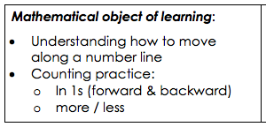
Snake Number Line Game
Page 18
A fun way for learners to practice jumping on a number line. It is a variation of Snakes and Ladders
The aim of the game is to get the correct number to land on the end number (10, 20 or 30)
There are 3 game boards for number ranges
One to ten
One to twenty
One to thirty
Laminate or slip into A4 plastic sleeves so that they can be re-used.

Slide 39
Snake Number Line Game:
Instructions for play
Learners work in pairs or threes
Learners take turns to throw the dice
Move that many moves on the board
Follow the arrows to jump to another number
NOTE: some of these jump forward and some jump backwards
Encourage the learners to say what they are doing as they follow an arrow
For example:
“I am jumping forward by 2 / backwards by 1” and so on
The learners must throw exactly the right number to land on the end number
For example:
If one learner is on 8 and they throw a three, this is too much to land exactly on ten
So they must jump to 9, 10 and then back to 9. They need a 1 to land exactly in the ten
Encourage them to say how many they need to get to the end number

Slide 40
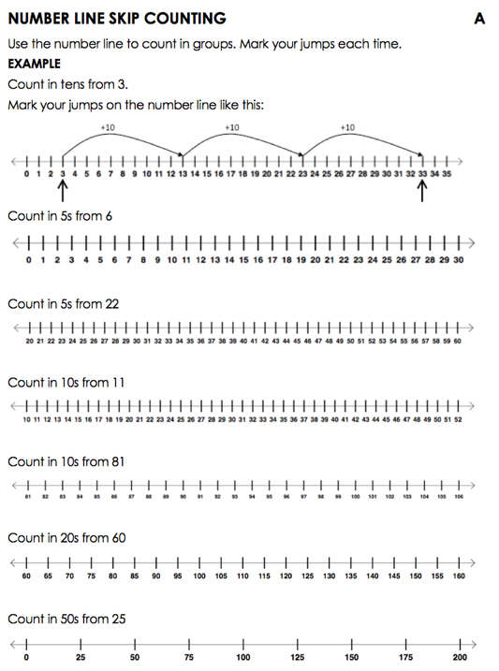
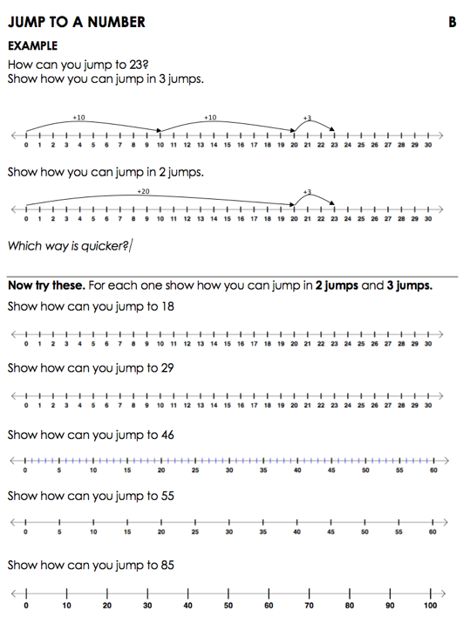
Worksheets
Page 19
A: Number Line Skip Counting
B: Jump to a Number

Slide 41
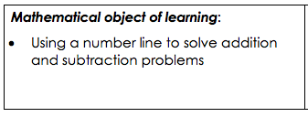
Problem solving with structured number lines
Page 22
Word problems can be solved using the number line.
Handbook has these examples:
  1st page: two worked examples.
  You might choose to do these with the whole class first, perhaps even as a Number Talk
  Next 2 pages: using pre-drawn number lines to solve the problems
  Final page: learners to draw their own number lines

Slide 42
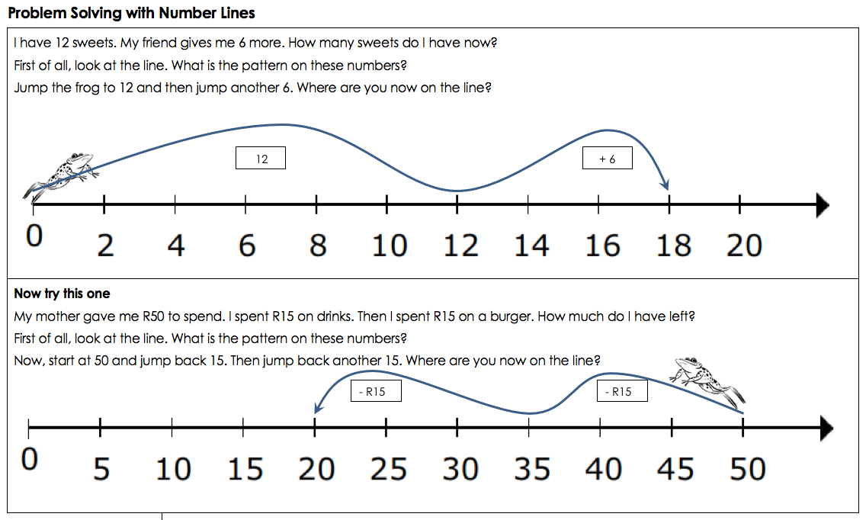
Two worked examples…

Slide 43
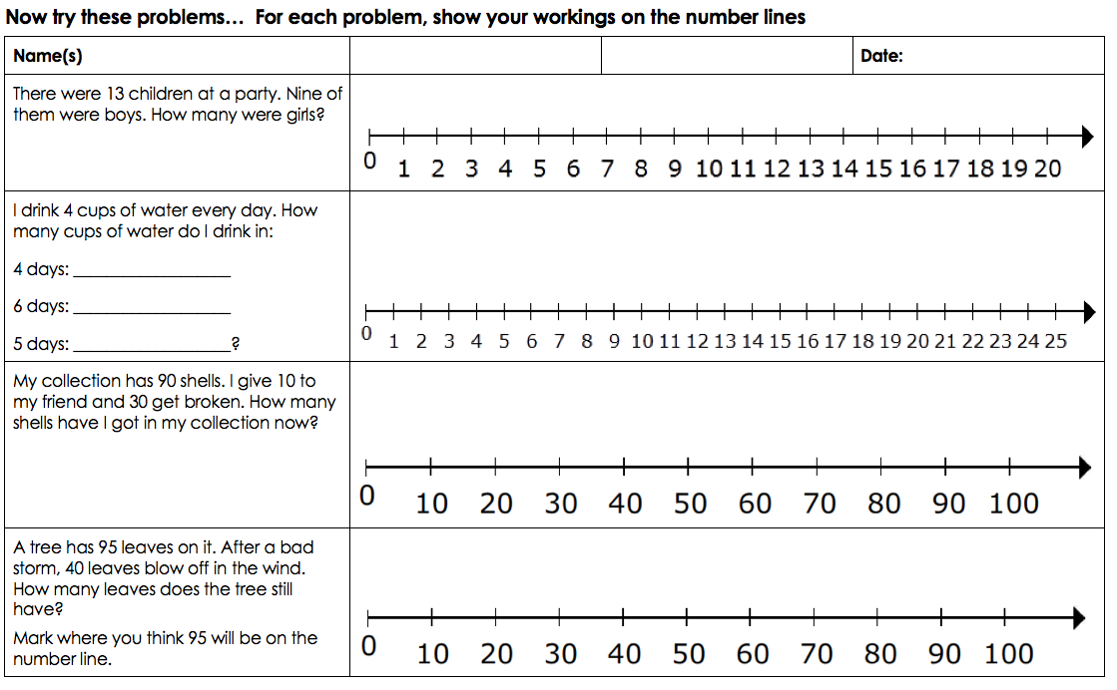
Using pre-drawn number lines

Slide 44
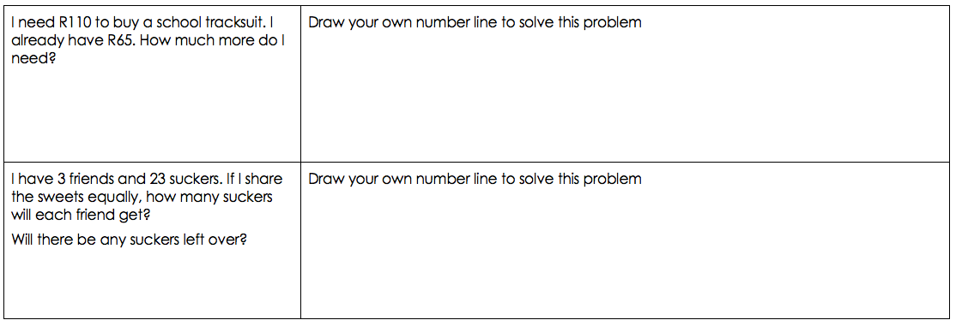
Learners to draw their own number lines
NOTE: neatness is not a requirement here. Using the number line to solve the problem accurately is the focus.

