Slide 1


eNICLE
Grade 1 & 2 programme
Session 9
18th September 2018
NEXT SESSION:
23rd October
Prof Mellony Graven, Dr Debbie Stott, Dr Pam Vale, Ms Roxanne Long, Ms Samu Chikiwa, Mr Wellington Hokonya

Slide 2
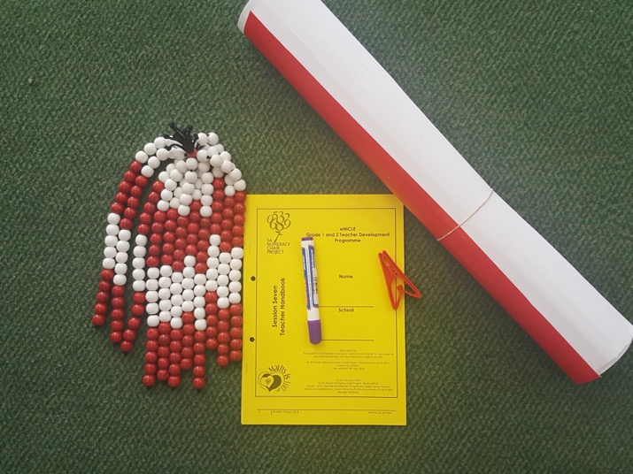
Group feedback on: resources from session 7
Number Talks & Bead String Activities
In groups discuss the questions in the handbook on Page 7
Select a scribe to jot down main ideas and points of discussion

Slide 4
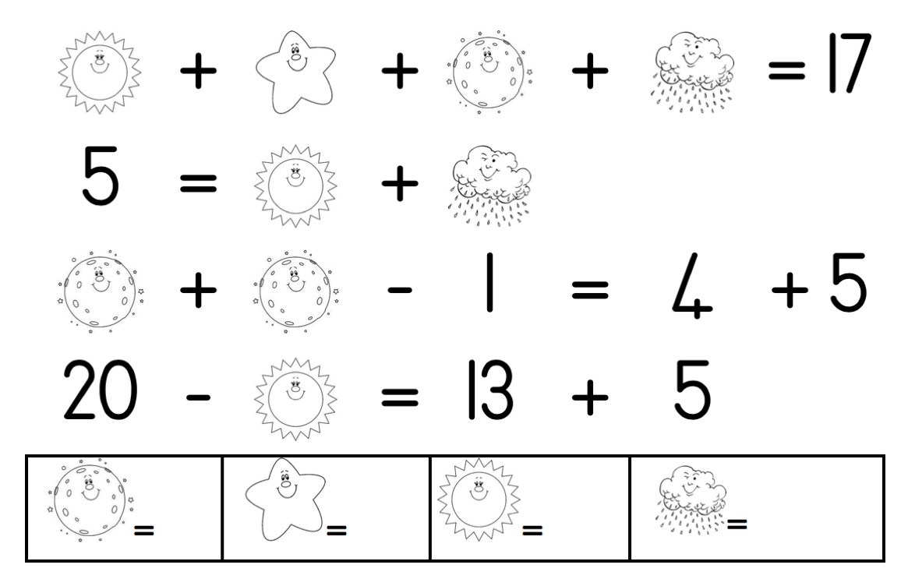
Today’s Number Talk [1]
Instructions
Find the values of the pictures

Slide 5
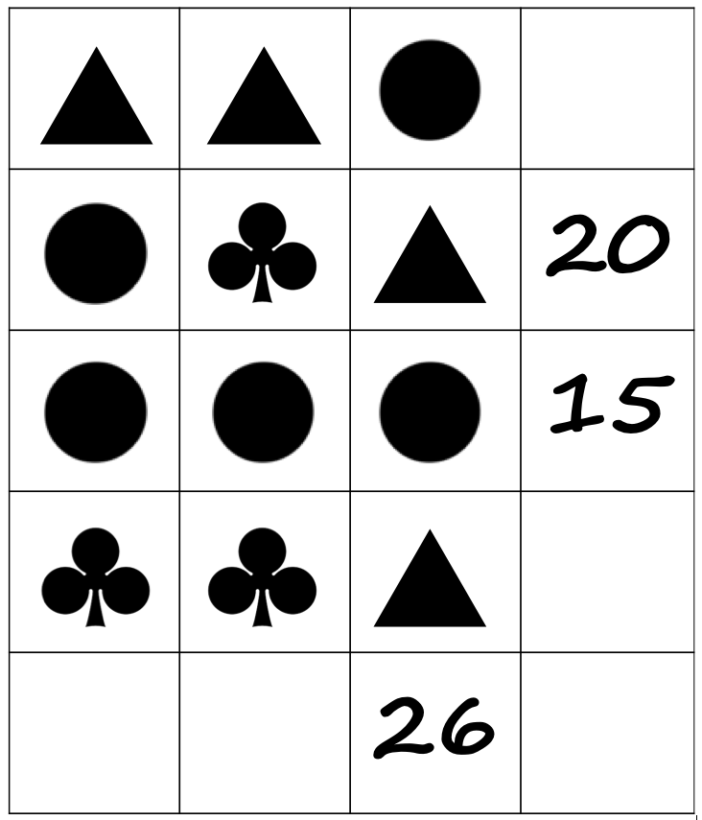
Today’s Number
Talk [2]
Instructions
Find the values of the shapes

Slide 6
Number Talks:
Reflection questions
What kind of mathematical facts and skills do learners need to solve this puzzle? Can you think of at least three?
What kind of mathematical thinking do learners need to solve this puzzle?
Think about your class. Would you say this puzzle was?
  Beginner level?
  Medium level?
  Advanced level?
Why?

Slide 7
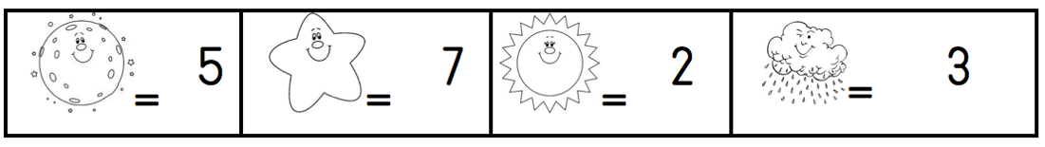
Solutions

Slide 8
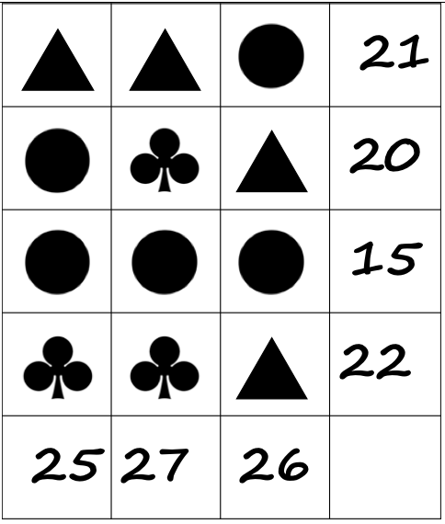
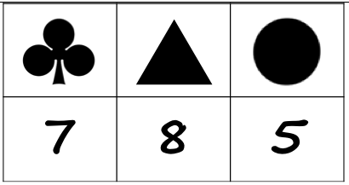
Solutions

Slide 9
“Maths Challenges” Number Talk prompts
For Grade 1 and 2 learners
To use these prompts:
  Select a number talk prompt
  Work through the prompt yourself so that you know how you can solve it
  Decide how to present the prompt to the learners in your classroom. Will you:
    Draw it on the board?
    Project it?
    Photocopy pages for pairs of learners to work with?
  Learners may need longer than 10 minutes to work with these prompts. 15-20 minutes should be sufficient.

Slide 10
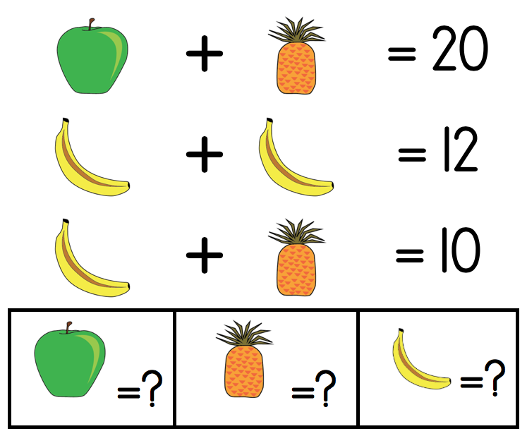
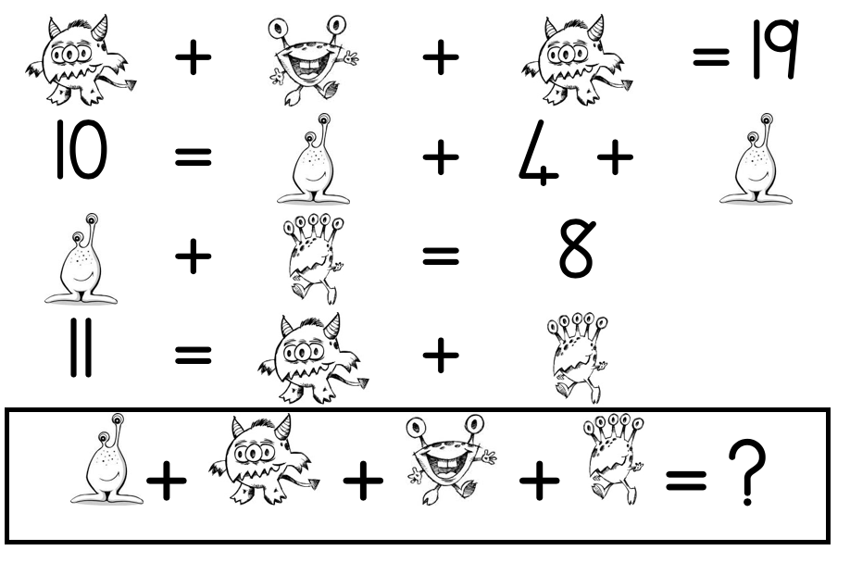
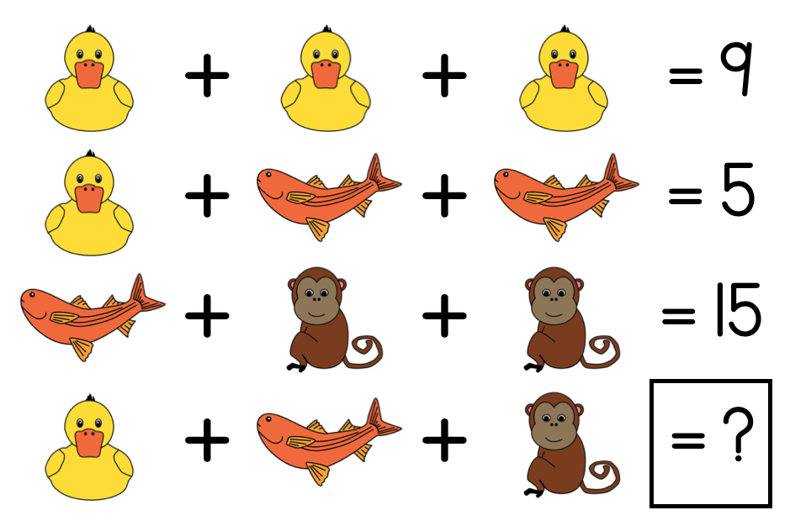
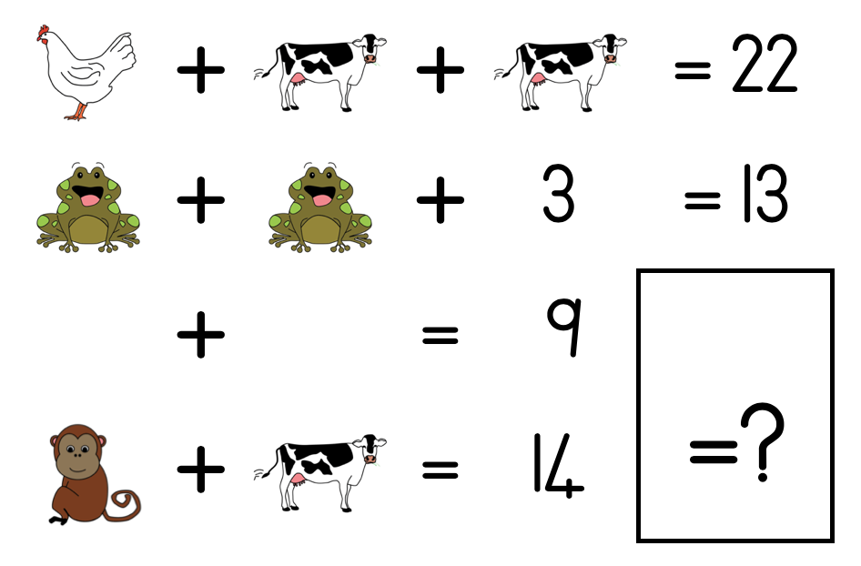
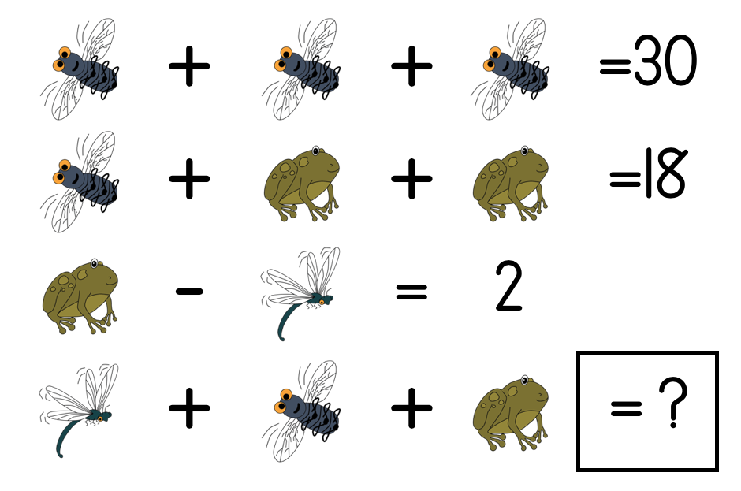
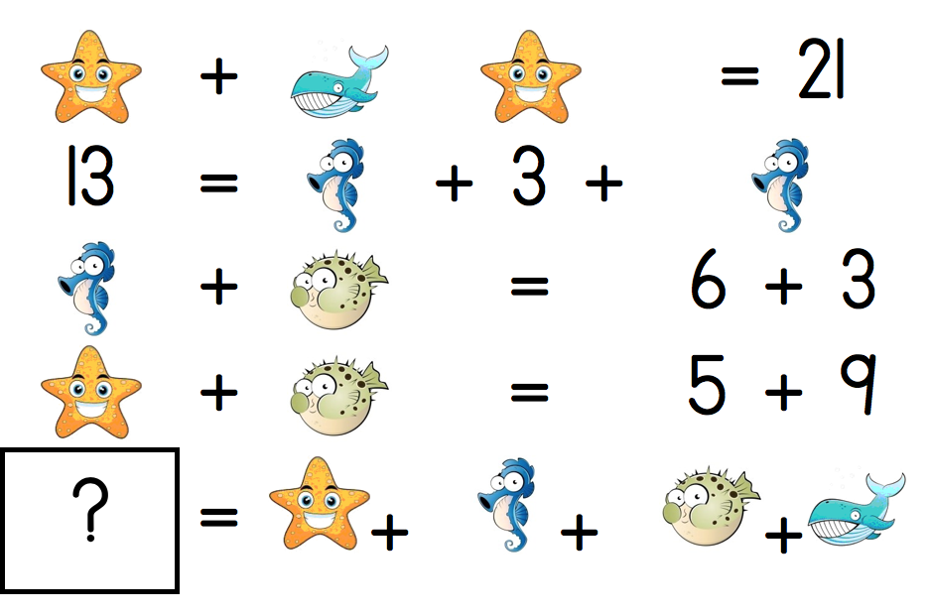
“Maths Challenges” Number Talk prompts

Slide 11
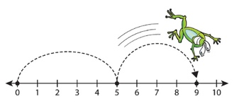
Linear representations of number
Regular use of a number line can help learners to form a mental number line
To help learners to calculate mentally
IMPORTANT
Start with:
→ STRUCTURED NUMBER LINES
(session 8)
→ Semi-structured number lines
(this session)
→ Empty number lines
(session 10)

Slide 12
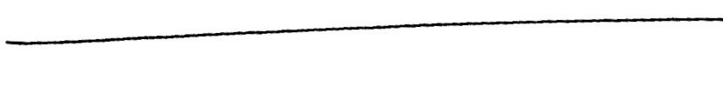
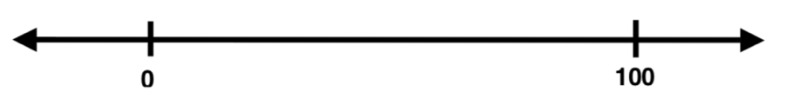
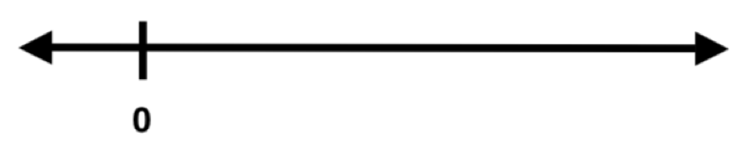
There are many types of number lines:
Empty
  No points/marks
Closed
  Beginning and end points
Open
  Beginning point /no end point or vice versa
Structured
  Defined partitions & labelled marks
Semi-structured
  Some partitions and /or labelled marks

Slide 13
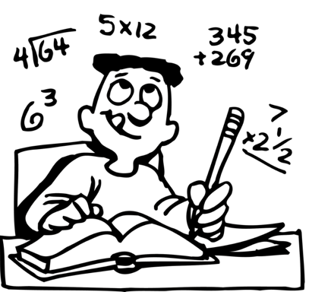
Different types of number lines require different kinds of thinking
Open line:
  partition (or subdivide) the space as necessary to solve a problem
  BUT
  One point on a number line does not tell us much about the numbers we are working with

Slide 14
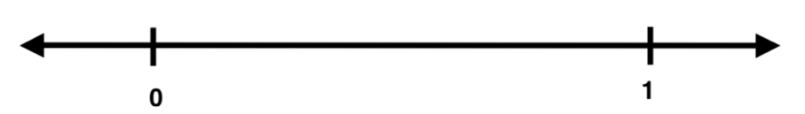
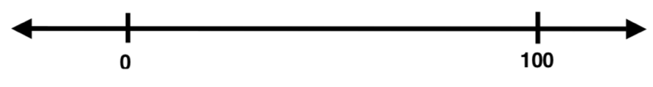
Thinking
If add another point: becomes a closed number line
Zero to 1
  Thinking to partition this line:
    Fractional thinking
    Halving strategies to find ½ or ¼
    To find thirds or fifths, need different thinking
Zero to 100
  Thinking to partition this line:
    10s, 20s or ½ of 100 (50)
    Doubling and halving strategies

Slide 15
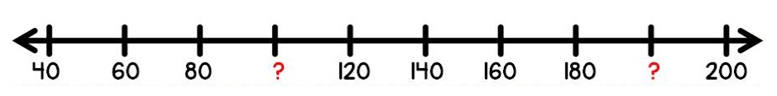
Thinking
use other numbers provided to work out the missing numbers
  Use the pattern from the other numbers to find the missing numbers.
  i.e. the pattern is counting up from 40 to 200 in twenties.

Slide 16
Why work with semi-structured number lines?
Before you work with the semi-structured number line
  Do a lot of work with the structured number line.
  Learners should be comfortable with working with these before doing any semi-structured number line work
Why work with semi-structured number lines?
  Develop good number sense
  Visualise a mental number line in their heads
  Use and develop strategies such as:
    doubling and halving
    estimation
    patterns
    friendly numbers (i.e. tens and hundreds)
  Locate whole or parts of numbers in relation to other numbers
  Order numbers
  Provide support for working with empty number lines

Slide 17
Clothes Line Maths
Life-sized number line in your classroom
Learners interact directly with the number line
Learners manipulate the numbers and their position on the line
It can be adjusted to work with different number ranges
It can encourage discussion
Preparing a “Clothes line”
Find a place in your classroom where you can hang a thin rope (or piece of string) across the room so it is at the learners' eye level.
Prepare tent cards (see below) to hang on the number line.

Slide 18
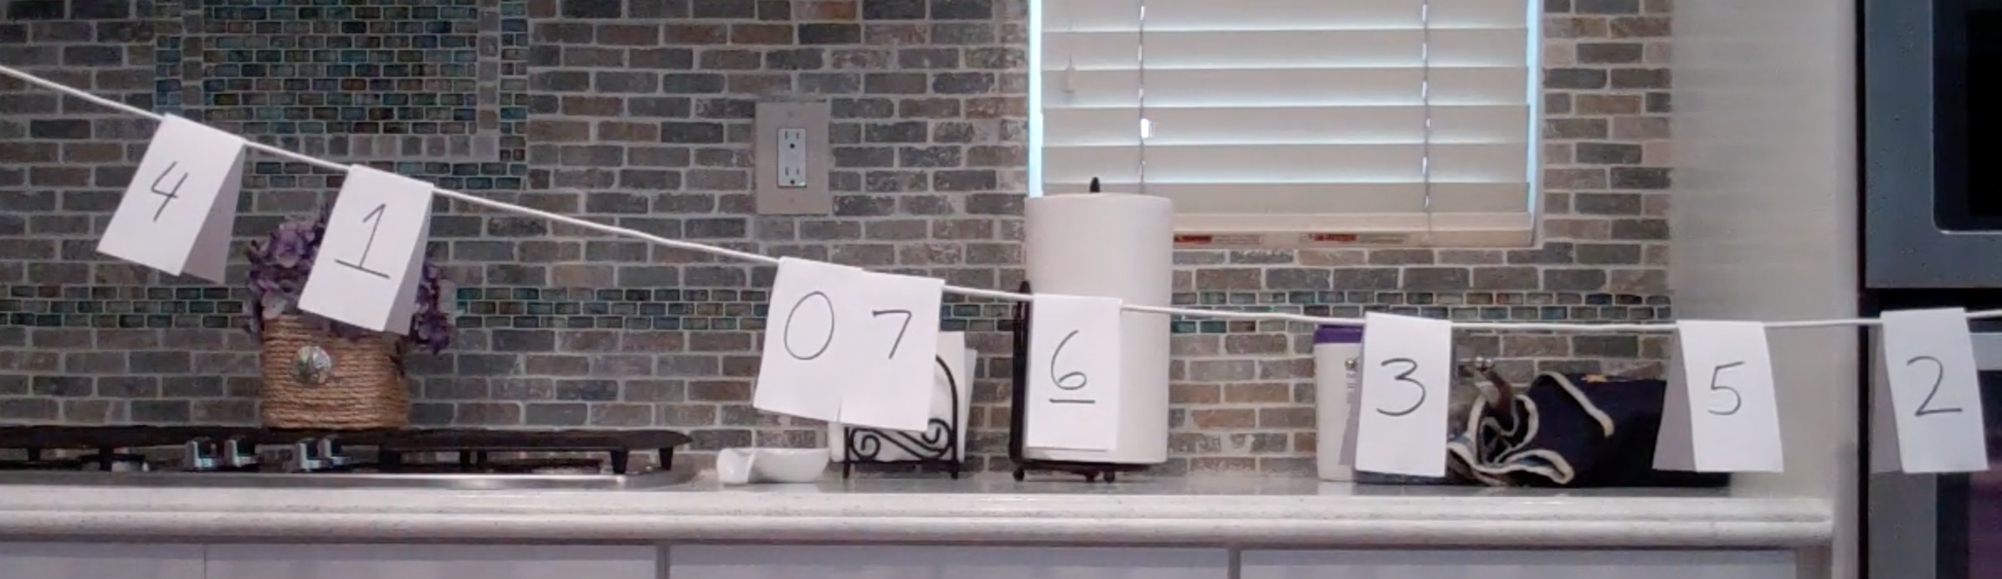
Video
http://mr-stadel.blogspot.com/2015/08/clothesline.html
Or
https://vimeo.com/137037579

Slide 19
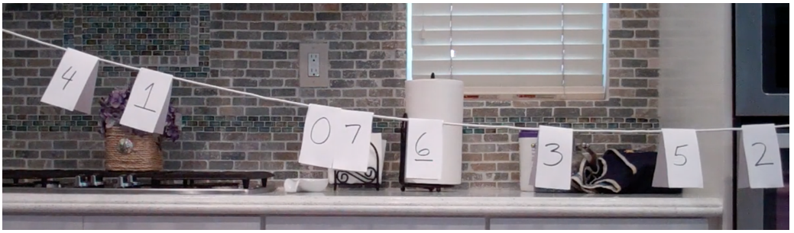

Number Line Activities
Zero to Ten
  Pages 16 & 17
Move the numbers so they make sense
  Page 18

Slide 20
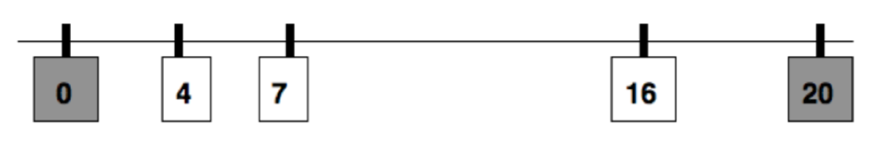
Number Line Activities
Where would these numbers go?
  Page 19
Next to, Far Away
  Pages 20 & 21

Slide 21
Number Line Activities
Finding the Middle
  Pages 22 & 23
Doubling
  Pages 24 & 25

Slide 22
Number Line Activities
What’s on the card
  Pages 26 & 27
What number am I?
  Page 28

Slide 23
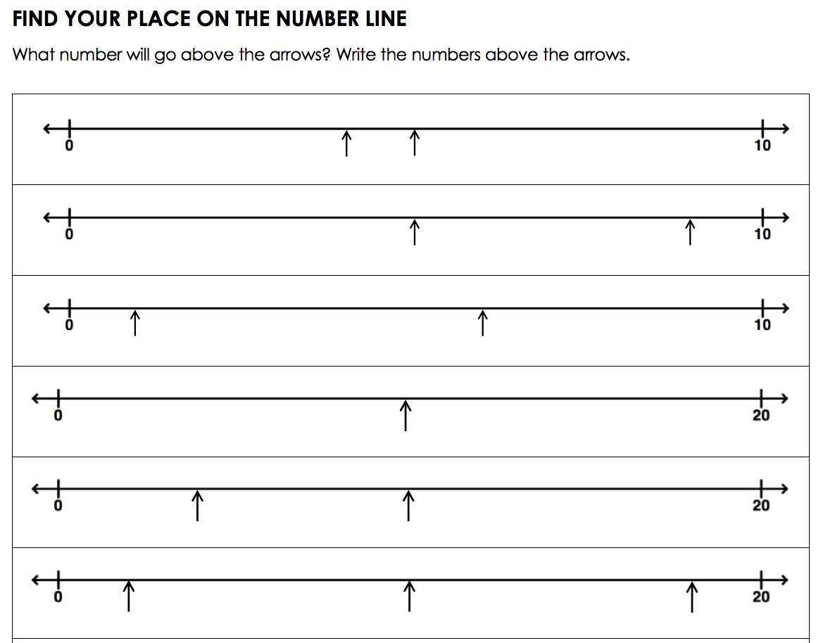
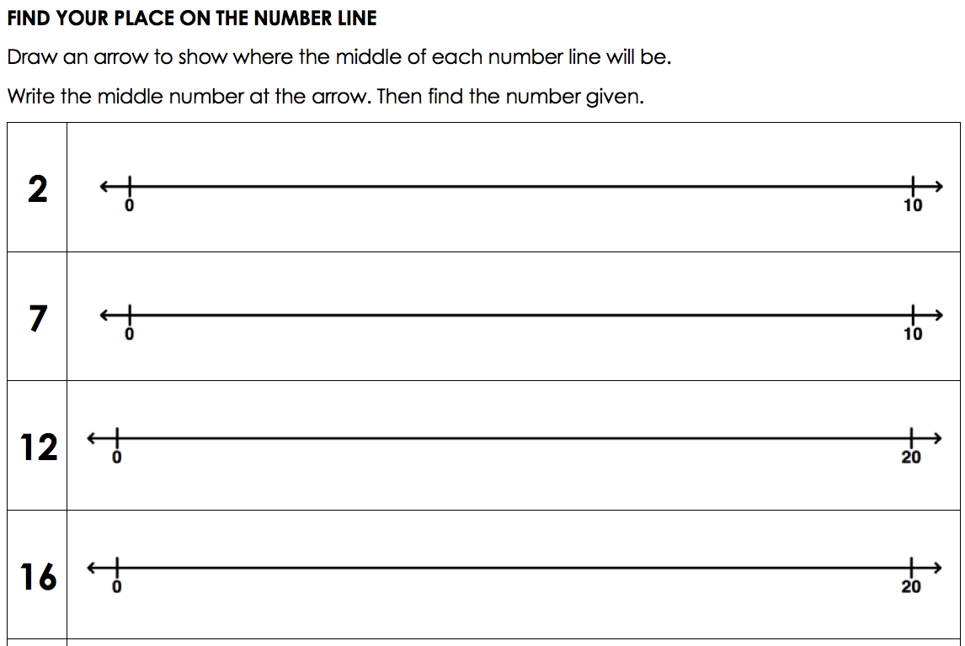
Number Line
Worksheets

