Slide 1
Work out the answers to these on your own …
Do it mentally if you can
Then jot down how you worked it out …
Double 76
35 + 36
Halve 56
Subtract 100 from 634
2016 – 1999
10 x 13
51 – 25
120 x 15
1 + 2 + 3 + 4 + 5 + 6 + 7 + 8 + 9 + 10
16 x 12
Add 10 to 92
99 + 99 + 98

Slide 2
What is a spectrum?
Used to classify something, in terms of its position on a scale between two extreme or opposite points
Neither agree
Or disagree
Totally disagree
Slightly disagree
Slightly agree
Totally agree

Slide 3
A need for progression
Current assessments
  do not provide any diagnostic information about where our learners are at
  Simply tell us that our learners are not at the expected grade level.
Be able to assess the extent to which a learner may or may not have mastered a particular aspect of mathematics at different points in time / understand if a particular strand or interrelationship of strands is evident
Much research points to the need for coherence and progression in the teaching of mathematics
Early intervention “can be problematic” for teachers if they do not know what the learner is struggling with.
A need for tasks and assessments that allow teachers to understand exactly what level their learners are at, so that they can identify resources and tasks that will help to progress learners to where they should be.
Teachers are unlikely to identify useful resources or generate resources with carefully inlaid progression if they do not have an understanding of how learners progress through school mathematics from Grade R to Grade 7

Slide 4
Why a spectrum?
Kilpatrick et al (2001) - conceptualisation of mathematical proficiency
In our project - need to be able to assess different levels of proficiency in different strands at different points in time so that we can assess learner numeracy progression over time:
  the fully embodied idealised version of a strand needs to be unpacked so that various levels of attainment might be identifiable.
To consider that a student might be either procedurally fluent or not procedurally fluent is less useful:
  Rather gauge the extent to which they are mastering the fluency and to find ways to move them along the spectrum from what might be a restricted form of procedural fluency towards fully elaborated procedural fluency.

Slide 5
Emergence of the spectrum from data
How can we code and record, in summary form, responses that were noted on learner interview forms?
For a question the final answer given might be the same over time but the method of solution and efficiency of solution is different.
Each question, could be categorised as a question engaging procedural fluency.
If the learner answered the question correctly, regardless of the method they used to answer it, we were tempted to say they had achieved procedural fluency.
Yet, the method they used may have contradicted the notions of efficiency and fluency, even while accuracy had been achieved.
= problematic!

Slide 6
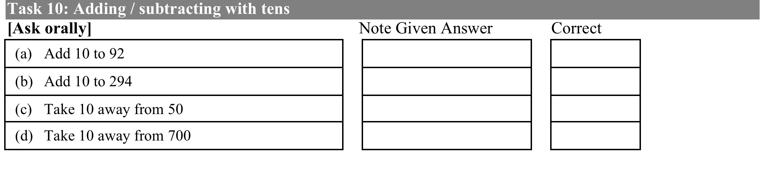
1st example: question 10 add 10 to 92

Slide 7

Add 10 to 92
The cards labelled A to G show the types of answers we have received from learners for this question
In your groups:
  Look at the methods used and discuss
  Place the methods along this spectrum
  Where do the methods in your group fit?
Concrete
Constrained
Somewhere
in between
Flexible
Fluent

Slide 8
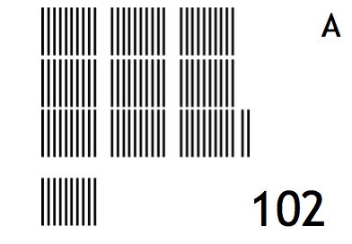
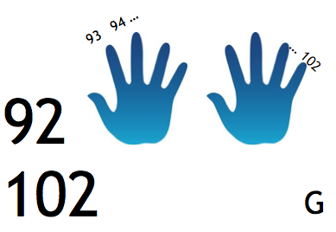
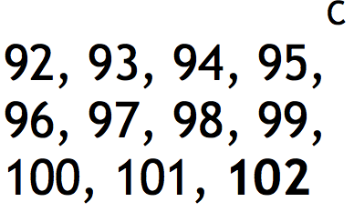
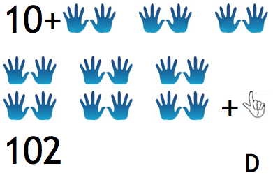
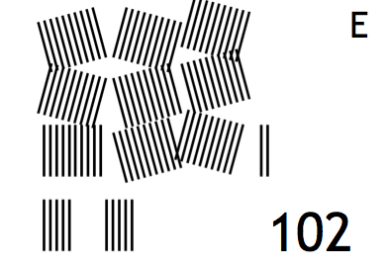
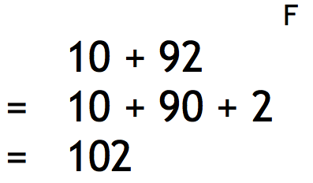
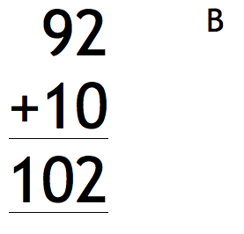
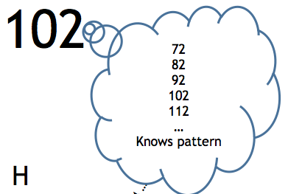
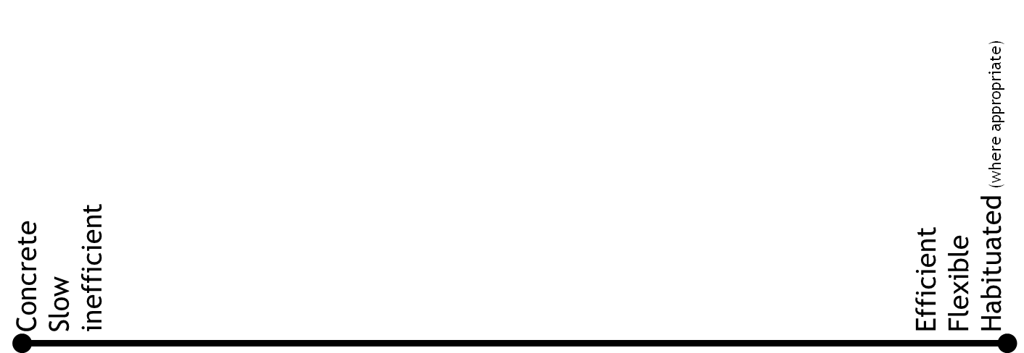
  Add 10 to 92
  These cards show the types of answers we have received from learners
  Where would you put these along this spectrum?

Slide 9
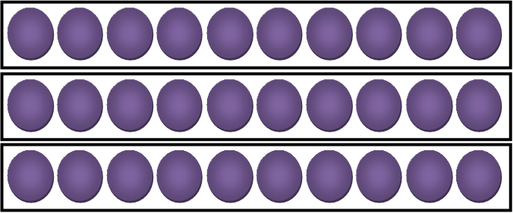

2nd example: Incrementing tens

Slide 10
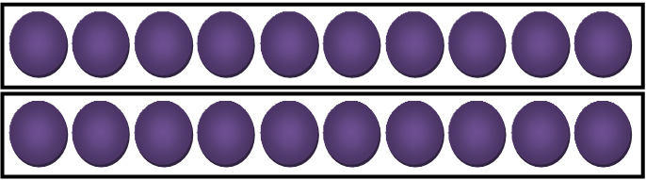

2nd example: incrementing tens
How many
can you see?

Slide 11
Less efficient:
count the dots each time a new strip is added including the 4 dot strip
Slightly more efficient:
count the first 10 strip in ones or twos and then count by touching each strip (in tens) as they are laid down
Slightly more efficient:
count the first 10 strip in ones or twos and then mentally add 10 each time a strip is laid down.
More efficient method:
mentally count the dots on 4 and the 10 strip and then count on in groups of 10 e.g. 44 + 30 is 74 (knowing 40 and 30 is 70)
SPECTRUM FOR incrementing 10s
Concrete
Constrained
Flexible
Fluent

Slide 12
Moving from progression in tasks to progression in operations

Slide 13
What does curriculum say:
Numeracy Handbook for Foundation Phase teachers (Grades R-3) says that number sense develops as follows:
  Level 1: Counting all
  Level 2: Counting on
  Level 3: Breaking down and building up numbers (2012, p. 22)
So how is a spectrum different?
  Some notable differences are that it is:
    VISUAL
    More detailed in thinking about level 3…
    By operation (addition/subtraction; multipliction/division)
Let’s have a look...

Slide 14
Operations progression
Becomes more of a learning trajectory
Addition and subtraction spectrum / learning trajectory
1
Constrained methods
2
Less constrained methods
3
Semi fluent methods
4
Flexible, fluent methods
Use of fingers, tally marks, circles, drawings of any kind
Count all
Breaking down into place value (‘splitting’), using some kind of expanded notation
Count on / Count up to / Count down
Other strategies (see below), working with a friendly number
Doubles/halves
Combining with 5 & 10
Partitions of 5 & 10
Strategies using known addition and subtraction facts, knowing when appropriate to use algorithms for 2 and 3 digit problems
Multiplication and division spectrum / learning trajectory
1
Constrained methods
2
Less constrained methods
3
Semi fluent methods
4
Flexible, fluent methods
Use of fingers, tally marks, circles, drawings of any kind
Skip counting, repeated addition
Arrays, grid method, breaking down into expanded notation (‘splitting’)
Strategies using known multiplication and division facts, knowing when appropriate to use algorithms for 2 and 3 digit problems

Slide 15
Multiplication methods for progression analysis – PART ONE
Using the Multiplication spectrum, look at each of the problems on your handouts
Do not worry about correct / incorrect answers.
Look at the methods used and decide where you would place them along the spectrum
Tick / circle the appropriate number as shown in the first example

Slide 16
Multiplication methods for progression analysis – PART TWO
Using the analysis you did in Part One…
Use the letters in the tables
summarise which methods fall under which parts of the spectrum.
For example:
  I marked method A as a level 1 (constrained method), therefore I have added it under the constrained methods part of the spectrum

Slide 17
For example:
I marked method A as a level 1 (constrained method)
Therefore I have added it under the constrained methods part of the spectrum

Slide 18
Spectrums in your practice
Informal / formative assessment to inform your teaching
Encourage you to assess your own learners work in terms of a spectrums
Error analysis
Classroom, cluster, district, province
Encourage you to design your own spectrums
Think about what the learning trajectory might be for fractions

