Slide 1


SCHOOL OF LANGUAGES AND LITERATURES:
African Language Studies Section
ORIENTATION LECTURE
Wednesday, 16 February 2022

Slide 2
Introduction
Why study isiXhosa at University?
African Language Studies Section (Objectives and Careers)
Courses on offer: Non-Mother Tongue
Courses on offer: Mother Tongue
Vocation Specific Courses

Slide 3
School of Languages and Literature (SoL)
SoL comprises of the following Sections:
Afrikaans and Netherlandic Studies
African Language Studies
Chinese Studies
Classical Studies
French Studies
German Studies
Modern Fiction Studies

Slide 4
Why study isiXhosa at University?
Mandela’s famous quote “If you talk to a man in a language he understands, that goes to his head. If you talk to him in his language, that goes to his heart”
South African Constitution encourages the development and use of African languages (Constitution of the RSA, 1996)
Eastern Cape has approximately 83% of its total population as speakers of
isiXhosa (Stats SA, 2003) and other dominant languages are English and Afrikaans.
Rhodes University student population of 7179
  64% indicated English as their home language
  15% have isiXhosa as home language
  2% have Afrikaans as home language
  Others (19%) (Data Management Unit, RU, 2007)
Rhodes University language Policy recognises and advances academic viability and status of isiXhosa, English and Afrikaans – the 3 official languages of the Eastern Cape Province.

Slide 5
African Language Studies Section
Objectives:
To promote and advance scholarship in African languages
To promote multilingualism through 1st and 2nd language programmes, and
To facilitate student access and retention, particularly of historically disadvantaged students.
What careers can one follow after studying African Language Studies at Rhodes?
Journalism (radio, television, newspapers, etc)
Public relations officer
Educator
Advertising
Speech technologist
Translator
Interpreter
Author
Language technologist
Government (and other companies) policy formulator
Editor (in newspaper, magazine, publishing company, etc)

Slide 6
Courses on Offer: IsiXhosa Language Acquisition
This is a three-year major subject which may be studied for degree curricula in the Faculty of Humanities.
IsiXhosa Language Acquisition 1
  A full year course
  No prior knowledge required
  Matriculated with isiXhosa as a 2nd or 3rd language (may be permitted to 2NMT)
  The emphasis is on practical proficiency in speaking and reading/writing
IsiXhosa Language Acquisition 2 & 3
  Introduction to the grammatical system of Xhosa.
  Introduction to the sociolinguistics of the Xhosa language.
  Introduction to language planning with special reference to Africa.
  Introduction to the various types of literature and study of selected Xhosa literary works. Abridged versions of Xhosa novels are used for better understanding of the Xhosa culture and use of language.
  In case of 3 NMT there are also research projects

Slide 7
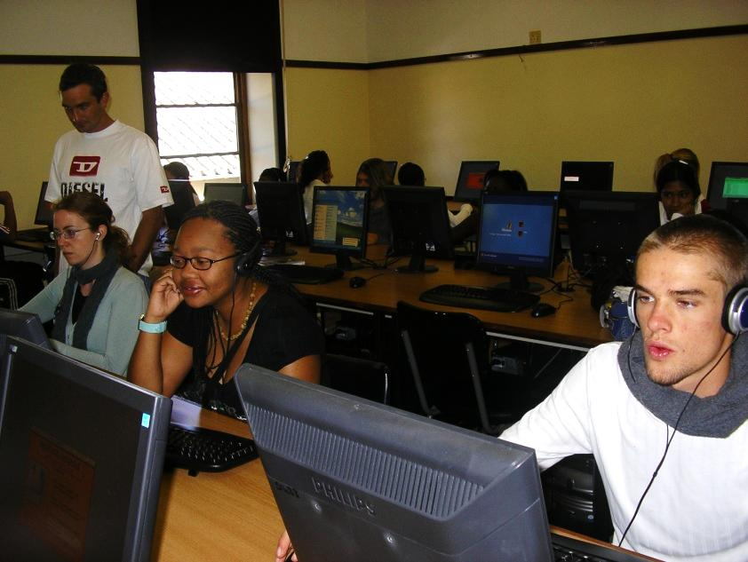

IsiXhosa L2 class in the Multimedia Facility

Slide 8
Courses on Offer: African Language Studies
The first year course is an introduction to isiXhosa as a language and the second year deals with the theoretical background of the language and isiXhosa 3 deals with the practical aspect in the form of projects.
African Language Studies offers innovative and discipline related courses such:
Translation,
Language and technology,
Literature,
Language in context,
Lexicography
IsiNguni Language Comparative Studies,
Language and media as well as
Language and society.

Slide 9
Entry requirements
L2 courses – none
L1 courses – Mother tongue speaker of isiXhosa or any of the Nguni languages (isiSwati, isiZulu and isiNdebele) otherwise at the discretion of the Section Head
If you are still not sure, speak with Mama Nosilela, the Head of Section

Slide 10
Vocation Specific Courses
These courses provide students with knowledge and skills that they would use immediately in practical training, and as practitioners in the specific areas.
The list of Vocation Specific Courses offered in the Section is as follows:
IsiXhosa for Pharmacy,
IsiXhosa for Journalism,
Staff course
Community engagement communication course

Slide 11
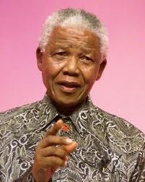
Umbulelo
Siyabulela, nangamso.
Dankie
Thank you
If you talk to a man in a language he understands, that goes to his head. If you talk to him in his language, that goes to his heart.

Slide 12
Any QUESTIONS???
------------------

